Slide 1
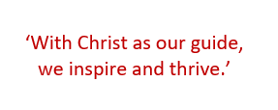
Year 2 Parent Information Meeting 2026

Slide 2
WELCOME TO THE YEAR 2 PARENT SESSION
You will find out about:
Staffing
Expectations and behaviour
General reminders
Key dates
The curriculum
How you can help at home

Slide 3
THE YEAR 2 TEAM
Teachers:
Mrs Johnson: Monday, Tuesday, Thursday and Friday
Miss Rudman: Wednesday
Teaching Assistants:
Miss Harvey
Mrs Julien will also teach Y2 on Thursday afternoon.
Mr Barlow will teach sport to Y2 on Monday afternoon.

Slide 4

EXPECTATIONS
Ready
Respectful
Safe
Notes:
Children should be ensuring that they are READY to learn. LOOKING at the adult speaking. EQUIPMENT ready.
We should all be RESPECTFUL to one another. Adults show children RESPECT and children must show adults the same RESPECT.
When someone is speaking, we show them RESPECT by giving them eye contact and LOOKING at them.
We show RESPECT by remaining on task and allowing those around us to learn.
We show RESPECT by trying our BEST and producing work we are proud of.
We show RESPECT by taking RESPONSIBILITY for our own learning.
The school and classroom should be a SAFE environment.
We use TOOLS and EQUIPMENT safely, following rules such as how to hold scissors to keep us safe.
We WALK around the school building to ensure we do not slip or fall to keep us SAFE.
We use KIND HANDS and FEET at all times to make sure those around us our safe.
We use kind words to others to make sure that those around us feel EMOTIONALLY SAFE.

Slide 5

EXPECTATIONS
Work
Stay focused and let others learn.
Take pride in your work.
Always try your best and keep going, even when it’s tricky.
Attitude to Learning
Be an active and curious learner.
Respect others so everyone can learn.
Take responsibility for your own learning.

Slide 6

RECOGNITION BOARD
Children are recognised and rewarded for making positive choices by moving their star (with their name on it) onto the Recognition Board.
We will also continue to use the school’s reward system through Class Dojo.

Slide 7


Slide 8
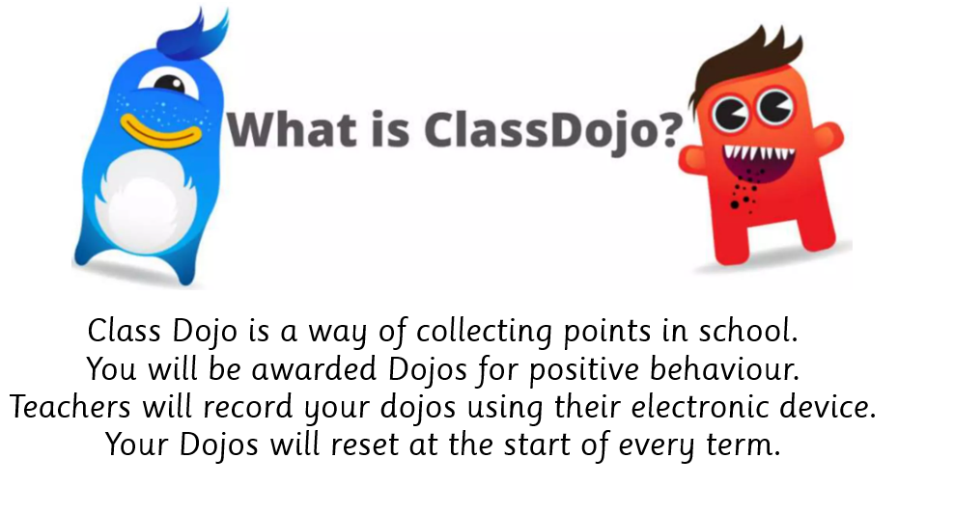
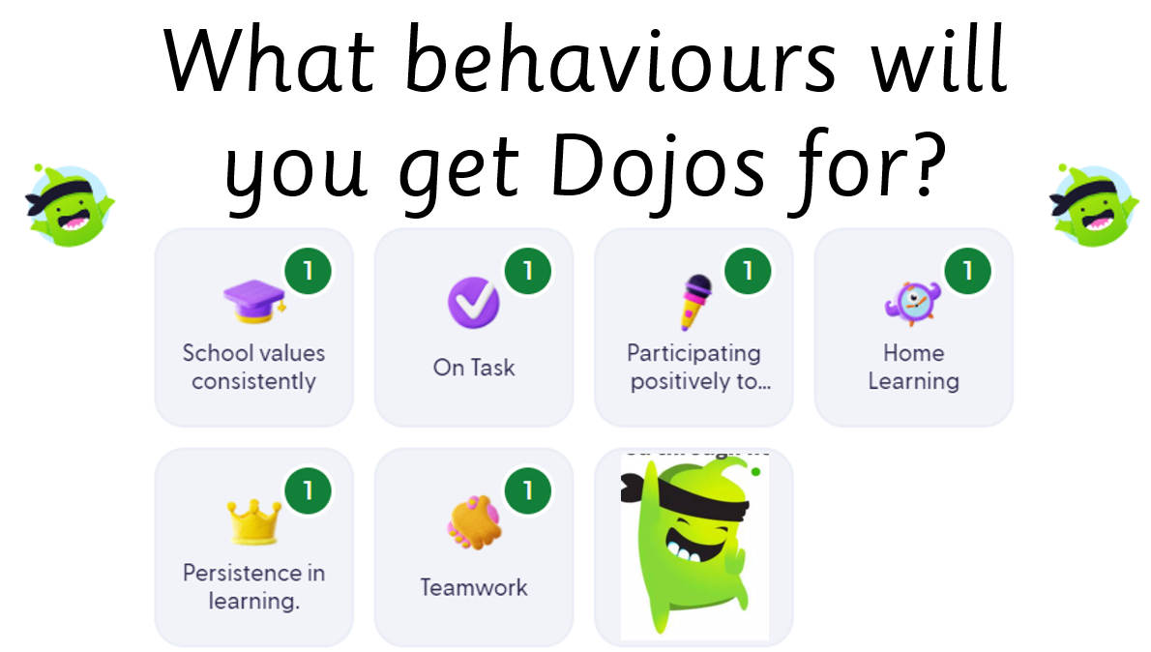

CLASS DOJO

Slide 9
REMINDERS
Water Bottle
Please ensure your child brings a water bottle to school every day.
Book Change
Books are changed on Monday, but we ask that children bring their reading books and records to school daily, so we can listen to them read.
Home Reading
We encourage children to read at home every day. It is a school requirement that reading records show at least three adult signatures each week. If a child does not complete regular home reading, a reading alert will be issued.
Notes:
Reading at home makes such a difference, even if only 5 minutes a day.
Even in the car if you get somewhere early, on the way to football etc.
Children are expected to build their reading stamina significantly in Year 2. They can only achieve this if thy are reading regularly at home!
(Later on Accelerated Reader - ZPD explained and quizzes in class.

Slide 10
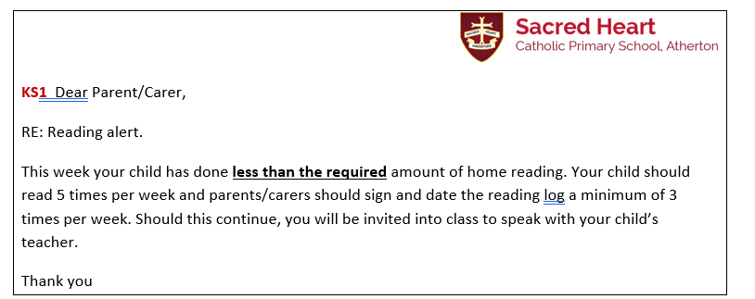
READING ALERTS

Slide 11
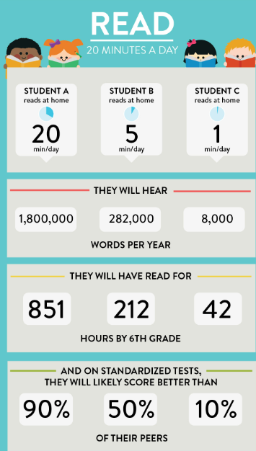

THE IMPORTANCE OF READING

Slide 12



Slide 13
READING
In Year 2, the children will be using the sounds and words that they have learned in Reception and Year 1 to read longer and unfamiliar words.
The children will be expected to read more fluently and rely less on sounding out words.
Children will also be beginning to read with expression.

Slide 14
READING IN CLASS
Children will be expected to develop their inference skills which means being able to ‘read between the lines’ / find clues in the text.
Children will have a lot of comprehension practise to help them to develop comprehension skills.
As the year progresses, children will be expected to become more independent with their reading and start to choose their own books, some of which will be longer.
Some of the children may move onto our Accelerated Reader Scheme where they will choose their own books and then sit a short comprehension quiz online at the end of the book.

Slide 15

READING COMPREHENSION - QUESTIONS TO ASK AT HOME

Slide 16
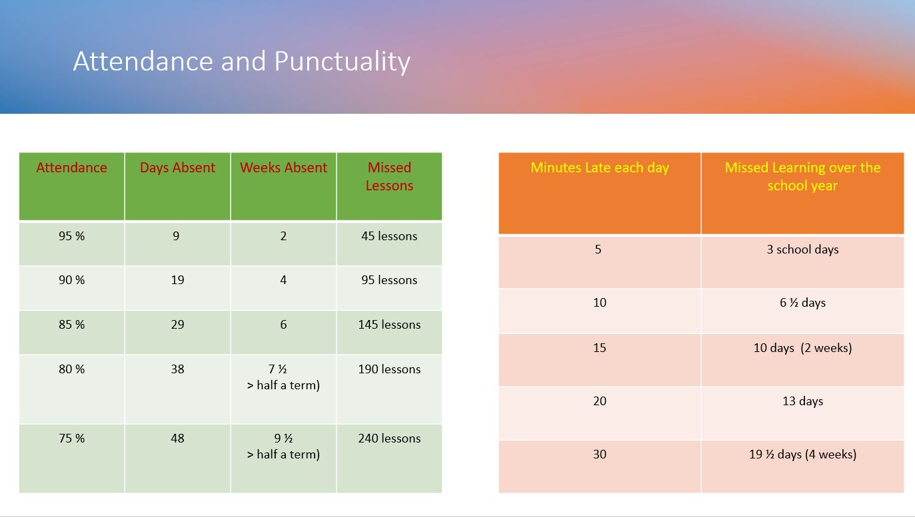
ATTENDANCE AND PUNCTUALITY

Slide 17
COMMUNICATION PLAN
Key points:
5 working days to reply – we try to respond sooner but can’t always guarantee it depending on what is already scheduled that week.
Not all staff work every day.
We kindly ask that parents arrange meetings with staff in advance rather than arriving at school without notice. As our school grounds are private, unplanned visits may not be possible, and staff are often engaged with teaching or other scheduled responsibilities. To ensure we can give you the time and attention you deserve, please contact the school office to arrange a suitable appointment.
This is because - Staff have pre-planned work to complete or undertake or might not be in or in a position to support you at that time.
When communicating with school, include key facts and try and avoid emotive language this helps us to be more effective and efficient in feedback and any investigations.
Facebook is not a part of our communication plan – it is a window into school life. All questions, queries must be directed to the office. Inappropriate comments will be deleted, and comments may be turn off for that post or class posts moving forward.

Slide 18
SPORTS
Monday afternoon
Children need to come to school dressed in their sports uniform.

Slide 19
HOME LEARNING
This will be set on Google Classroom on a Monday and children are given a week to complete this work. It is important that children complete this work as it supports the learning from class.
One Maths and one English home learning task is set weekly. This may be paper based or set on IXL. Even if it is paper-based, please click ‘hand-in’ on Google Classroom to notify me that the work has been completed.
During a half term, the children may be set an RE piece of work.

Slide 20
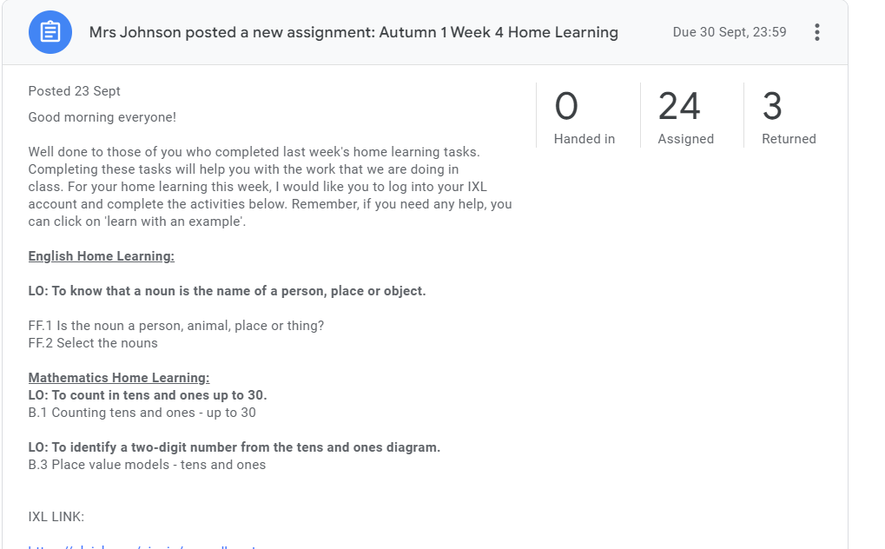
WHAT GOOGLE CLASSROOM LOOKS LIKE

Slide 21
KEY DATES
Friday 2nd October. Year 2 Collective Worship (9.05am) Anti-Bullying Assembly
Monday 14th December 2.30pm – EYFS and KS1 Christmas Nativity Performance.
Tuesday 15th December 9.30am– EYFS and KS1 Christmas Nativity Performance.

Slide 22
ASSESSMENTS
Y1 Phonics Screening Test
If your child did not pass the Statutory Y1 Phonics Screening test this year, they will resit this in June.
Y2 Optional SAT assessments
In June, all of the children complete end of year assessments. At Sacred Heart, we have opted to use the optional Year 2 SAT assessments. The outcome is used to inform the final teacher judgement.

Slide 23
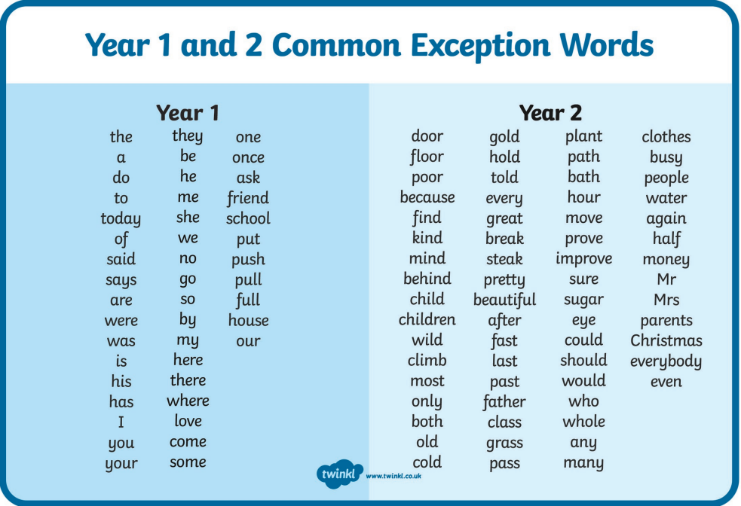

Slide 24
THANK YOU VERY MUCH FOR COMING.
ANY QUESTIONS?

