Slide 1

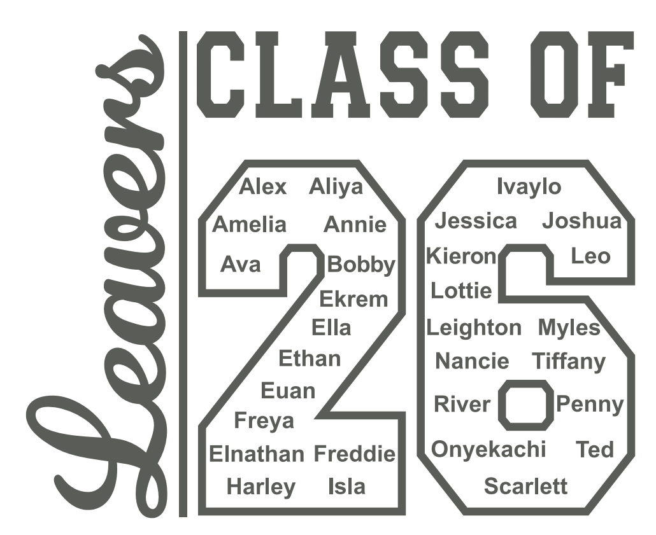

Year 6 Parent Meeting

Slide 2
Welcome
1.102024
THE YEAR 6 TEAM
Mr Hough
Mr Sawyer
Mrs Julien

Slide 3
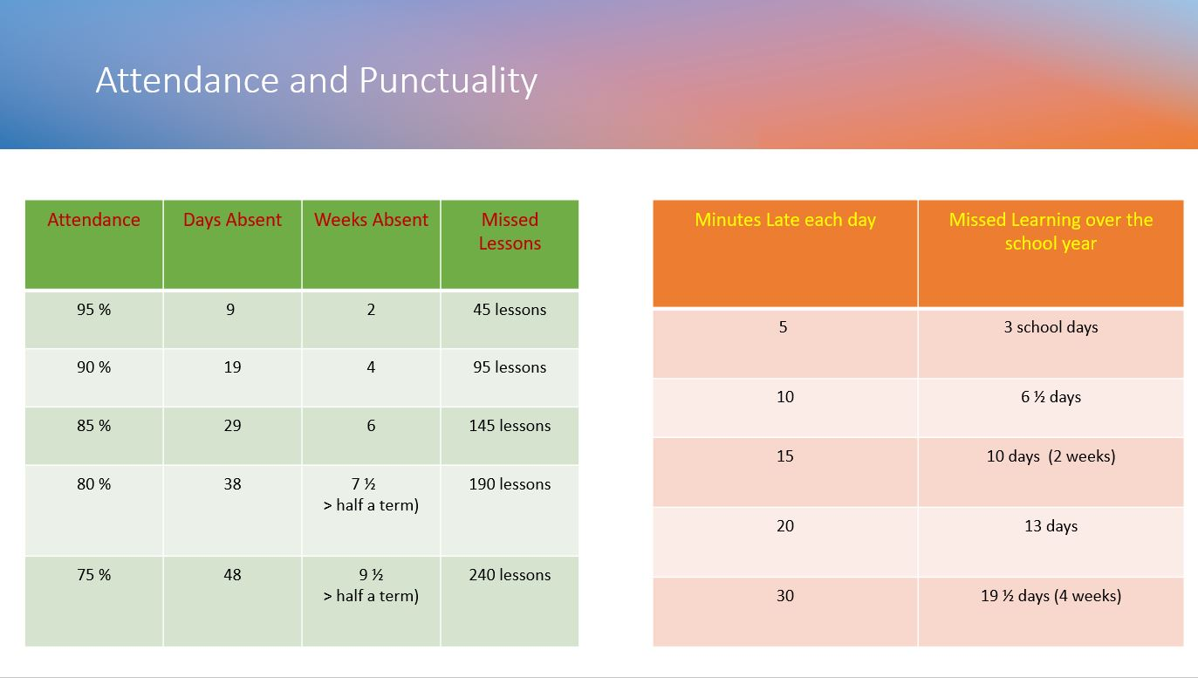

Attendance Matters

Slide 4
Communication Plan
Key points:
5 working days to reply – we try to respond sooner but can’t always guarantee it depending on what is already scheduled that week.
Not all staff work every day.
We kindly ask that parents arrange meetings with staff in advance rather than arriving at school without notice. As our school grounds are private, unplanned visits may not be possible, and staff are often engaged with teaching or other scheduled responsibilities. To ensure we can give you the time and attention you deserve, please contact the school office to arrange a suitable appointment.
This is because - Staff have pre-planned work to complete or undertake or might not be in or in a position to support you at that time.
When communicating with school, include key facts and try and avoid emotive language this helps us to be more effective and efficient in feedback and any investigations.
Facebook is not a part of our communication plan – it is a window into school life. All questions, queries must be directed to the office. Inappropriate comments will be deleted, and comments may be turn off for that post or class posts moving forward.
Welcome
1.102024

Slide 5

EXPECTATIONS:
During learning/ lessons:
Be ready to learn – have the right equipment and a positive attitude.
Join in – take part in discussions and activities.
Help yourself – if you’re stuck, look around at what might be around you (handouts/task boards/information on the screen etc.)
Use classroom strategies in place or ask an adult
Listen to others’ ideas – respect what classmates share.
Take care with presentation – write neatly and set work out carefully.
Challenge yourself – don’t just stop at the easy option.
Stay calm and keep trying – mistakes are part of learning.
Celebrate your effort – be proud of what you’ve achieved.
Use your time wisely – stay on task and finish work on time.

Slide 6
EXPECTATIONS:
Attitude to Learning:
Show resilience – keep trying, even when learning feels difficult.
Be open to feedback – listen carefully and use it to improve.
Stay curious – ask questions and seek deeper understanding.
Stay focused – avoid distractions and give your best effort.
Collaborate positively – contribute to group work and respect others’ ideas.
Show initiative – look for ways to extend your learning beyond the minimum.
Reflect regularly – think about what you’ve learned and how you can improve.

Slide 7

The 2026 SATs for Key Stage 2 will take place from May 11 to May 14, 2026, assessing Year 6 students in Maths, Reading, and Grammar, Punctuation, and Spelling (GaPS).

Slide 8
REMINDERS
Water Bottle: please make sure that your child brings this to school each day.
Snack: if your child does not have toast, please make sure to send a suitable snack for break times.

Slide 9




Home Learning
With Christ as our guide, we inspire and thrive

Slide 10
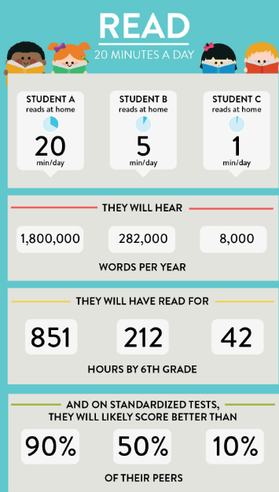


Slide 11



Slide 12


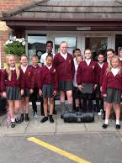
School Starts @ 8:45-9:00AM
(Rolling Register)
Physical Education – Wednesdays
Home Learning –Thursday (to be handed in following Thursday)
Full school uniform

Slide 13





Ready
Respectful
Safe
CAN'T STOP THE FEELING! (from DreamWorks Animation's "TROLLS") (Official Video) (youtube.com)

Slide 14

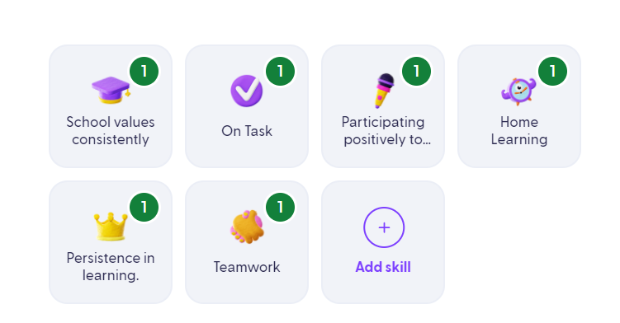


What behaviours will children get Dojos for?

Slide 15
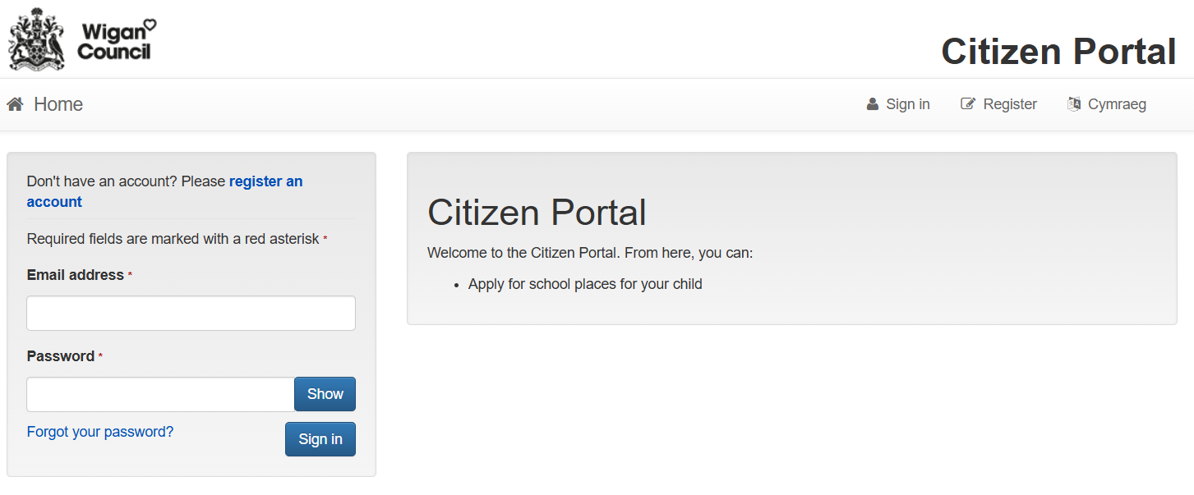
High School Application…
The closing date for applications is 31st October 2025.

Slide 16

Leavers…
Icon Embroidery Ltd
Unit 5, The Gables, Stour Road, Astley, Manchester, M29 7PX
01942 375253
07866529152

