Slide 1

Year 5 Welcome Meeting

Slide 2
Welcome
1.102024
THE YEAR 5 TEAM
Mrs Woodward
Miss Harvey
Miss Hart

Slide 3
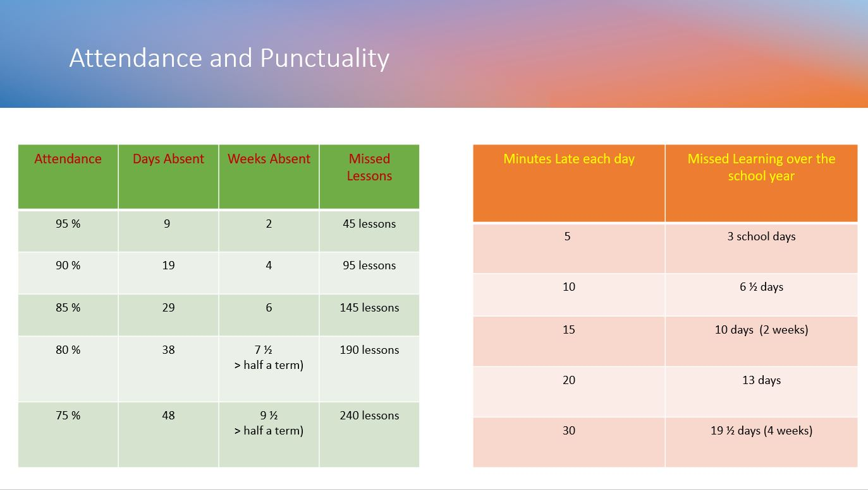

Slide 4
Communication Plan
Key points:
5 working days to reply – we try to respond sooner but can’t always guarantee it depending on what is already scheduled that week.
Not all staff work every day.
We kindly ask that parents arrange meetings with staff in advance rather than arriving at school without notice. As our school grounds are private, unplanned visits may not be possible, and staff are often engaged with teaching or other scheduled responsibilities. To ensure we can give you the time and attention you deserve, please contact the school office to arrange a suitable appointment.
This is because - Staff have pre-planned work to complete or undertake or might not be in or in a position to support you at that time.
When communicating with school, include key facts and try and avoid emotive language this helps us to be more effective and efficient in feedback and any investigations.
Facebook is not a part of our communication plan – it is a window into school life. All questions, queries must be directed to the office. Inappropriate comments will be deleted, and comments may be turn off for that post or class posts moving forward.

Slide 5
CLASS EXPECTATIONS
Work:
Remain on task, allow others to learn.
Produce work you are proud of.
Try your best and to build resilience.
Attitude to Learning:
Be an active learner.
Allow others around you to learn.
Take responsibility for your own learning.

Slide 6
REMINDERS
Water Bottle: bring every day
Snack: if your child does not have toast, please make sure to send a healthy snack for break times
Reading book: Every day to be checked.

Slide 7




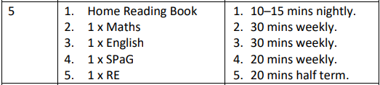
Home Learning
Set on Wednesdays for the following Wednesday
Combination of paper-based and online learning
Set via Google Classrooms
Follow the link on GC to our IXL page
Any issues please let us know

Slide 8

Access your local library:
https://www.wigan.gov.uk/Resident/Libraries/index.aspx

Slide 9



Slide 10


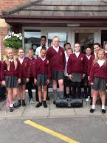
School Starts @ 8:45-9:00AM
(Rolling Register)
Physical Education – Friday
Home Learning –Wednesday (to be handed in following Wednesday)
Full school uniform

Slide 11





Ready Respectful Safe
CAN'T STOP THE FEELING! (from DreamWorks Animation's "TROLLS") (Official Video) (youtube.com)

Slide 12

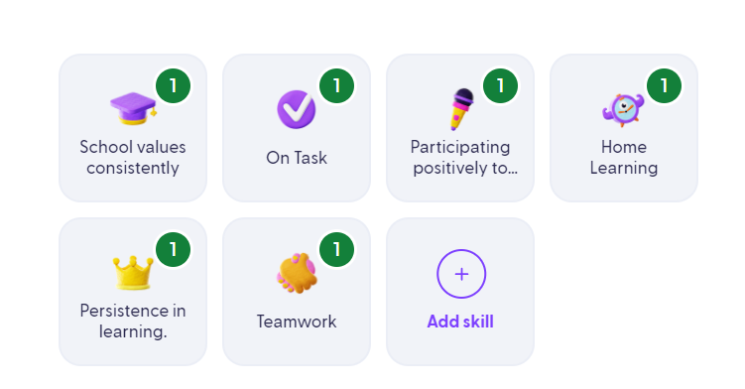


What behaviours will children get Dojos for?

