Slide 1
Year 3 Meet the Teacher

Slide 2
WELCOME TO YEAR 3’S Meet the Teacher
You will find out about:
Staffing
Reminders
Expectations
Behaviour
The curriculum
How you can help at home

Slide 3
THE YEAR 3 TEAM
Teachers:
Miss Williams
Mrs Jones: Tuesday
Mr Barlow: Tuesday PM
Teaching Assistants:
Mrs Lonsdale

Slide 4
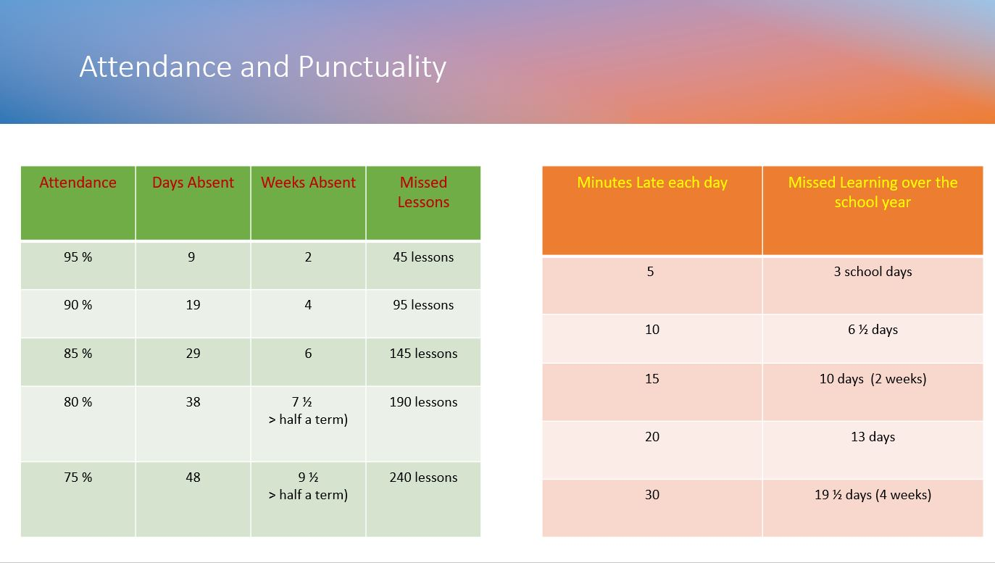

Slide 5
Communication Plan
Key points:
5 working days to reply – we try to respond sooner but can’t always guarantee it depending on what is already scheduled that week.
Not all staff work every day.
We kindly ask that parents arrange meetings with staff in advance rather than arriving at school without notice. As our school grounds are private, unplanned visits may not be possible, and staff are often engaged with teaching or other scheduled responsibilities. To ensure we can give you the time and attention you deserve, please contact the school office to arrange a suitable appointment.
This is because - Staff have pre-planned work to complete or undertake or might not be in or in a position to support you at that time.
When communicating with school, include key facts and try and avoid emotive language this helps us to be more effective and efficient in feedback and any investigations.
Facebook is not a part of our communication plan – it is a window into school life. All questions, queries must be directed to the office. Inappropriate comments will be deleted, and comments may be turn off for that post or class posts moving forward.

Slide 6
REMINDERS:
PE Day: Pe day is Tuesday. Children to come to school in full PE kit.
Water Bottle: please make sure that your child brings this to school each day.
Snack: if your child does not have toast, please make sure to send a suitable snack for break times.

Slide 7
REMINDERS:
Book Change will be on Tuesdays, Wednesdays and Thursdays but we ask for reading books and records to be brought to school every day so that we can listen to your child read.
Home Reading: we encourage children to read daily at home and it is a school requirement that children have at least 5 adult signatures each week in their reading records to indicate that they have read at home.

Slide 8



Slide 9
Home Learning: will be set on Google Classroom on a Tuesday for the following Tuesday so children are given a week to complete this work. It is important that children complete this work as it supports the learning from class.
One Maths and one English home learning task is set weekly.
In addition, children will have TTRockstars to practise times tables.

Slide 10
SCHOOL RULES
Ready
Respectful
Safe

Slide 11
EXPECTATIONS
Work:
Remain on task, allow others to learn.
Produce work you are proud of.
Try your best and to build resilience.
Attitude to Learning:
Be an active learner.
Allow others around you to learn.
Take responsibility for your own learning

Slide 12

BEHAVIOUR:
The class are given targets to be placed on the recognition board.
In addition, children can earn dojos for positive behaviours and going above and beyond.

Slide 13

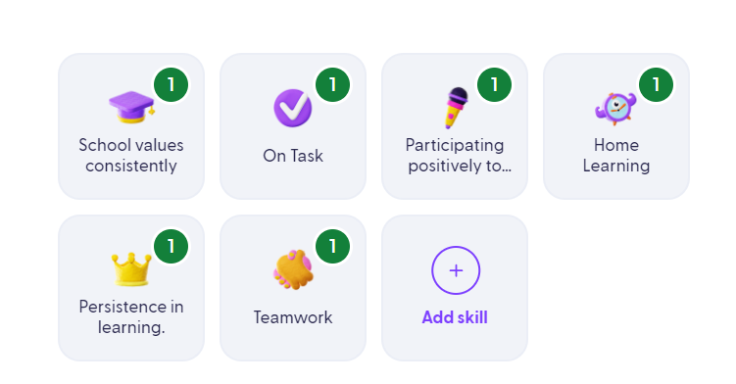

What behaviours earn Dojos?

Slide 14
THE CURRICULUM
What do we learn about in year 3?
In Year 3, the children are given the opportunity to access a rich and varied curriculum.
Each morning, children will complete a Maths, English, Guided Reading, Handwriting and Spelling lesson.
Throughout the week, the afternoons will involve, RE, Science, History or Geography, Computing, Art, Music, PSHE, Music and PE.

Slide 15
THE CURRICULUM
What do we learn about in year 3?
Science Topics:
Animals including Humans
Rocks and Fossils
Magnets
Light
Plants

Slide 16
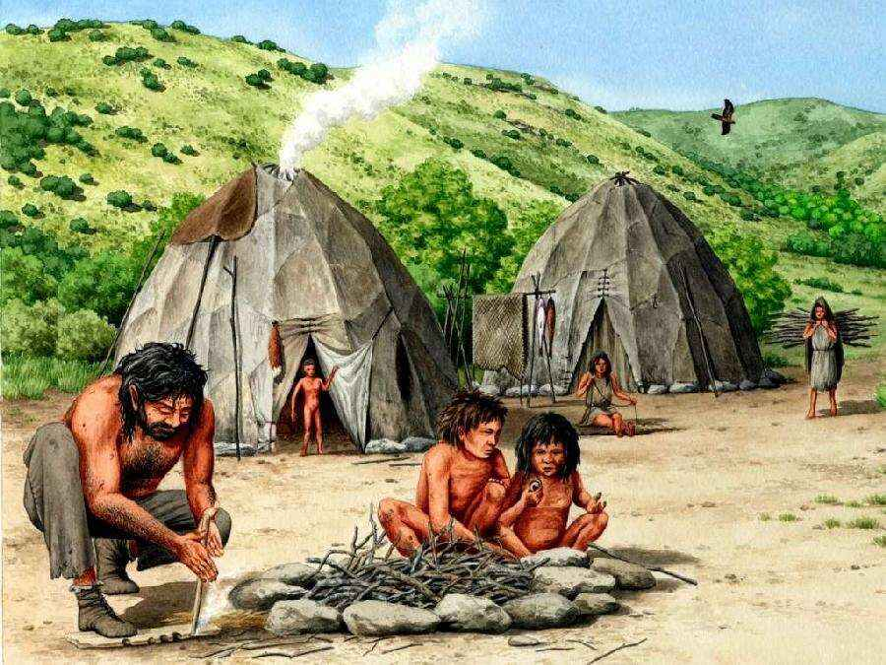
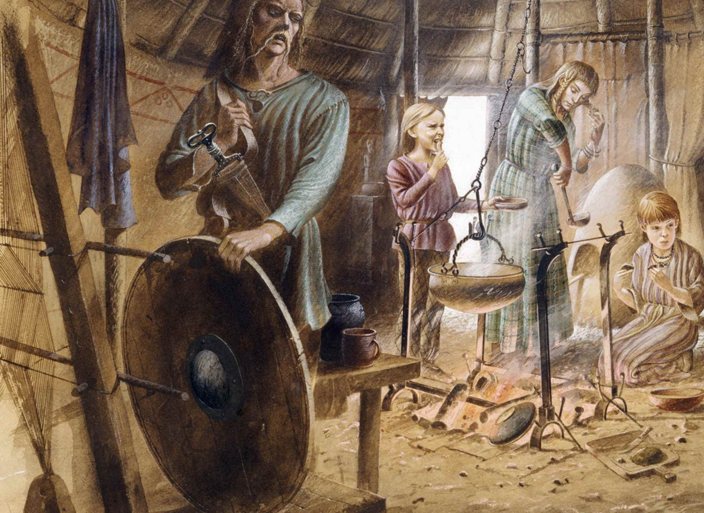

THE CURRICULUM
What do we learn about in year 3?
History Topics:
The Stone Age
The Iron Age
Ancient Egypt

Slide 17



THE CURRICULUM
What do we learn about in year 3?
Geography Topics:
Settlements and Land Use
Biomes and Climate
Volcanoes

Slide 18
HOW YOU CAN HELP?
Reading - Please read as often as you can with your child, preferably a little bit every day.
Maths- Please practice the 2-, 5- and 10-times tables with your child. They need to be able to recall and use multiplication and division facts for these tables.

Slide 19
USEFUL WEBSITES TO SUPPORT LEARNING:
www.ictgames.com
www.phonicsplay.co.uk
www.topmarks.co.uk
www.bbc.co.uk/education
www.nrich.maths.org
www.oxfordowl.co.uk

Slide 20
THANK YOU VERY MUCH FOR COMING.
ANY QUESTIONS?

