Slide 1

Year 1 Parent Meeting

Slide 2
Welcome
1.102024
THE YEAR 1 TEAM
Mrs Rogerson
Miss Melville
Miss Rudman - Class teacher on a Tuesday

Slide 3
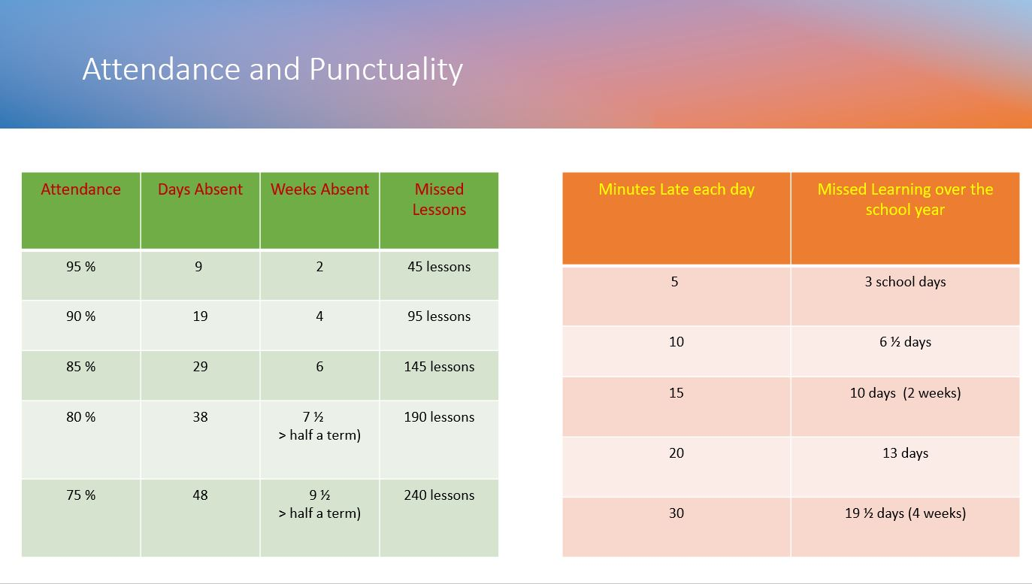

Attendance Matters

Slide 4
Communication Plan
Key points:
5 working days to reply – we try to respond sooner but can’t always guarantee it depending on what is already scheduled that week.
Not all staff work every day.
We kindly ask that parents arrange meetings with staff in advance rather than arriving at school without notice. As our school grounds are private, unplanned visits may not be possible, and staff are often engaged with teaching or other scheduled responsibilities. To ensure we can give you the time and attention you deserve, please contact the school office to arrange a suitable appointment.
This is because - Staff have pre-planned work to complete or undertake or might not be in or in a position to support you at that time.
When communicating with school, include key facts and try and avoid emotive language this helps us to be more effective and efficient in feedback and any investigations.
Facebook is not a part of our communication plan – it is a window into school life. All questions, queries must be directed to the office. Inappropriate comments will be deleted, and comments may be turn off for that post or class posts moving forward.
Welcome
1.102024

Slide 5
EXPECTATIONS
Work:
Remain on task, allow others to learn.
Produce work you are proud of.
Try your best and to build resilience.
Attitude to Learning:
Be an active learner.
Allow others around you to learn.
Take responsibility for your own learning

Slide 6


The 2026 Phonics Screening Check will take place from Monday 8th June to Friday 12th June, 2026.
Year 1’s assembly Friday 26th September 2025
EYFS and KS1’s Nativity:
Monday 15th December and Tuesday 16th December

Slide 7

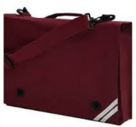
REMINDERS
Water Bottle: please make sure that your child brings this to school each day.
School bags: please make sure your children brings their school bag in every day and books will be changed on a Monday.
Snack: if your child does not have toast, please make sure to send a suitable snack for break times.

Slide 8




Home Learning
will be set on Tuesday and needs to be completed by the following Monday
With Christ as our guide, we inspire and thrive

Slide 9
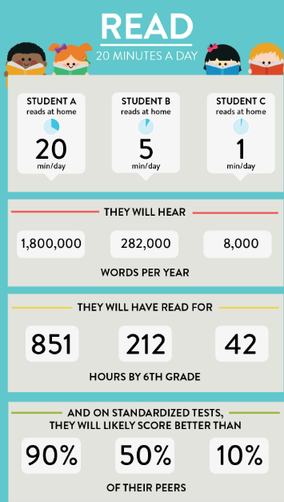


Slide 10




Slide 11


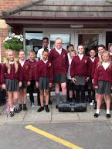
School Starts @ 8:45-9:00AM
(Rolling Register)
Physical Education (PE) – Wednesdays
Home Learning –Tuesday (to be handed in following Monday)
Full school uniform

Slide 12





Ready Respectful Safe
CAN'T STOP THE FEELING! (from DreamWorks Animation's "TROLLS") (Official Video) (youtube.com)

Slide 13
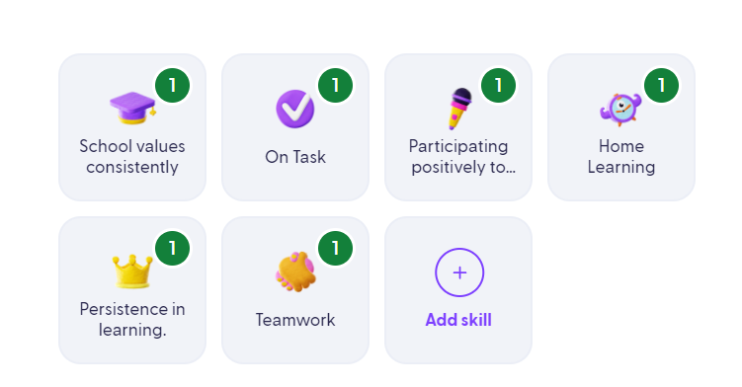


What behaviours will children get Dojos for?

