Slide 1

Welcome to Year 4
Parent Meeting

Slide 2

THE YEAR 4 TEAM
Miss Ellison (Class Teacher)
Mrs Wong (TA)
Mrs Jones (Cover)
SWIMMING STAFF
Mrs Wong
Mr Sawyer
Miss Hart
Welcome
1.102024

Slide 3
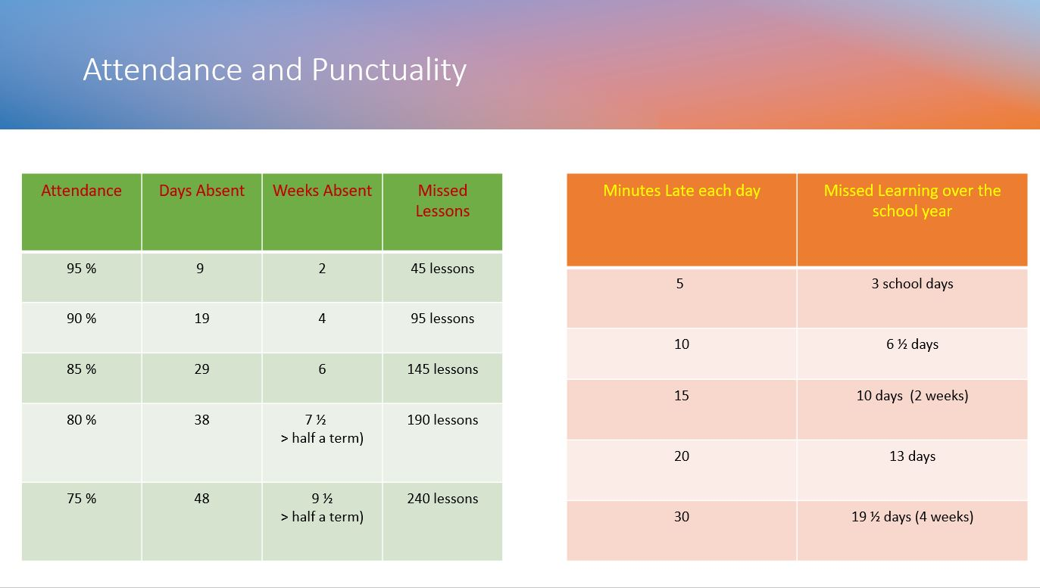
ATTENDANCE MATTERS

Slide 4
Communication Plan Key Points:
5 working days to reply – we try to respond sooner but can’t always guarantee it depending on what is already scheduled that week.
Not all staff work every day.
We kindly ask that parents arrange meetings with staff in advance rather than arriving at school without notice. As our school grounds are private, unplanned visits may not be possible, and staff are often engaged with teaching or other scheduled responsibilities. To ensure we can give you the time and attention you deserve, please contact the school office to arrange a suitable appointment.
This is because - Staff have pre-planned work to complete or undertake or might not be in or in a position to support you at that time.
When communicating with school, include key facts and try and avoid emotive language this helps us to be more effective and efficient in feedback and any investigations.
Facebook is not a part of our communication plan – it is a window into school life. All questions, queries must be directed to the office. Inappropriate comments will be deleted, and comments may be turn off for that post or class posts moving forward.
Welcome
1.102024

Slide 5
Swimming
Swimming will take place every Friday afternoon in place of PE .
What your child needs:
Swimming shorts/costume *no bikinis please
Towel
Goggles if needed
Hair needs to be tied back and no jewellery
Children can be collected from the Pelican centre. They will be dismissed from their from 3:10pm. We will set off back to school at 3:15pm.
Children need to come to school with their PE kits on and a spare bag with their swimming kits in.

Slide 6
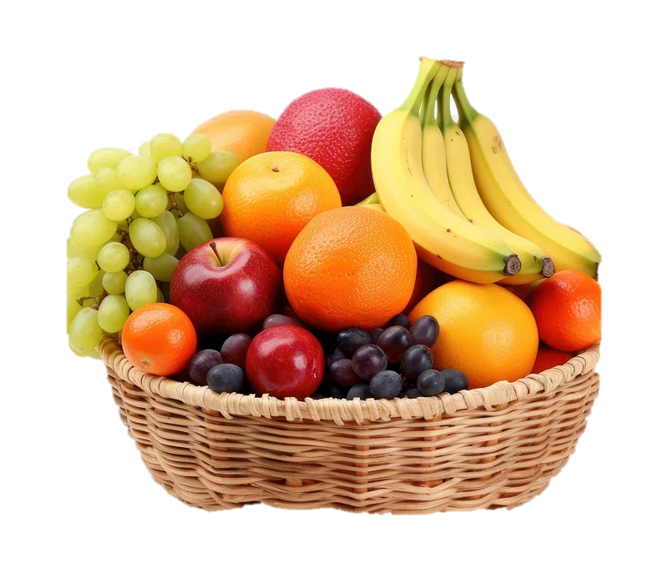




What to bring to school
Snack
School Book Bag
Lunch box (if required)
Water bottle
Home Learning Folder

Slide 7






Slide 8

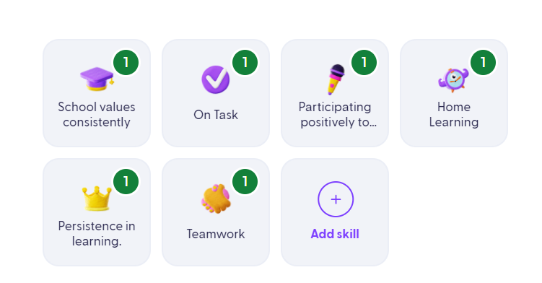


What behaviours will children get Dojos for?

Slide 9
Home Learning
Home Learning will be set using the Google Classroom account every Monday to be returned by the following Monday.
Children will be provided with a Maths and English task which will have a particular focus. All English and Maths home learning tasks are provided to consolidating prior learning.
Children will be asked to complete 5 minutes of TT Rockstars and reading daily.

Slide 10

Expectations of Year 4 Reading
Read daily for a minimum of 5 minutes.
Children should write a short comment and sign their reading record each time. Parents should sign the children's record at least once per week to verify that the children are reading.
Once a child has completed their book they will then be issued with a new book.
Children that are accessing books from the Bubble will complete a short comprehension quiz based on their book and the percentage score will be written in their reading record.
Reading records will be checked every day and signed on a Monday by school.

Slide 11

TTRS Expectations
Towards the end of Year 4, the children will complete a Multiplication Tables Check (MTC).
In preparation for this the children will be completing TTRS at school daily.
Times Tables are important to improve mental maths skills.
As part of home learning, children need to practice for at least 25 minutes a week at home.

