Slide 1
Year 2 Spelling, Punctuation and Grammar Parent Workshop

Slide 2
Aims of the workshop
To inform you about how we teach spelling in Year 2.
To explain some of the spelling rules that we learn in Year 2.
To explain some of the grammatical terminology and grammar objectives for Year 2.

Slide 3
Spelling in Year 2
We use Super Sonic Phonic Friends (continuation from Reception and Year 1) and begin to learn the Year 2 spelling rules. (This is a 20 minute lesson four times a week.)
Children need to take responsibility for their own spelling.
In English lessons, children may be asked to repeat an incorrect spelling at the bottom of their work.
Non-negotiable symbol.

Slide 4
Spelling in Year 2
Teachers may use the non-negotiable symbol when marking children’s work to indicate an incorrect spelling that the child should be able to spell. Children are then expected to correct this with their pink pen.
It isn’t just about learning words for a test. We are aiming for children to consistently apply these spellings within all of their writing.

Slide 5
In Year 2, we start to learn different spelling rules.
Children begin to understand that words are not always spelt like they are said.
‘jumpt’ – as soon as we have taught the concept of regular verb –ed spelling we must insist on ‘jumped’. No excuses. ‘wantid’ becomes ‘wanted’ etc.

Slide 6
Some of the Year 2 Spelling Rules
‘ge’ or ‘dge’?
e.g. edge, lodge and breakage, understanding that the letter ‘j’ is never used to end the spelling of a word.
‘s’ or ‘c’?
A ‘c’ is used before letters y, i or e, in words such as cell and fancy.
‘kn’ ‘gn’ or ‘wr’?
Your child may work on learning spellings which begin with these letters, such as gnome, knit and wrist.

Slide 7
‘-el’ or ‘-le’?
Children may work on words ending in ‘le’, such as little or stable, understanding that ‘-el’ is a less common spelling.
Words ending in –tion
e.g. potion, lotion, transition.
Adding the suffix –es
When adding ‘-es’ to verbs and nouns ending in ‘-y’, children may be taught that the ‘y’ becomes an ‘i’ before the ‘-es’ is added, e.g. hurry – hurries and berry – berries.
The possessive apostrophe
When saying something belongs to someone else we add an apostrophe to show belonging, e.g. the teacher’s apple or the cat’s toy.

Slide 8
Adding suffixes ‘-ing’, ‘-er’, ‘-est’ ‘-ed’ and ‘y’.
If the word ends in ‘y’ (with a consonant before it), such as ‘carry’, we change the ‘y’ for a ‘i’ then add the ending, e.g. carried, carrier or happiest.
When a word ends in ‘e’ (with a consonant before it), we must remove the ‘e’ and add the suffix.
e.g. take – taking and pose – posed.
If the word has a short vowel and single consonant, we double the consonant and add the suffix. e.g. pat – patting and hum – hummed.

Slide 9
Children will also add the suffixes –ness, -ful, -ment, -ly and –less.
The general rule is that if a suffix ends in a consonant, like the above, you can add it to most words without having to do anything, e.g. useful, likeness, priceless, quickly and payment.
The main exceptions occur when the word ends in ‘y’ e.g. happiness.
contractions
e.g. we’ll, they’ve and haven’t which contain an apostrophe.
we’ll is the shortened form of ‘we will.’
A very common error is putting in an apostrophe where it isn’t needed.

Slide 10
Contractions
I’m I am
you’re you are
we’d we would
they’ll they will

Slide 11
These are words where the usual spelling rule does not apply. ‘Tricky’ words.

Slide 14
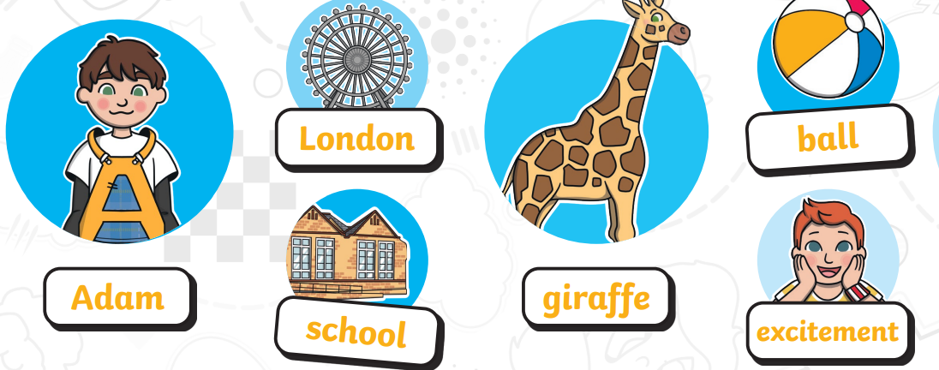
Nouns
The name of a
person, place, object or idea.

Slide 15
Activity example:
Pick out the three nouns in the sentences below…
A whale has an enormous heart that can weigh as much as a small car.
The flower had petals which fell onto the grass.

Slide 16
Verbs

Slide 17
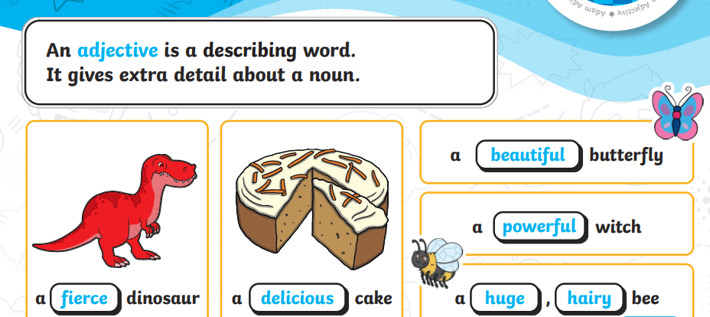
Adjectives

Slide 18
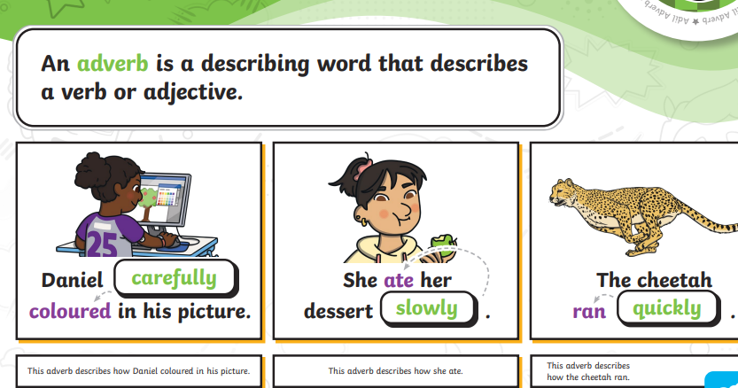
Adverbs

Slide 19
Present tense to past tense example activity.
The following sentences are written in the present tense. Try changing them to the past tense by putting Yesterday at the beginning of each.
They skip on the playground.
The baby is crawling across the mat.
I walk down the corridor.
Ben is talking to his friend.
How have the verbs changed?

Slide 20
Answers
Yesterday they skipped on the playground.
Yesterday the baby crawled across the mat.
Yesterday I walked down the corridor.
Yesterday Ben talked to his friend.
Children must remember to double the consonant in skipped.

Slide 22
Some examples of grammar activities
in Year 2.

Slide 26
Home learning
It is important that learning at home is an extension of practice in school.
Our weekly spelling test will consist of three common exception / ‘tricky’ words and four words from that week’s spelling lesson.
When learning spellings, it is helpful if you ask your child to apply the spelling in a sentence – this is a true indication that the child has embedded the spelling rule.
The weekly home learning tasks may include grammar activities which are sometime set on IXL or SPaG.com

Slide 27
USEFUL WEBSITES TO SUPPORT LEARNING:
www.ictgames.com
www.phonicsplay.co.uk
www.topmarks.co.uk
www.bbc.co.uk/education
www.oxfordowl.co.uk

Slide 28
THANK YOU VERY MUCH FOR COMING.
ANY QUESTIONS?

