Slide 1
Year 2 Parent Information Meeting and Parent Maths Workshop
September 2023

Slide 2
WELCOME TO YEAR 2’S STUDY SUPPORT SESSION
You will find out about:
Staffing
Expectations
Behaviour
General reminders
The curriculum
How you can help at home

Slide 3
THE YEAR 2 TEAM
Teachers:
Mrs Johnson: Monday, Tuesday, Thursday and Friday
Mrs Rogerson: Wednesday
Mrs Blezard: Friday afternoon
Teaching Assistants:
Mrs King-Heath: morning
Miss Fearick: afternoon
Mrs Jones: Tuesday and Friday afternoon

Slide 4
EXPECTATIONS
Work:
Remain on task, allow others to learn.
Produce work you are proud of.
Try your best and to build resilience.
Attitude to Learning:
Be an active learner.
Allow others around you to learn.
Take responsibility for your own learning

Slide 5
BEHAVIOUR:
We will continue to use Dojo points from Reception and Year 1.
Every day the children have 3 classroom points and two playground point.
(The behaviour policy can be found on the school website if you require more greater detail).
At the end of each half term, children are awarded TEAM Certificates for their behaviour. To celebrate their achievements, we also have a class Team Treat.

Slide 6
REMINDERS:
Water Bottle: please make sure that your child brings this to school each day.
Book Change will be on a Monday but we ask for reading books and records to be to brought to school everyday so that we can listen to your child read.
Home Reading: we encourage children to read daily at home and it is a school requirement that children have at least 3 adult signatures each week in their reading records to indicate that they have read at home.

Slide 7
Sport takes place on Wednesdays so children need to come to school dressed in their sports kit.
Spellings: these will be given out on a Tuesday and children will be tested on them on the following Tuesday. (7 words)
Home Learning: will be set on Google Classroom on a Monday and children are given a week to complete this work. It is important that children complete this work as it supports the learning from class.
One Maths and one English home learning task is set weekly.
During a half term, the children will be set both an RE and Topic based piece of work.

Slide 8
THE CURRICULUM
What do we learn about in year 2?
In Year 2, the children are given the opportunity to access a rich and varied curriculum. In the morning children complete a daily phonics lesson and we use Super Sonic Phonic Friends.
Mornings also consist of a Maths and English lesson and this year we are introducing an additional 15 minute maths lesson on four mornings a week called ‘Number Sense’.
‘Number sense is the ability to be flexible with numbers. It helps children understand both how our number system works, and how numbers relate to each other.’

Slide 9
In the afternoons we have different sessions each day including the foundation subjects: (Science, RE, Music, French, PSHE, Computing and Topic which consists of History, Geography and Art).
Special days/weeks: throughout the year, we have specific weeks where we teach Design Technology. We also have an additional 3 mornings a year dedicated to Science where the children will be taking part in scientific investigations.
Visits and visitors: to enhance our curriculum, where possible we may invite visitors to school or arrange to take the children out of school for a learning experience.
For example, in October, we will be taking Year 2 to the Manchester Jewish Museum to learn about the Jewish faith.
For our History topic we have gone on a walk to learn about our local area and to discuss how it has changed over time.

Slide 10
PHONICS:
We follow Supersonic Phonic Friends. We have a daily Supersonic Phonics lesson. We will start the year recapping the units:
Choose to Use Spellings and
Switch it Spell Sounds
When the children are ready, they will move onto the
Key Stage 1 Spelling Rules.
Within these lessons, children will be learning various spelling rules, and will continue to orally rehearse sentences and apply these words within sentences.
Y1 Phonics Screening Test:
If your child did not pass the Statutory Y1 Phonics Screening test this year, they will resit this in June.

Slide 11
Some examples of the spelling rules for Year 2:

Slide 12
READING:
In Year 2, the children will be using the sounds and words that they have learned in Reception and Year 1 to read longer and unfamiliar words.
The children will be expected to read more fluently and rely less on sounding out words.
Children will also be beginning to read with expression.
Children will be expected to develop their inference skills which means being able to ‘read between the lines’.
Children will have a lot of comprehension practise to help them to develop comprehension skills.
As the year progresses, children will be expected to become more independent with their reading and start to choose their own books, some of which will be longer.

Slide 13
READING COMPREHENSION QUESTIONS TO ASK AT HOME

Slide 14
READING COMPREHENSION QUESTIONS TO ASK AT HOME

Slide 15
YEAR 2 WRITING EXPECTATIONS:
• To write coherent pieces linking ideas in sentences together (real and fictional).
• To read and check that their sentences make sense.
• To write different kinds of sentences eg. statements, questions, exclamations & commands.
• To demarcate most sentences with capital letters and full stops.
• To begin to use other punctuation at times: question marks, exclamation marks, commas, and apostrophes for contraction (I’m instead of I am) or possession ( the dog’s dish)
• To use the correct & consistent tense in writing eg. past or present tense.

Slide 16
YEAR 2 WRITING EXPECTATIONS (continued):
• To use expanded noun phrases, adjectives and description.
‘The beautiful, shiny ring glimmered in the sunshine’.
• To link ideas in sentences using coordination ( and, but, or) and subordination (when, if, that, because).
• To use cursive handwriting – beginning to use diagonal & horizontal strokes to join handwriting.
• To segment and spell words using plausible phonetic attempts.
• To spell many common exception words correctly (See list of common exception words).

Slide 18
HOW YOU CAN HELP?
Spellings- Do not accept incorrect spellings at home. Make sure that your child can spell the days of the week, numbers in words and the months of the year correctly. They still struggle to spell these consistently, even when they are on the board everyday!
Reading - Please read as often as you can with your child, preferably a little bit every day.
Punctuation – children must use capital letters and full stops to demarcate sentences. They should use question marks when writing a question and develop their use of a range of punctuation such as exclamation marks (starting with HOW or WHAT), commas in a list and apostrophes.

Slide 19
MATHEMATICS PARENT WORKSHOP
Here at Sacred Heart we use the White Rose Hub as a resource and scheme.
With White Rose, our children always begin learning in the following order by:
Using concrete materials.
Using pictures to show their working out.
Developing abstract concepts where they are required to use their knowledge and apply it within problem solving situations.
We will have a look at some examples together later in the workshop.

Slide 20
MATHEMATICAL EXPECTATIONS IN YEAR 2:
• To read & write all numbers to 100 in digits & words.
• To order and compare numbers to 100 using < > =.
• To say 10 more/less than any number to 100.
• To count in multiples of 2, 3, 5 & 10 from any number up to 100.
• To recall & use multiplication & division facts for 2, 5 & 10 tables.
• To recall & use number facts to 10 to inform +/- facts to 20.
• To know the value of coins and make totals.

Slide 21
MATHEMATICS EXPECTATIONS (continued):
• To partition 2 digit numbers in different ways:
ie. 23 is 20 + 3, 15 + 8, 10 + 10 + 3
• To add & subtract:
▪ 2-digit numbers & ones, ie. 23+6
▪ 2-digit number & tens, ie. 42+20
▪ Two 2-digit number, ie. 33+21
▪ Three single -digit numbers, ie. 3+9+4

Slide 22
MATHEMATICAL EXPECTATIONS (continued):
• To recognise & use inverses (+/-) E.g. 19 + 1 = 20 and from this know that 20 - 1 = 19 and solve missing number problems.
• And 5 x 3 = 15 so 15 ÷ 3 = 5.
• To solve problems using all four operations. (+, -, x and ÷).
• To recognise and find fractions of shapes and sets of objects for ½; 1/3; 1/4; 2/4; 3/4.
• To tell the time to quarter hours, extending to 5 minute intervals .
• To know common 2D and 3D shapes, describing properties such as how many edges, faces, vertices etc.

Slide 23
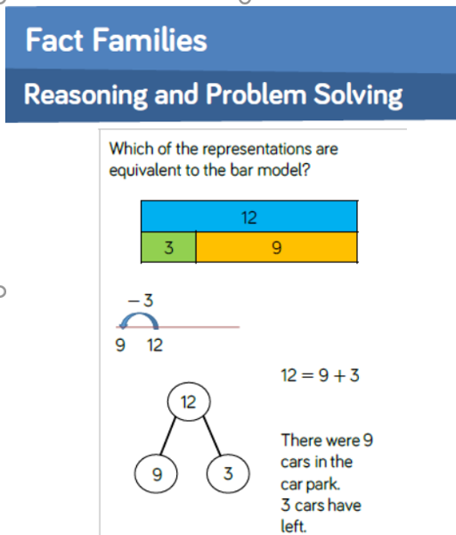
STEP 1:
Initially, the children use concrete apparatus for working out.
STEP 2:
Moving forward, the children will then apply the skill pictorially.
Notes:
STEP 1: Initially we will use counters, a tens frame, a bead string, REKENREKS so the children can physically work out the problem.
STEP 2: Drawing a bar model, a part-whole model. MODEL ON A WHTEBOARD HOW EACH OF THESE CAN HELP TO FIND THE MISSING NUMBERS.

Slide 24
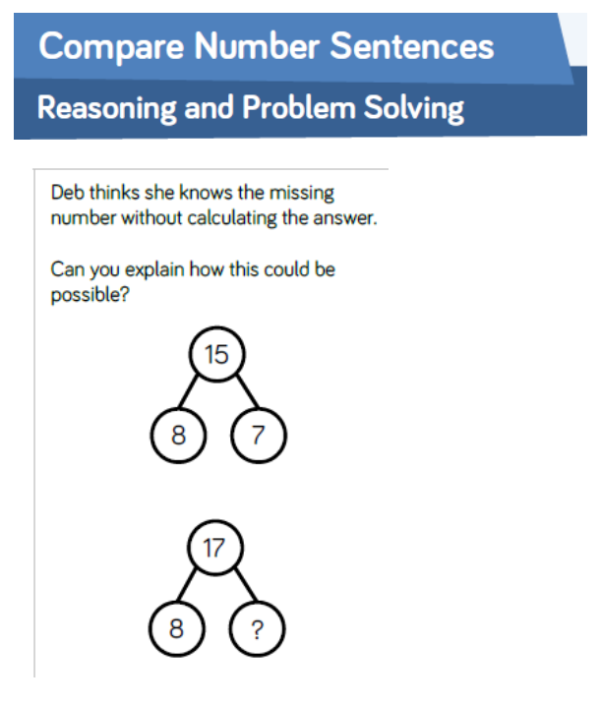
STEP 3:
Applying and reasoning what they have learned by problem solving.
It is essential that children are able to reason about numbers and that they can articulate their understanding of a concept.
In every maths lesson, we provide opportunities for children to attempt ‘Greater Depth Challenges’ which may include problems like this.

Slide 25
ADDITION

Slide 26
SUBTRACTION

Slide 27
ANY QUESTIONS SO FAR?
LET’S WORK TOGETHER ON THE
NEXT EXERCISE.

Slide 28
ADDITION EXAMPLE
44+33=
We will go through an example of adding using tens and ones.
Make 44 + 33 using the tens and ones on your table. CONCRETE
Can you draw the tens and ones on your whiteboard? PICTORAL
Notes:
MAKE 44+33 using tens and ones. Next step would be draw tens and ones. Then draw an empty numberline. Then column method once understand what the digits represent.

Slide 29
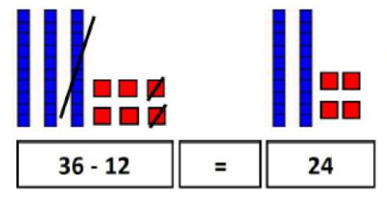
The same for subtraction
Make 36 - 12 using the tens and ones on your table. CONCRETE
Can you draw the tens and ones on your whiteboard? PICTORAL
Notes:
MAKE 44+33 using tens and ones.

Slide 30
HERE ARE SOME WAYS YOU MAY SEE SUBTRACTION RECORDED IN YOUR CHILD’S BOOK.

Slide 31
HOW CAN YOU HELP AT HOME?
Arithmetic & Times Tables:
Please practise the 2, 5 and 10 times tables with your child. They need to be able to recall and use multiplication and division facts for these tables.
Help your child to develop a quick recall of number bonds to 10 and 20, using mathematical language at all times.

Slide 32
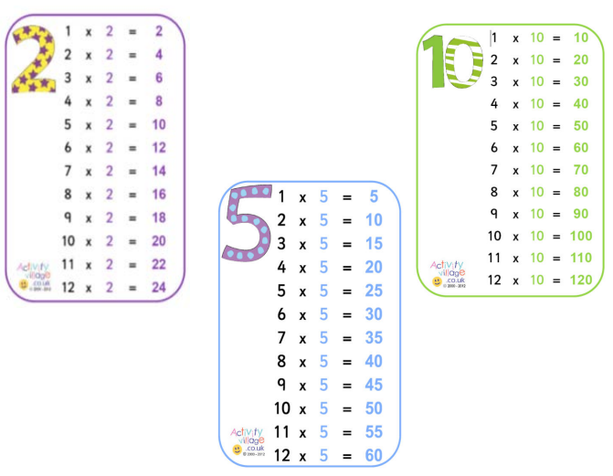
MULTIPLICATION TABLES THAT ALL CHILDREN SHOULD KNOW BY THE END OF YEAR 2.
This means to be able to recall any times table fact and the related division fact from all of these tables.

Slide 33
USEFUL WEBSITES TO SUPPORT LEARNING:
www.ictgames.com
www.phonicsplay.co.uk
www.topmarks.co.uk
www.bbc.co.uk/education
www.nrich.maths.org
www.oxfordowl.co.uk

Slide 34
THANK YOU VERY MUCH FOR COMING.
ANY QUESTIONS?

