Slide 1
Sacred Heart RC Primary School.
Relationship, Health and Sex Education
RHSE
A Presentation for Parents

Slide 2
Mission Statement
By living out our Catholic faith
TOGETHER
we ENCOURAGE
and ACHIEVE.
I have called you by name.

Slide 3
At Sacred Heart we recognise that each of our children is unique and made in the image of God. RHSE promotes self-esteem and well-being. It helps them to form and maintain worthwhile and satisfying relationships, based on respect for themselves and others, at home, at school and within the community. RHSE is an important part of the education of the whole child.
As a Catholic school, RHSE is rooted in the teachings of the Catholic Church with marriage and family at the centre of the teaching. Every child’s family life will be treated with respect. This includes where this differs from the church’s teaching.
Following guidance from our own Bishop and Diocese, the Conference of Bishops of England and Wales and as advocated by the DFE, all relationship and sex education in our school will be firmly embedded within the Religious Education framework as it is concerned primarily with nurturing the human wholeness of our pupils.

Slide 4
Relationships, Health and Sex Education is based on the concept of parents being the child’s primary educator.
The bishops council and the DfE recognise this and see school’s role as that of supporting parents in this responsibility and not replacing it.

Slide 5
People Involved in the Formation of the Policy
RE-Coordinator (CES training completed)
Headteacher (CES training completed)
Governing body
All teaching staff (CES training completed)
Parents contributing feedback and views about the RHSE provision
All school personnel, parents and carers have been made aware of this policy. This policy will be made available to view via the schools’ website. Hard copies will also be available at the schools’ office.

Slide 6
What is RHSE?
Relationships and Sex Education is a key aspect of Personal, Social, Health and Economic Education (PSHE).
RHSE is a Key aspect of the spiritual, moral, social and cultural (SMSC) development in schools.
It is the understanding of the importance of marriage for family life, stable and loving relationships, respect, love and care.
It is also about the teaching of sex, sexuality and sexual health.
RSE is taught though the statutory Science curriculum and ‘Journey in Love’ and it is not taught through RHE.

Slide 7
Aims
In partnership with parents, it is the aim of Sacred Heart School to provide suitable teaching at the appropriate time during a pupil’s time at our school and to provide children with a ‘positive and prudent sexual education’. One which is compatible with their physical, cognitive, psychological and spiritual maturity, and rooted in a Catholic vision of education and the human person.

Slide 8
Pupils should know about:
Families and People who care for me;
Caring friendships;
Respectful relationships;
Online relationships;
Being safe.

Slide 9
RHSE should ensure that all children:
Develop confidence in talking, listening and thinking about feelings and relationships.
Are able to name parts of the body and describe how the body works.
Have the skills, language and confidence to protect themselves.
Are prepared for puberty.

Slide 10
Delivery of RHSE
RHSE, at Sacred Heart, is not delivered in isolation, but firmly embedded in all curriculum areas including Personal, Social, Health and Economic (PSHE) education, Citizenship and Science (see RHSE Overview for the cross curricular, integrated approach). There are opportunities to teach about relationships in every day interactions by all who are part of the Catholic family that is Sacred Heart, for example as set out in the Code of Conduct and embedded in policies such Behaviour and Anti Bullying. Our school is a nurturing place in which people are valued and treated with respect.
Whilst some aspects of RHSE are non-statutory, significant aspects remain as part of the National Curriculum for Science and as such, are statutory for all pupils. [Parents are unable to withdraw from statutory content].
We believe parents are the prime educators of their children
The school, church and family will work together; our role as a school is to support you and not to replace you.
Other programmes used to support the curriculum are, ‘A Journey in Love’ and ‘Diversity’ schemes.

Slide 11
Science
In Key Stage 1 the children learn:
that animals, including humans, move, feed, grow use their senses and reproduce;
to recognise and compare the main external parts of the bodies of humans;
that humans and animals produce offspring which grow into adults;
to recognise similarities and differences between themselves and others and treat others with sensitivity.
In Key Stage 2 the children learn:
that life processes common to humans and other animals include nutrition, growth and reproduction;
the main stages of the human life cycle.

Slide 12
A Journey in Love
Approved and recommended by the Archdiocese. This has been taught since January 2018.
The programme teaches that:
The journey begins at the moment of our conception God is at the heart of love.
Puberty can be an extremely confusing time for children, our message will be that even in this confusion, God is there.
The Sacrament of marriage publicly declares the commitment of each spouse to the other permanently in the acknowledgement that it is God-given.

Slide 13
A Journey in Love
The central message of the Christian faith is love. The central message of our RSE teaching is love.
“My commandment is this: love one another, just as I have loved you”
John 15:12

Slide 14
The structure of A Journey in Love Journey in Love has been taught in Sacred Heart for the last two years.
The programme is made up of 4 areas:
Physical
Social
Emotional
Intellectual
Each area is broken down into:
Activities
Pause & Reflect
Prayer
What will ‘A Journey In Love’ look like in each year group?

Slide 15
Nursery
Children begin to know and understand that they are part of the wonder of God’s love and creation.
Examples of Nursery activities:
Focus on different parts of their body and look at their own and each others features.
Observe facial expressions.
Identify the signs of feeling happy and sad.
Look at the wonders of God’s world through the song ‘If I were a butterfly’.

Slide 16
Reception
Children know and understand that God has made them unique and that although we are all different we are all special to him.
Examples of Reception activities:
Discuss how we are different from one another.
Identify who they play with and what they enjoy doing.
Look at the different types of friends they have.
Describe how to be a good friend.
Recognise that Jesus is our friend.

Slide 17
Year 1
Children know and understand that they are growing and developing as members of their own family and God’s family.
Examples of Year 1 activities:
Talk about who is in their family.
Talk about how fast babies change and grow.
Look at happy and sad moment within a family.
How is love shown in a family?
Know that we are members of God’s family.

Slide 18
Year 2
Children know and understand that they are growing and developing in a God-given community.
Examples of Year 2 activities:
What is community?
Explore school as a community.
How can we contribute to the community?
As children of God, how should we help each other?

Slide 19
Year 3
Children know and understand the virtues essential to friendship e.g. loyalty, responsibility and experience the importance both of forgiving and being forgiven and of celebrating God’s forgiveness.
Examples of Year 3 activities:
Who cares for me at home, school, parish, community?
How do you keep safe?
How do you take care of others?
How do you feel if a friend is not there for you or you are not there for them?
How can I forgive and include others as Jesus did?

Slide 20
Year 4
Children know and understand that they are all different and celebrate these differences as they appreciate that God’s love accepts us as we are and as we change.
Examples of Year 4 activities:
Recognise all pupils grow and develop at a different rate.
Identify the development of the baby in the womb.
Look at how pupils appreciate their own and others gifts, talents, achievements and all that makes us unique.
St Paul’s teaching on love.

Slide 21
Year 5
Children know and become aware of the physical and emotional changes that accompany puberty- sensitivity, mood swings, anger, boredom, etc.
They grow further in their understanding of God’s presence in their daily lives.
Examples of Year 5 activities:
Identify and celebrate the ways I have changed since birth.
Discuss the external and internal changes which happen to boys and girls in puberty- pupils may be divided into male and females and taught separately for this section of the unit.
Recognise behaviour changes as we grow up.
Identify that physical changes from child to adult means the ability to become a mother or father.
Reflect on ways to become more sensitive to the emotional development of oneself and of others.

Slide 22
Year 6
Children develop, in an appropriate way for their age, an understanding of sexuality and grow further in their appreciation of their dignity and worth as children of God.
Examples of Year 6 activities:
Explain how human life is conceived.
Recognise Male and female reproductive organs- children may be separated into males and females for this section.
Know that sexual intercourse occurs between husband and wife.
Understand how a child grows within the mother’s womb.
Understand that God causes new life to begin through the love that parents have for each other.
Celebrate God’s creative love in creating us as his children.

Slide 23
‘Diversity’
Teaching children to respect and accept differences and diversity using the Equality Act 2010 as a solid foundation.
Taking a proactive approach to bullying.
Reducing potential for radicalisation.
Preparing children for life in Modern Britain.
Teaching ‘’British Values’’.
How is it taught?
35 picture books: 5 in each year group from EYFE to Y6.
Picture books deal with all equalities in the Equality Act 2010 race, religion, gender, gender identity including transgender, age, disability, sexual orientation.
Each characteristic is taught in context with British law.
Each class will use each text for one week to underpin all the learning foci whilst applying their English skills.

Slide 24
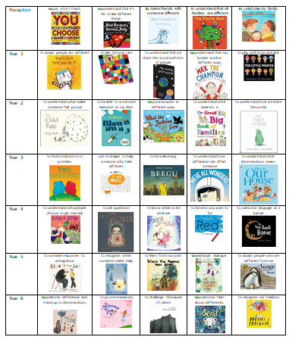

Slide 25
Reception

Slide 26
Year 1

Slide 27
Year 2

Slide 28
Year 3

Slide 29
Year 4

Slide 30
Year 5

Slide 31
Year 6

Slide 32
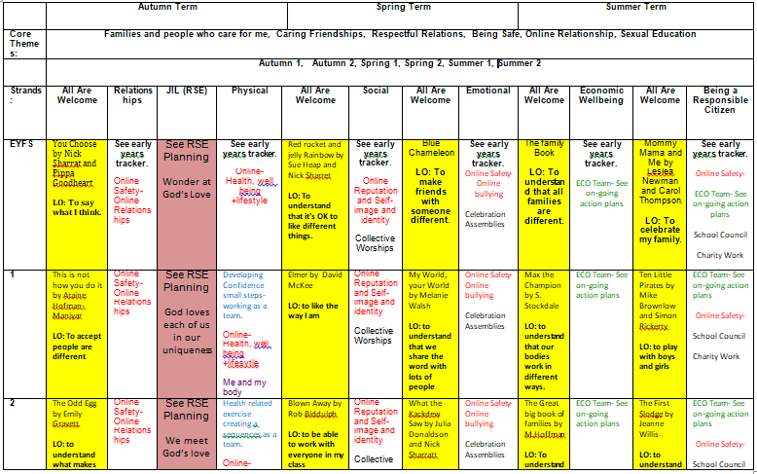
Cross Curriculum Approach

Slide 33
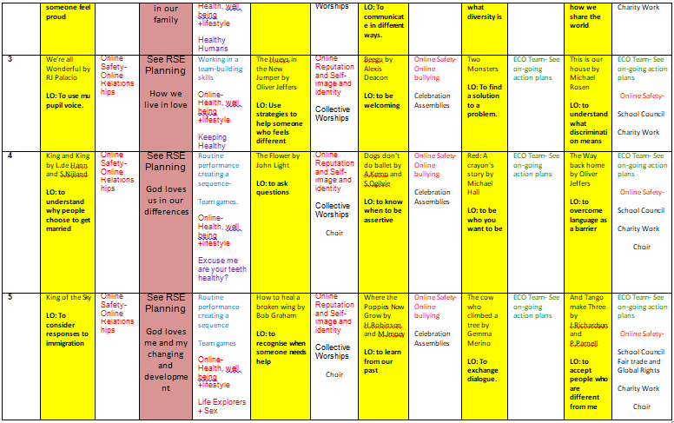

Slide 34
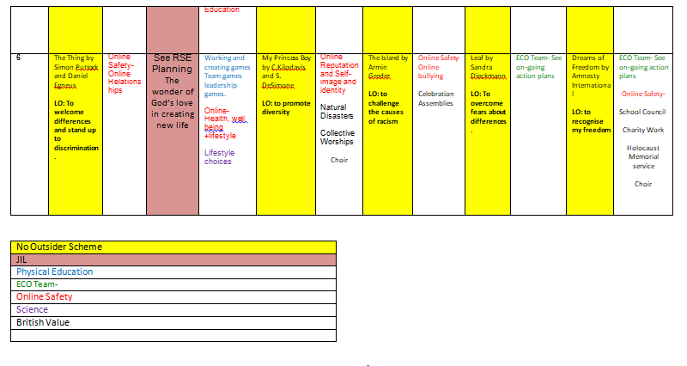

Slide 35
Assessment
The statutory Science elements of the curriculum will be assessed formally and reported in the same way as all science areas. Class teachers assess pupils’ understanding and progress through formative and summative processes. These include task outcomes, questioning and observation. At the end of the year, each year group will review the RHSE programme that they have implemented and pass on any comments to the RHSE leader as part of the monitoring cycle. A random selection of pupils will be interviewed and all parents are invited to provide written feedback on the provision of RHSE once a year. The RHSE policy is reviewed on an annual basis taking into account the feedback from teaching staff, pupils and parents. Governors will consider evaluations and recommendations before amending the policy.

Slide 36
Confidentiality
Teachers cannot offer unconditional confidentiality during these sessions. Pupils will be advised of this prior to sessions beginning. Any disclosures made during these sessions must be dealt with in accordance with the current Safeguarding Policy.

Slide 37
Answering Difficult Questions
Staff are aware that views around RHSE related issues are varied. However, while personal views are respected, all RHSE issues are taught without bias and in line with the Catholic teaching and values. Topics are presented using a variety of views and beliefs so that pupils are able to form their own, informed opinions but also respect others who may have a different opinion. Both formal and informal RHSE arising from pupils’ questions are answered according to the age and maturity of the pupil(s) concerned and the limits of the year group topics. The school believes that individual teachers must use their skill and discretion in this area and refer to the Designated Safeguarding Lead if they are concerned or believe any pupil to be at risk.

Slide 38
Inclusion
The RSE policy reflects and is line with the schools’ Equal Opportunities Policy and our school ensures that the RHSE teaching programme is an inclusive one and is appropriate and relevant to all pupils, including those with SEN and disabilities. Teachers ensure that the content, approach and use of inclusive language reflect the diversity of the school community, and will help all pupils to feel valued and included, regardless of their gender, ability, disability, experiences and family background. RHSE strives to meet the needs of all pupils regardless of their developing sexuality and deals honestly and sensitively with sexual orientation, answers appropriate questions and offer support in-line with national expectations and requirements.

Slide 39
Parental rights to withdraw their children
Parents have the right to withdraw their children from the non-statutory aspects of the RHSE curriculum, except for those parts included within the National Curriculum for Science, which are statutory.
Effective methods to communicate the schools’ approach to RHSE, including the parental right to withdraw their child, are through the schools’ website, the RHSE policy and the year group RHSE curriculum.
Information letter sent home to parents. The letter also includes arrangements for a parent meeting with staff.
Parents are also informed that the RHSE curriculum is an essential vehicle in supporting a school’s statutory duty to:
Safeguard and promote the welfare of their children;
Advance the 2010 Equality Act;
Encourage the spiritual, moral, social and cultural development of pupils;
Foster British values, and prepare children and young people for the challenges, opportunities and responsibilities of adult life, along with the coverage of the National Curriculum for Science.

Slide 40
Any Questions?
https://assets.publishing.service.gov.uk/government/uploads/system/uploads/attachment_data/file/812593/RSE_primary_schools_guide_for_parents.pdf
Or
Contact school to speak to Miss Ditchfield or Mr M^{c}Dermott

