Slide 1
Welcome to Year 5
Meet the Teacher
Maths Workshop

Slide 2
Aims
Identify the staff who are supporting your child this year
Be clear on the daily/ weekly routines of Year 5
Be clear on expectations of Year 5
Understand the expectations on Reading and Home learning
Dates of events for Year 5
Maths Workshop on the focus of mental methods.

Slide 3
Staffing
Class Teacher and Teaching Assistants | Mrs Delargy (Class Teacher) Mrs Lonsdale (Teaching Assistants) (12 Weeks Placement)
Arts | Mrs Woodward
Computing | Miss Ditchfield
History and Geography | Mrs Kirkup
Science | Mr Sawyer
PE | Mr Barlow

Slide 4
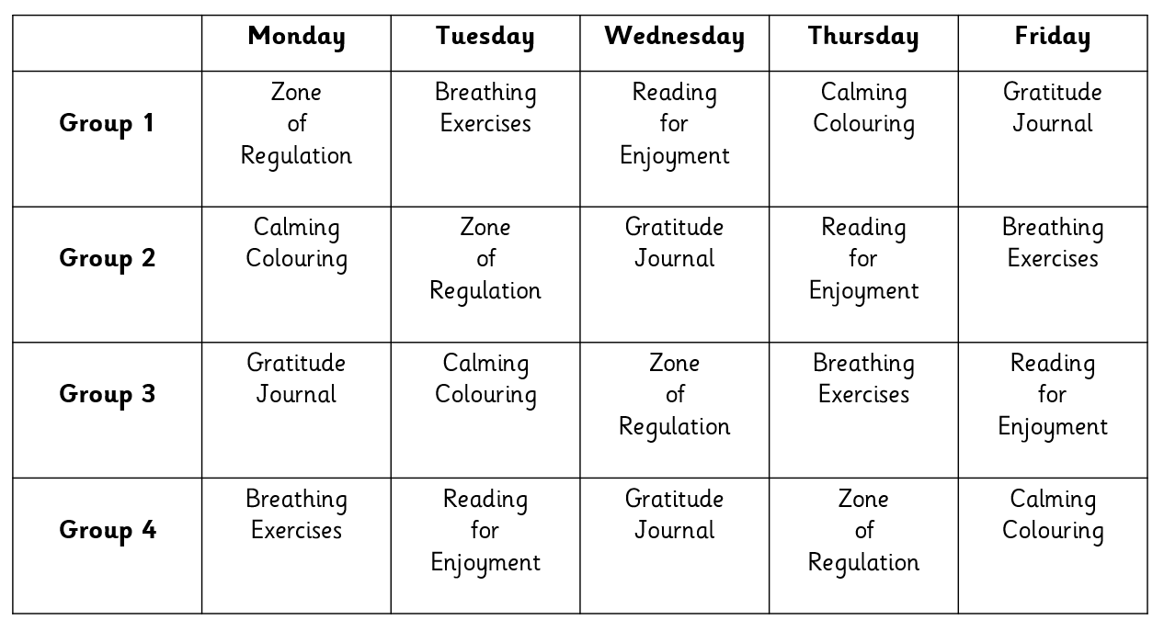
Morning Carousel
The children enter the classroom from 8.45 am and complete a morning carousel.
Appropriate music, in keeping with the Catholic Ethos of the school, is to be played throughout the morning registration carousel.
The class register and dinner register is taken at 9 am.
Register closes at 9.05 am

Slide 5
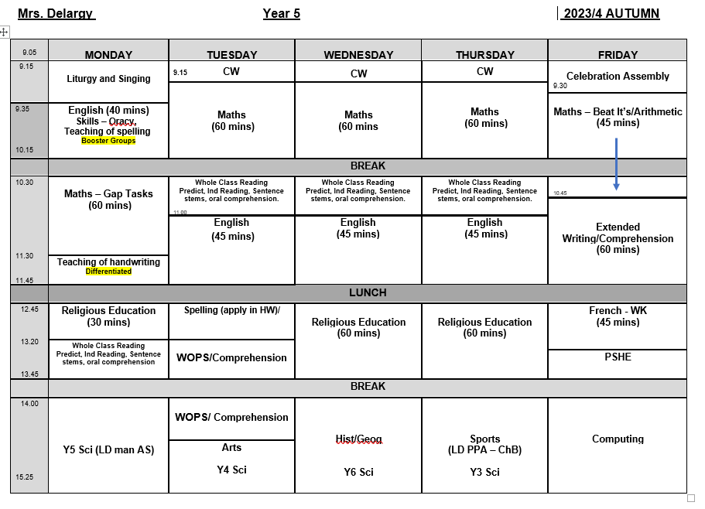
Class Timetable
Year 5 have P.E. on Thursday so they need to come into school wearing the school PE kit.

Slide 6
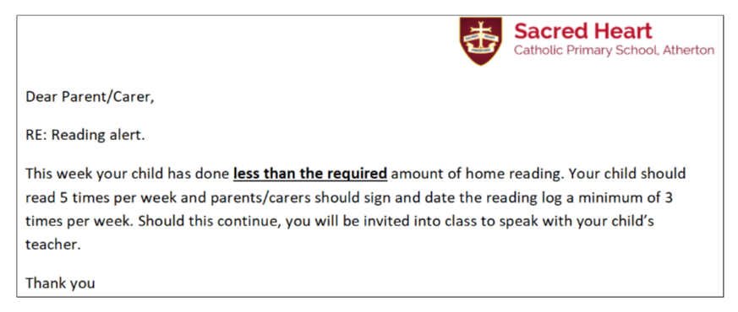
Reading in Year 5
Children are expected to read at home 5x per week for a minimum of 20 minutes.
Children should sign their reading record each time and write a short comment 2x per week.
Parents should sign the children's record at least once per week to verify that the children are reading.
Once a child has completed their book, they will then take an Accelerated Reader test in school i.e. complete a short comprehension quiz based on their book.
Books will be changed on completion of the Accelerated Reader Quiz.
Reading records will be checked every Monday and Thursday.

Slide 7
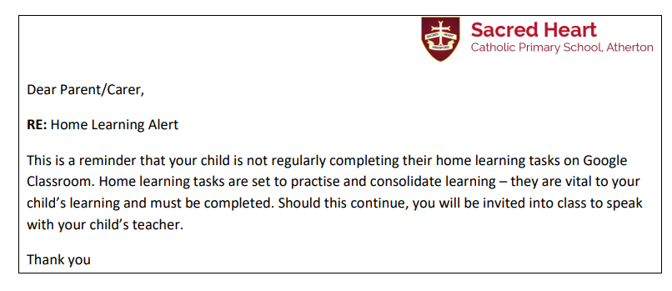
Home Learning
Home Learning will be set using the Google Classroom account every Thursday to be returned for the following Thursday by 3.30 pm.
They will be provided with 1 Maths and 1 English task. The focus of the tasks will be a consolidation of what has been covered in class or a pre learning task.
The children will bring home 7 spellings each week; either high frequency words or a given spelling pattern.
Additionally there will be a foundation home learning activity assigned each half term to compliment the focus of a particular topic or as a consolidation of prior learning.

Slide 8
Key Dates
AUTUMN TERM
Friday 22nd September Year 5 Whole School Collective Worship ‘Ourselves’
Sunday 8th October Family Mass Led by Year 5 (other classes to support).
23rd -27th October Half Term
Monday 30th October INSET Day
Wednesday 1st November Parents Evening
Friday 17th November Year 3 led the whole school Collective Worship
Thursday 14th December Christmas Lunch
Thursday 21st December Key Stage Two Carol Service (Time TBC)
Friday 22nd December Christmas Mass (9.30 am)

Slide 9
Maths Workshop
Focus: Mental Maths

Slide 10
Why Are Mental Maths Strategies Important?
Mental strategies are the foundations for most of the areas of mathematics that use numbers and the foundation of any written or formal method.
Without efficient mental strategies, children can often struggle to quickly and fluently calculate.
What is fluency in mathematics
‘Fluency in maths is not simply being able to ‘recall’ known facts, it is how children can use and apply these facts, including through a range of mental maths strategies, that are important.
“Low achievers are often low achievers not because they know less, but because they don’t use numbers flexibly.” – Jo Boaler

Slide 11
Developing Number Sense in Key Stage 1.
A solid foundation in number properties is central to pupils’ success in developing and applying mental maths strategies.
In Key stage 1 children explore the development of number properties as pre-requisites for the development of mental maths strategies.
i.e. they develop ‘Number Sense’
Number sense is a person's ability to understand, relate, and connect numbers.
Children with strong number sense think flexibly and fluently about numbers.
http://buildingnumbersense.blogspot.com/p/number-talks.html

Slide 12
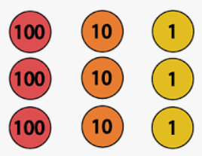
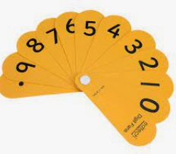
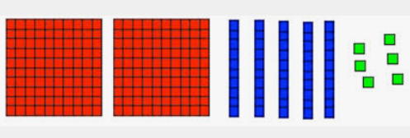
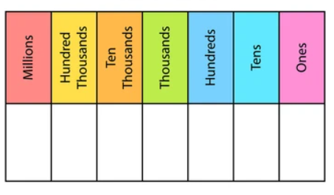
Throughout year 3 and 4 children have been applying their knowledge and understanding of number sense from Key Stage 1 to developing a range of mental strategies.
Children have access to a range of manipulative or concrete resources to support their understanding.

Slide 13
Mental strategies introduced from Year 1:
Using number bonds (pairs) to 1, 10, 100 etc.
Adding near multiples of ten and adjusting;
Partitioning and Recombining;
Bridging though ten;
Use relationships between operations;
Using known number facts;
Doubling and near doubling;
For example, if I know that double 250 is 500 then 250 + 260 will double 250 add 10.
Counting on;
For example, because the difference between 134 and 128 is going to be small, I can count on from 128 to 134.

Slide 14
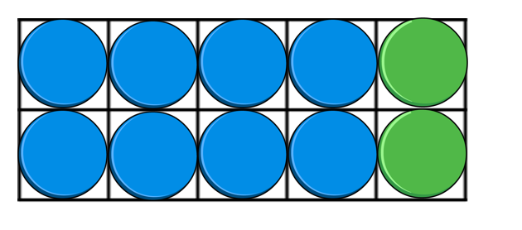
Using number bonds (pairs) to 1, 10, 100 etc.
8 + 2 =
Which other related calculations can we find?

Slide 15
Which related calculations can we find?
10
0.1
100
0.01
1000

Slide 16
Using number bonds (pairs) to find fact families

Slide 17
How would we use number bonds to solve the following calculations?
136 + 214 =
7.2 + = 10
Could this calculation be correct? Explain your reasoning.
5260 – 3182 = 2077

Slide 18
Throughout year 3 and 4 children have secured their understanding of place value.
Can you explain what happens to the digits within these calculations?
245 + 30 =
245 + 300 =

Slide 19
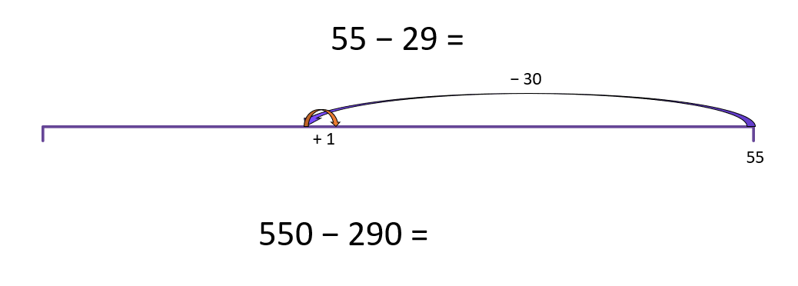
Adding near multiples of ten and adjusting (rounding and adjusting).
What do you notice about 29 that might help you?

Slide 20
Adding near multiples of ten and adjusting (rounding and adjusting).
Round to the nearest £100:
£823.11
£387.95
£800
£800
£900
£400
£300
£400
Answers
Notes:
Content Domain Reference: 6N4
Key Questions: Where are these amounts on the number line? How do you round to the nearest £100? Which place value column do you look at? Why?

Slide 21
Adding near multiples of ten and adjusting (rounding and adjusting).
Round to the nearest £1,000:
£9,765.87
£7,499.99
£10,000
£9,000
£10,000
£7,000
£7,000
£8,000
Answers
Notes:
Content Domain Reference: 6N4
Key Questions: How do you round these amounts? Which multiples of £1,000 are these values between?

Slide 22
How could we solve these calculations through rounding and adjusting?
5642 + 3999 =
3456 - 1998 =
3013 – 1500 =

Slide 23
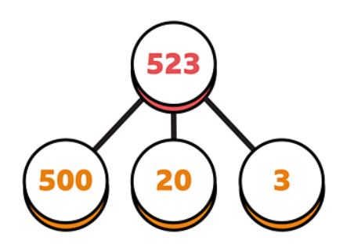
Partitioning and recombining.

Slide 24
How could we use partitioning and recombining to solve these calculations?
245 + 153 =
245 + 100 + 40 + 3 =
3256 + 4523 =
5984 – 2762 =

Slide 25
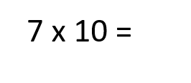
Using known number facts
Which related facts can you find?

Slide 26
Use relationships between operations
9 x 100 =
900
 | Th | H | T | O
 |  |  |  | 9
x 10 |  |  | 9 | 0
x 100
9
0
0
Answer
Notes:
Content Domain Reference: 5C6b
Key Questions: How do you multiply by 100? How do you multiply a single digit number by 100? How is this similar or different to multiplying by 10?

Slide 27
Use relationships between operations
37 x 10 =
370
 | H | T | O
 |  | 3 | 7
x 10
3
7
0
Answer
Notes:
Content Domain Reference: 5C6b
Key Questions: Where do you place the digits in the place value grid? How do you move the digits on the place value grid? What happens to the value of each digit?

Slide 28
Use relationships between operations
230 ÷ 10 =
23
 | H | T | O
 | 2 | 3 | 0
÷ 10
2
3
Answer
Notes:
Content Domain Reference: 5C6b
Key Questions: Is there another method you could use to divide by 10?
Extension: What would happen if we divided 23 by 10?

Slide 29
Use relationships between operations
1,700 ÷ 100 =
17
 | Th | H | T | O
 | 1 | 7 | 0 | 0
÷ 10 |  | 1 | 7 | 0
÷ 100
1
7
Answer
Notes:
Content Domain Reference: 5C6b
Key Questions: How do you divide a four-digit multiple of 100? What do you notice about the digits?

Slide 30
Use relationships between operations
2 x 6 =
2 x 60 =
2 x 600 =
12
120
1,200
Answers
Notes:
Content Domain Reference: 5C6b
Key Questions: How are these calculations related? What do you notice? How does answering one question help with the others?
Extension: Write the related division calculations.

Slide 31
Use relationships between operations
50 x 3 =
3 x 5 =
30 x 50 =
150
15
1,500
Answers
Notes:
Content Domain Reference: 5C6b
Key Questions: Which calculation is the easiest to solve? Why? What do you notice?
Extension: Calculate other related calculations e.g. 300 x 5, 300 x 50.

Slide 32
Using Mental Strategies In The SATs Tests
Mental maths appears six times in the content domain breakdowns for the KS2 Mathematics test framework and is one of the factors the national assessments are trying to assess.
SATs Tests Arithmetic Test
Efficient mental calculation strategies are key to success in the KS2 SATs Paper 1- Arithmetic.
In the Arithmetic paper, over 80% of questions are designed to be able to be solved mentally, or through jottings.
The children are expected to answer 36 questions in 30 minutes. Less than a minute per question! Having a bank of mental calculation strategies would help the children to answer some of these questions with speed and fluency.
Some of the questions are set out to encourage written methods, for example those requiring the children to answer long multiplication and division calculations. However, many children attempt the majority of the paper using formal written methods, which leads to them running out of time and not completing the paper.

Slide 33
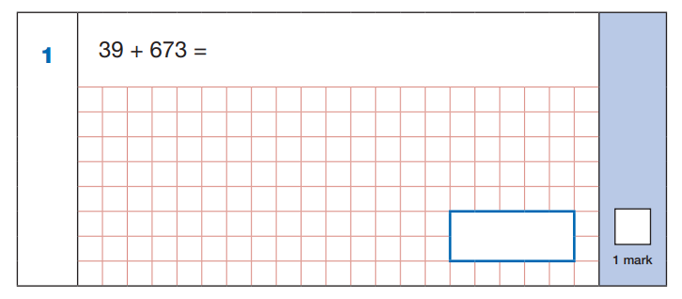
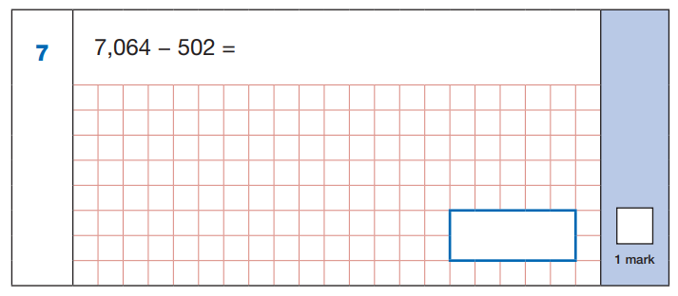
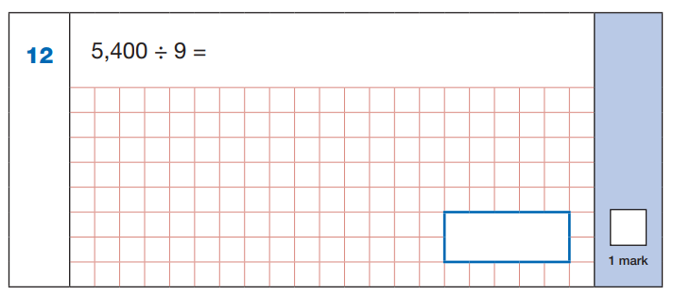

Slide 34
