Slide 1
Reading Workshop
Year 3 & 4

Slide 2
Workshop Aims:
To understand the importance of reading.
Ideas to foster a love for reading .
To highlight strategies to improve your child’s reading ability.
Examples to improve your child’s understanding of a text.
Reading support offered in our school.
An example of reading at home.

Slide 3
The POWER of reading
Reading is the KEY to learning.
It lays the foundation for future learning and is needed to access and flourish in every curriculum subject.
Reading helps to develop self-esteem, confidence and also helps to support our wellbeing and mental health.

Slide 4
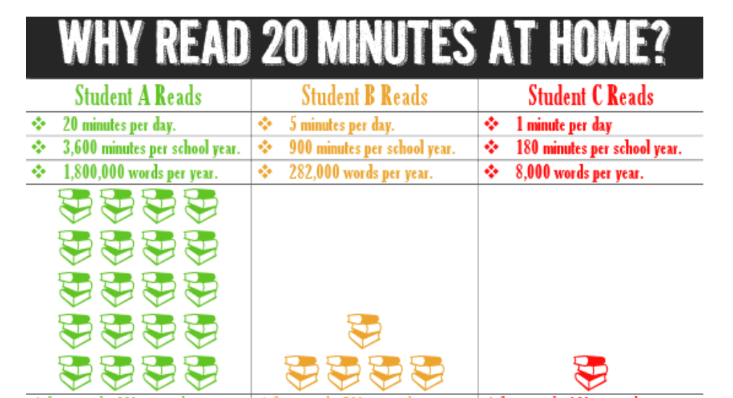

Slide 5
What is needed in order to read?

Slide 7
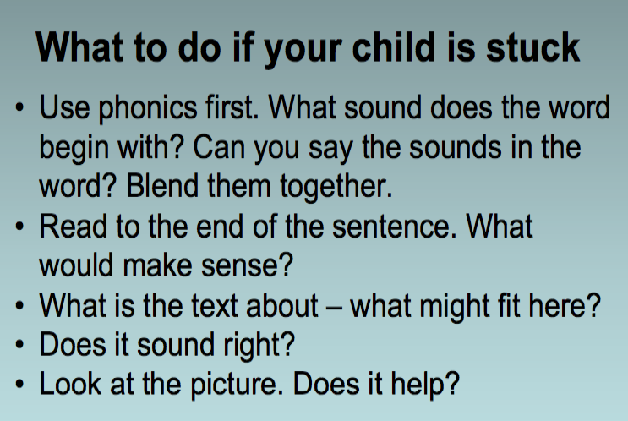

Slide 8
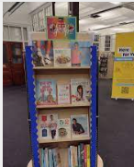
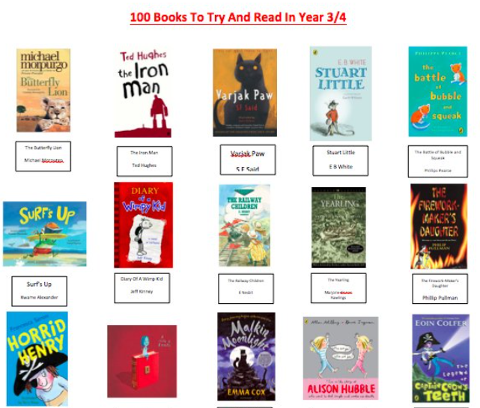
Ideas to develop a love
for reading

Slide 9
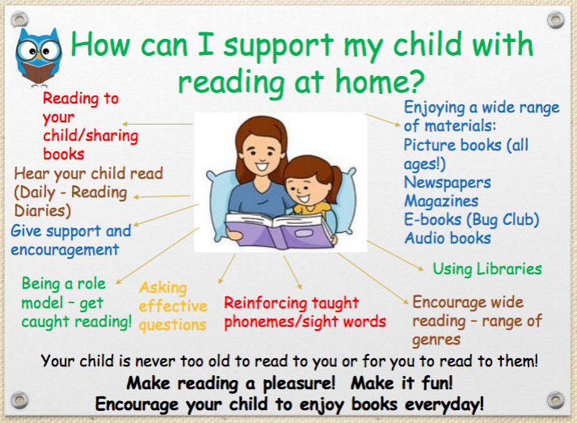

Slide 10
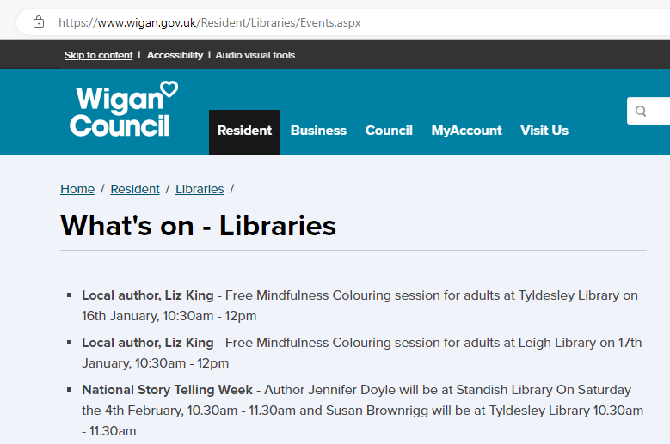
Keep an eye on free events at your local libraries, lots of clubs for children such as coding, art clubs as well as author visits.
*Summer Holiday Projects for certificates and medals to promote reading during the school holidays

Slide 11
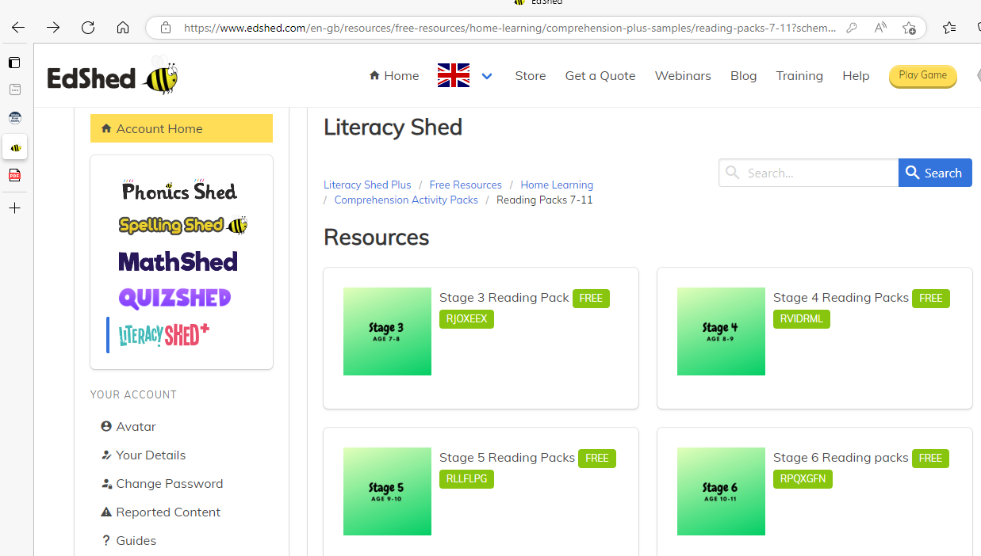
FREE RESOURCES

Slide 12
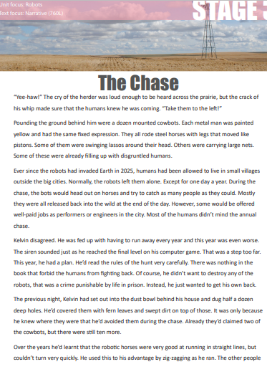
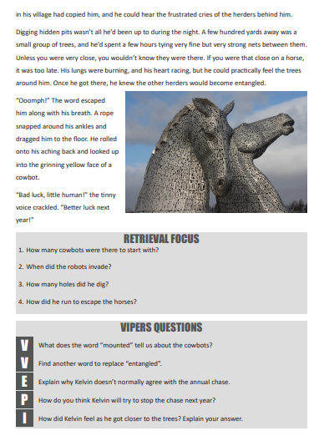
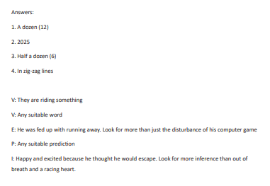
An example of Stage 3 (Year 3 free comprehension)

Slide 13
Reading Support In School
Sharing text in RE, Maths, English, Geography, History, Science and in Art.
Whole Class Reading x 4 weekly
English teaching tends to be delivered through a theme of the book that the children are accessing during their Whole Class Reading time.
Reading for Pleasure Wednesdays

Slide 14
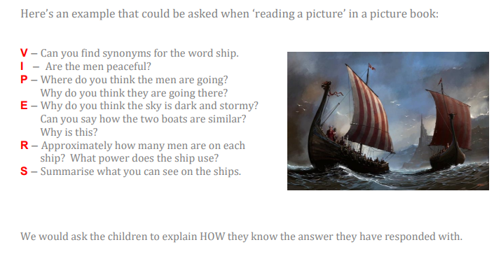
ORACY

Slide 22
An example of reading at home

Slide 23
Time to...
Look at the texts that your children are reading in class
Talk to other parents, sharing positive experiences
Ask the teacher any questions
Look at sample texts for reading comprehensions

