Slide 1
Developing Number Sense.
A solid foundation in number properties is central to pupils’ success in developing and applying mental maths strategies.
In Key stage 1 children explore the development of number properties as pre-requisites for the development of mental maths strategies.
i.e. they develop ‘Number Sense’
Number sense is a person's ability to understand, relate, and connect numbers.
Children with strong number sense think flexibly and fluently about numbers.
http://buildingnumbersense.blogspot.com/p/number-talks.html
https://www.nctm.org/Classroom-Resources/Illuminations/Interactives/Ten-Frame/

Slide 2
Why focus on Number Sense?
Children who struggle in maths often lack number sense.
What is Number Sense?
Children with strong number sense have:
A sense of what numbers mean.
Someone with a sense of what numbers mean has a visual model and concrete understanding of quantities.
An ability to look at the world in terms of quantity and numbers.(i.e. When is 100 a lot? When is it not very much?)
An ability to make comparisons among quantities. For example, they know that 300 is 400 away from 700 by using a mental number line, or know that there is a bigger difference between 50 and 150 than between 1,000 and 1,050.

Slide 3
There are several important mental calculation strategies that need introducing from Year 1, in Year 2 we re-visit and extend our understanding of them. These include:
Partitioning and recombining leading to sequencing
Doubling and near doubling.
Using number pairs to 1, 10, 100 etc.
Adding near multiples of ten and adjusting.
Using known number facts.
Bridging though ten.
Use relationships between operations, fact families.
Counting on.

Slide 4
There are several important mental calculation strategies that need introducing from Year 1 and then consolidated in Year 2. These include:
Partitioning and recombining leading to sequencing (keeping one number whole and partitioning the second, for example 8 + 12 = 8 + 10 + 2)
Doubling and near doubling. For example, if I know that double 6 is 12 then 6 + 8 will be double 6 add 2.
Using number pairs to 1, 10, etc. For example, 36 + 14, I know 6 add 4 equals 10, so I can add the ones then the tens. 10 + 40 =50
Adding near multiples of ten and adjusting. For example, to subtract 99 from 154, it would be efficient to subtract 100 and add 1.
Using known number facts. For example, if I know that 8 multiplied by 7 equals 56, I can work out eight multiplied by 70 and eight multiplied by 35.
Bridging though ten. For example, 19 add 4, I can partition 4 into 1 and 3, add 1 to 19 to make 20 and then add the remaining 3.
Use relationships between operations, fact families. For example, if I know that 7 + 8 = 15, I also know that 8 + 7 = 15, 15 = 7 + 8, 15 = 8 + 7, 15 – 7 = 8, 15 - 8 = 7, 7 = 15 - 8 and 15 -7 = 8
Counting on. For example, because the difference between 34 and 28 is going to be small, I can count on from 28 to 34.
Others need teaching when appropriate, for example:
x 4 by doubling and doubling again
x 5 by x10 and halving
÷4 by halving and halving again
÷ 5 by ÷10 and doubling

Slide 5
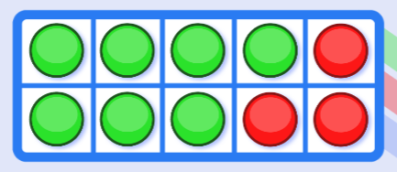
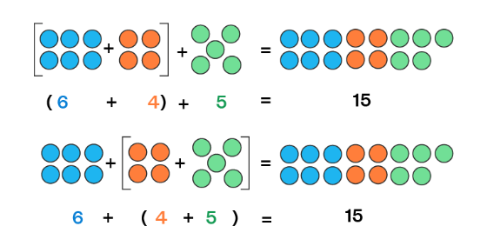
Commutative Property
https://ictgames.com/mobilePage/tenFrame/index.html
Associative Property

Slide 6
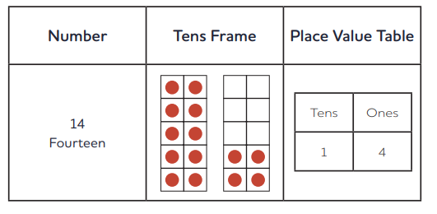

Slide 7
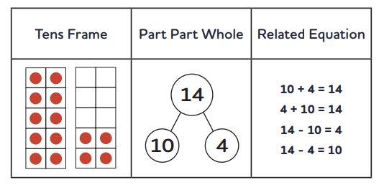

Slide 8
Bridging 10
7 + 5 =
Let’s try adding 7 + 5 using our ten frames.
Put 7 counters on your first frame.
How many empty spaces do you have?
Put 5 counters on the second frame.
Now let’s add. When we add, we put the counters together.
Do we have enough empty spaces for our 5 counters?
We’ll fill those spaces up with counters from our second frame. How many do we have in our first frame now?
And how many have we left on our second frame?
Our sum was 7 + 5. What is it now? (10 + 2 = 12). Now try using two frames to work out 8 + 5, 7 + 4, 9 + 4, 9 + 6.

Slide 9
Empty Number Lines
17 + 5 =
Can you use the number line to help you? How could you partition 17?

Slide 10
Reordering
This strategy is closely related to the commutative and associative properties of addition.
8 + 3 + 5 + 2.
which methods could we use?

Slide 11
Can you write the 8 fact families for : 21 + 34 = 55
Using relationships between numbers.
Fact families

