Slide 1
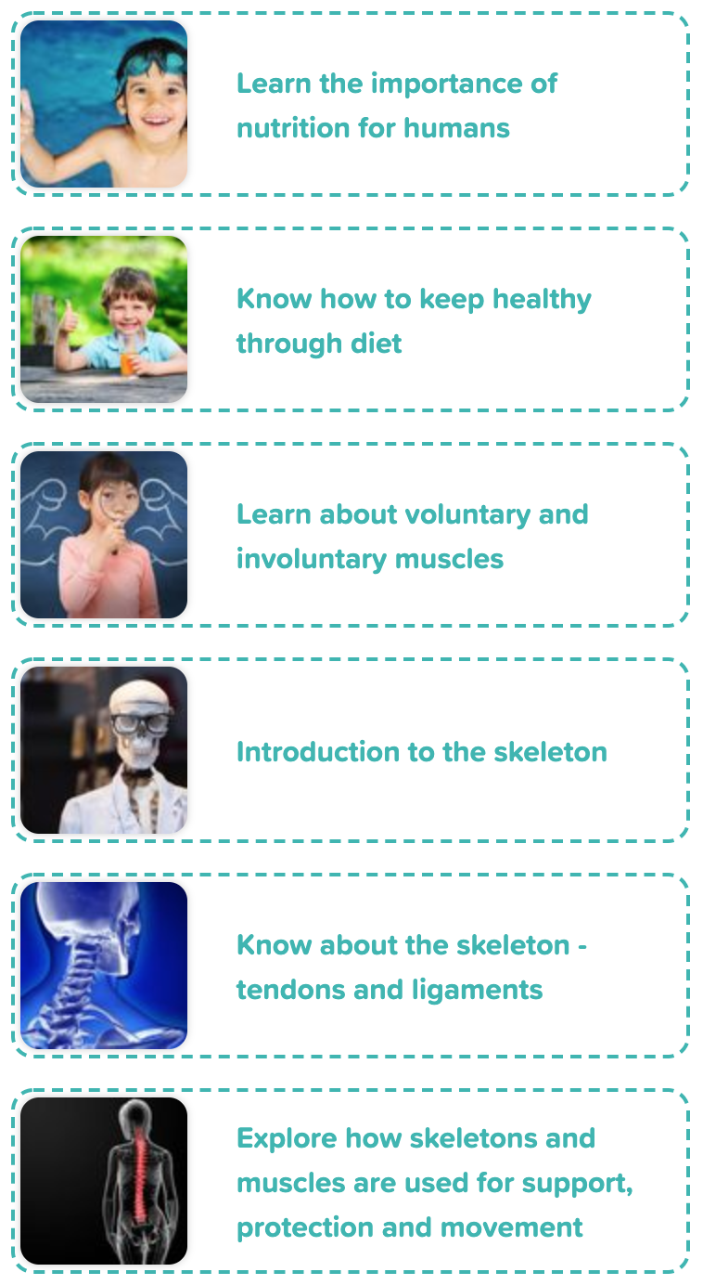
Year 3 Animals Including
Humans
Scientific Enquiry Covered | Rocket Words Covered | Name of Task / Tasks | Resources Needed | National Curriculum Reference | Summative Quiz Questions
Observing closely, using simple equipment | nutrition, vitamins, balanced diet, protein, carbohydrate | sk your peers what their favourite food groups are and create a bar graph. | Handout - Pages 1-4 | Describe the importance of exercise, eating the right amount of different types of foods, and hygiene. | Select the missing words in the text Being healthy is very important, and one of the ways to stay healthy is to eat food from all three major food groups. It is Select... to have good nutrition. One of the best healthy foods is Select... . Even if we can't get fruit fresh, we can get it in tins, it is still good for us. The most important thing is to have a Select...amount of all foods. Exercise is more important than a healthy diet. Sort these foods into good types of proteins and those which don't provide good proteins. What does the word 'vitamin' mean? Which of these functions do vitamins perform? (choose all that apply)
Identifying differences, similarities or changes related to simple scientific ideas and processes. | portion, food groups, balanced diet, vitamins, ingredients | Create a food diary. | Food Diary Handout Pencils | Identify that animals, including humans, need the right types and amount of nutrient, and that they cannot make their own food; they get their nutrient from what they eat. | Brown wholewheat pasta, bread and rice are more healthy than white pasta, bread and rice. When you eat healthily your body gets the Select... it needs to live well. It is important to eat from all the food Select..., but you should eat Select...the most, as well as Select... . You should avoid too many dairy products and Select... , sugary foods. Which of these are healthy foods and which are not healthy foods? What is it called when we eat the correct amount of a variety of foods? Name some good things about eating a healthy diet.
Reporting on findings from enquiries, including oral and written explanations, or presentation of results and conclusions. | involuntary muscles, voluntary muscles, biceps, triceps, hamstring muscle | Voluntary Muscles Test | handouts, Voluntary Muscles Tests, Stopwatch Eyelid Investigation Stopwatches Cotton wool Plastic sheets Protective goggles | Identify that humans and some animals have skeletons and muscles for support, protections and movement. | True or false: We can control all of the muscles in our body. Complete the sentence: When we smile, we use our _____ muscles. If a muscle is involuntary, it means that we {{can't}} control it. Our heart is an example. We know this is an involuntary muscle because it keeps beating when we are {{asleep}} and we cannot control its beating. Which of the pictures show voluntary muscles and which show involuntary muscles? What do voluntary muscles allow us to do?
Using straight forward scientific evidence to answer questions, or to support their findings. | skeleton, bones, skull, X-ray machine, rib cage | Construct and label the human skeleton | Modelling the Skeleton, Handout Bright coloured card, Scissors, Glue, Pen Bendy Bones, Jar , Vinegar, Chicken bones | Identify that humans and some animals have skeletons and muscles for support, protections and movement. | Our skeleton is made up of many bones. Some, like the rib cage are there to {{protect}} us. Others, like the spine are there for our posture and to {{support}} us. Our arms and legs each have {{three}} main bones in them, and make sure we can {{move}} properly. What functions does a skeleton perform? Which of these are bones in the leg? Which organs does the rib cage protect? Starting at the top of the body, and finishing at the base, put these bones in order of where they are in the human body
Reporting on findings from enquiries, including oral and written explanations, or presentation of results and conclusions | Achilles tendon, cartilage, marrow, ligament, tendon | Create a model of the human hand to show how tendons and ligaments enable movement | Card Straws Beads String Scissors Handout | Identify that humans and some other animals have skeletons and muscles for support, protection and movement | Tendons are strong fibres that attach...what? The largest tendon in your body is called...? Complete the statement: The largest {{tendon}} in the body is called the {{Achilles tendon}}, named after a heroic character in a story from a country called {{Greece}}. He died after being hit by an {{arrow}} in the {{heel}}, which is the part of the {{body}} where this {{tendon}}can be found. True or false: X-ray machines can see through your bones. True or false: Muscles help you move by pulling on your bones.
Reporting on findings from enquiries, including oral and written explanations, or presentation of results and conclusions. | support, protect, vertebrae, movement, contract and relax | Play a game of Body Bingo to test out your knowledge of the skeleton and muscles | Handout | Identify that humans and some animals have skeletons and muscles for support, protection and movement. | The main parts of our bodies which are known for protection are our ribcage and Select... . The ribcage contains Select... pairs of bones and they protect our heart and Select... . The skull is vital in protecting our Select... . True or False: Our bones couldn't move without muscles. Which of these functions is the spine most important for? Which of these doesn't have a skeleton? Which of these words explain the movement of skeletal muscles?
Developing Experts Year 3 National Curriculum Map September 2021

Slide 2
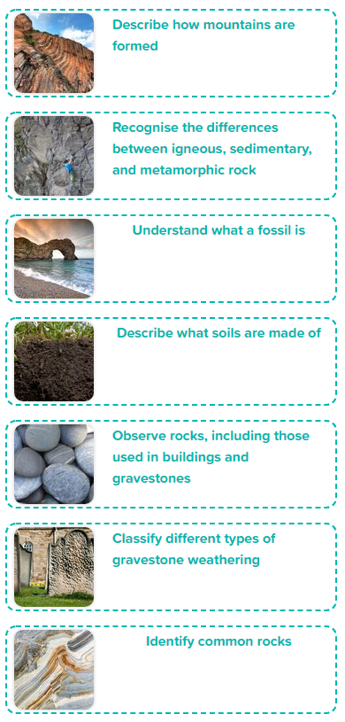
Year 3 Rocks
Scientific Enquiry Covered | Rocket Words Covered | Name of Task / Tasks | Resources Needed | National Curriculum Reference | Summative Quiz Questions
Communicating key concepts. | mountain, Europe, hill, Himalayas, Alps | Mountain Modelling | Scissors, Stiff card Coloured pens/ pencils/ paper, Other appropriate craft materials, Handout - Mission to Write! Mountain Storyboard. | Compare and group together different kinds of rocks on the basis of their appearance and physical properties. | Where are the mountains called the Alps? A mountain is made of rock and earth and rises above the land on which it sits. A mountain has to be over 600 metres tall or it would be called a hill. Which of these is a type of rock? Complete the statement: The Himalayas and {{Alps}} are both sets of {{folded mountains}} that were created when a huge force pushed parts of the Earth's {{crust}} upwards to form {{mountains}}. The Himalayas were once on the {{bottom of the ocean}}. Recognise what a folded mountain looks like.
Asking relevant questions and using different types of scientific enquiries to answer them. | metamorphic rock, igneous rock, sedimentary rock, magma, mineral | Make a sedimentary, igneous, and metamorphic rock using chocolate | dark chocolate, milk chocolate, white chocolate , grater , small grip seal bag , glass of hot water , paper , teaspoon, Handout | Compare and group together different kinds of rocks on the basis of their appearance and physical properties. | When a volcano erupts, it shoots out...? Complete the statement: Rocks are generally made of {{chemicals}} called minerals. {{Metamorphic}} rocks are made when a combination of {{heat}} and pressure causes great physical and chemical changes in {{some rock}}, transforming the look of the rock and even changing the {{minerals}} that were there in the first place. True or False: The word 'metamorphosis' means to change shape. Rocks made when magma from a volcano cools and becomes hard is called...? True or False: Limestone is made mostly of compressed bones and shells of millions of tiny creatures.
Identifying differences, similarities or changes related to simple scientific ideas and processes. | fossil, amber, Jurassic Coast, seashell, extinct | Exploring fossils | Fossil Challenge, Handout Make a Fossil in Amber , Water, Lemon or orange squash, Plastic spiders or insects, Plastic tubs, Freezer | Describe in simple terms how fossils are formed when things that have lived are trapped within rock. | What is a fossil? How long does it take for a fossil to form? Complete the statement: The {{Jurassic Coast}} is an area of coastline along the southern end of the {{UK}}. This area has become famous for the amount of {{fossils}} that have been found there. The poem She Sells {{Seashells}} on the Seashore is based on the life of Mary Anning, a lady who found thousands of fossils along this particular coastline. What does extinct mean? Which of these are fossils and which are not?
Using straightforward and scientific evidence to answer questions, or to support their findings. | peat, clay soil, chalky soil, sandy soil, texture | Soil Types Investigation | Four dry soil samples, Filter paper, Funnel, Beaker, Water, Hand washing facilities, Handout, Handout - Mission to Write! Soil Descriptions | Recognise that soils are made from rocks and organic material. | Which of these are types of soil? What is the process called that describes rocks being broken down into smaller pieces, that help make up soil? Complete the statement: The word '{{decompose}}' means to be broken down into smaller parts after {{death}}. After a while, and sometimes with help from {{decomposers}} such as flies, fungi and {{bacteria}}, the animals or plants {{rot}} away and leave {{nutrients}} behind, that enrich the soil they were laying in. True or false: Clay soil is thin and water pours easily through it. What is manure?
Using straightforward and scientific evidence to answer questions, or to support their findings. | lichen, acid rain, chemical weathering, physical weathering, biological weathering | Identifying Rocks | Identifying Rocks Handout, Rock Audit Handout a visit to the local cemetary or a photo of the local cemetery | Recognise that soils are made from rocks and organic material. | What are gravestones? What sort of things can make a gravestone wear down? Complete the statement: {{Physical}} weathering is when water from rain gets into {{cracks}} in a rock such as a {{gravestone}}, the water freezes, expands (because when water freezes it {{gets bigger}} than when it was a liquid), then this makes the crack in the rock become even {{bigger}}. {{Chemical}} weathering is when things in the air like pollution from {{factories and cars}}, or acids within rain, attack the {{surface}} of the rock and wear it away. Which of these shows weathering on a gravestone, and which shows no sign of weathering? What effects can weathering have on a gravestone?
Set up simple practical enquiries, comparative and fair tests | marble, sandstone, limestone, flake, granite | Test rocks for absorbency | Rock Absorbency, range of rocks, magnifying glass, bucket of water handout, Graveyard Visit, Handout, Pen, Camera (optional), Gravestone Design, Handout, Pen / pencils Books / internet for research | Compare and group together different kinds of rocks on the basis of their appearance and sample physical properties. | Sometimes cracks in rocks build up {{soil}} in them. This allows some types of plant to grow in the crack in the rock. The plants {{roots}} makes the cracks wider as the plant grows. This is an example of {{biological}} weathering. Limestone weathers over time when slightly acidic rainwater falls on it. The fossils of extinct animals are sometimes found on a gravestone when weathering has worn away part of the surface. What does extinct mean? Which of these are rocks and commonly used in gravestones? What kind of rock is sandstone?
Grouping and classifying. | sandstone, marble, slate, granite, grain size | Identifying Rocks | Download handouts, plans and more Samples of granite, sandstone, marble, and slate. Handout | Compare and group together different kinds of rocks on the basis of their appearance and simple physical properties | Which of these images show granite and which show marble? Select the missing words in the text Marble has many different uses. Blocks of marble are used to make Select... and Select.... Crushed marble is used in Select... , some cleaning products, and some Select.... Which is a sedimentary rock? Granite is usually more than one colour because it is made of different minerals. What colours from the list below can be found in granite? Rocks were a common building material in the past, but which materials have replaced them?
Developing Experts Year 3 National Curriculum Map September 2021

Slide 3
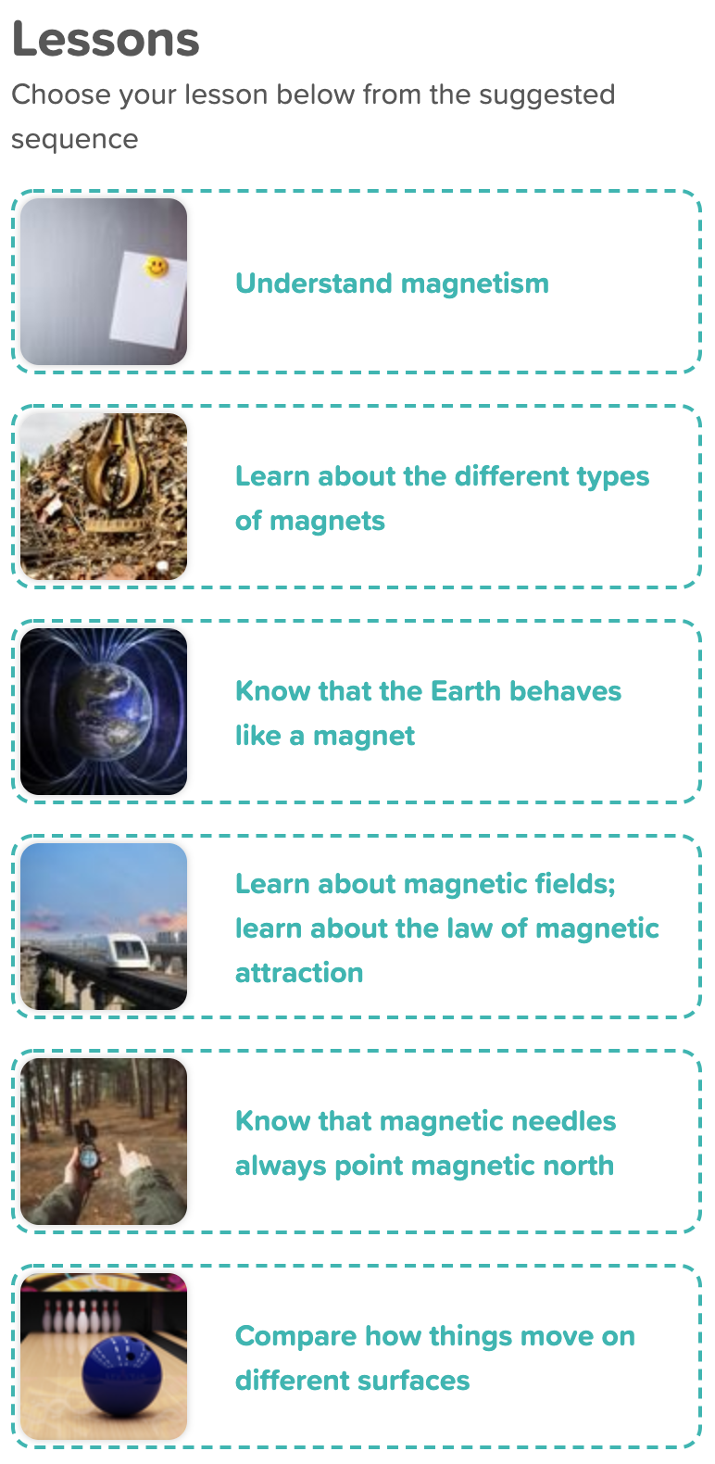
Year 3 Forces and Magnets
Scientific Enquiry Covered | Rocket Words Covered | Name of Task / Tasks | Resources Needed | National Curriculum Reference | Summative Quiz Questions
Gathering, recording, classifying and presenting data in a variety of ways to help in answering questions | lodestone, iron, ore, attract, magnetic strip | Testing magnetic materials | Testing Magnetism , 1 magnet per child/pair, A selection of materials to test i.e. card, sponge, rubber etc. It is a good idea to include paperclips, iron nails as examples of magnetic, materials but also include aluminium foil to show not all metals are magnetic. Handout | Compare and group together a variety of everyday materials on the basis of whether they are attracted to a magnet, and identify some magnetic materials. | What kind of magnet is this? Complete the statement: A magnet has an {{invisible}} force around it, that pulls other types of metal towards it. It only works on metals that have {{iron}} in them. It doesn't work on things like {{paper}}, {{plastic}}, {{cloth}}, or {{gold}}. True or false: There is a naturally magnetic stone called a loadstone. Name some places in which magnets are found. True or false: Magnets can pick up paperclips.
Reporting on findings from enquiries, including oral and written explanations, displays or presentation of results and conclusions. | bar magnet, cow magnet, horseshoe magnet, disc magnet, flexible magnet | Identifying differences, similarities or changes related to simple scientific ideas and processes. How magnets repel and attract. | Handouts, plans Comparing Magnets, A selection of different types of magnets, i.e. bar magnet, horseshoe magnet, ring magnet, disc magnet, sphere magnet. | Observe how magnets attract or repel each otters and attract some materials and not others. | True or false: A sheep magnet is used by farmers to help prevent illnesses in sheep. What does this picture show? Where are the magnetic forces strongest on a bar magnet? What are the poles called on a magnet? True or false: Cow magnets are used to are used to remove sharp metal objects out of a cow's stomach (something they have eaten accidentally).
Making systematic and careful observations. | North Pole, magnetic field, molten rock, compass, solar radiation | Complete an orienteering challenge using a compass! | Handouts, Orienteering Challenge Handout, Print Outs of chosen symbols, Map of School, Compass, Pen, Paper, Magnetic Investigation, Variety of magnets - bar magnet, horseshoe magnet etc. Investigation Sheet | Observe how magnets attract or repel each other and attract some materials and not others; describe magnets as having two poles, predict whether two magnets will attract or repel each other; depending on which pole are facing. | What is a 'summary'? Why does a compass point to the Earth's North Pole? True or false: A magnet will point towards the Earth's North Pole nearly all the time. Complete the statement: Molten {{iron}} moving around inside the {{Earth}} is what creates the magnetic field that surrounds it. Molten means {{melted}}. Some {{birds}} can sense the magnetic field as they {{fly around}} and it helps them {{go}} in the right {{direction}}. True or false: Pigeons can see magnetic fields that are around the Earth.
Making systematic and careful observations | attract, repel, propulsion, Maglev train, high speed train | Magnetic Shielding | Handouts, Magnetic shielding , paperclip, thin thread, something to hold the magnet, Selection of magnetic and non magnetic materials | Observe how magnets attract or repel each other and attract some materials and not others; describe magnets as having two poles, predict whether two magnets will attract or repel each other; depending on which pole are facing. | True or false: A Maglev train is one that uses magnets to pull it down hard onto the train track. What happens when you take two bar magnets and bring both their north pole ends together? Complete the statement: The Maglev {{train}}, which can be found in {{China}} gets its name from the words '{{magnet}}' and 'levitation' (which means {{to lift}} into the air without touching). It can travel at speeds up to {{600}} km/h (kilometres per hour). This can be done by having {{north pole ends of}} magnets on the train and on the track. The Earth's magnetic forces is strongest at..? True or false: Propulsion is when something is pushed forwards.
Making systematic and careful observations, using a range of equipment. | compass, magnetic needle, direction, orienteering, Magnetic North | Make a leaf compass | Making a Compass Needle (magnetic) - can use a paperclip instead Magnet Small leaf Dish of water Handout | Observe how magnets attract or repel each other and attract some materials and not others; describe magnets as having two poles, predict whether two magnets will attract or repel each other; depending on which pole are facing. | What has a magnet in it and helps us find which way to go? True or false: A compass will point either north or south. If you face the way the needle of a compass is facing, what direction is behind you? Name some people that use compasses. Complete the statement: There are two North Poles. One is the {{geographic}} North Pole. This one is the place that is simply the most northern part of the {{world}}. The second is the {{magnetic}} North Pole, and this is where the {{magnetic field}} in the northern part of the Earth is at its {{strongest}}.
Using straightforward scientific evidence to answer questions or to support their findings. | direction, surface, pendulum, tilt, friction | Have a go at seeing how objects slide over different surfaces! | Handout toy boat (or wooden block) thick books, stopwatch cardboard/wooded ramp, a selection of materials e.g. bubble wrap, cling-film, paper, felt, sandpaper | Compare how things move on different surfaces. | What is a pendulum? Which type of floor will a ball roll quickest on? Complete the statement: The distance an object travels depends on what the object {{looks like}}, what it is {{made of}}, how {{heavy}} it is, how {{hard}} a {{force}} is used, what it needs to travel {{through}}. True or false: When you go tenpin bowling, you have to throw a light ball down a wooden lane to try to knock over some skittles. The lightness of the ball makes it easy to knock the skittles over. What happens if you apply a force to an object that is already moving?
Developing Experts Year 3 National Curriculum Map September 2021

Slide 4
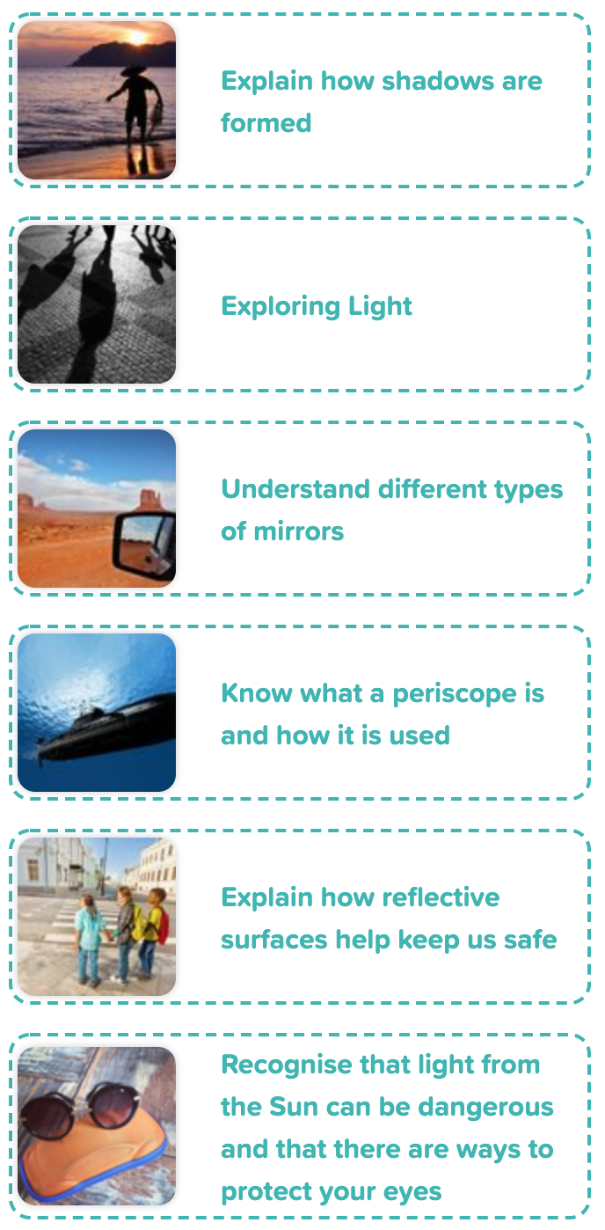
Year 3 Light
Scientific Enquiry Covered | Rocket Words Covered | Name of Task / Tasks | Resources Needed | National Curriculum Reference | Summative Quiz Questions
Using results to draw simple conclusions. | position, intermediate, sundial, clockwise, indirectly | Shadow stick investigation | Shadow Stick Investigation, A3 white paper or larger Wooden skewer, toothpicks or weight to hold down the paper, pencil, watch/clock Handout | Know how to measure shadows, and find out how they are formed, and what might cause the shadows to change. | Shadows are formed when the shape of an {{opaque}} object {{blocks}} a source of light. The light is stopped from {{travelling}} further by the solid object, and a {{dark}} area that is the same shape as the object appears behind it. Shadows are always {{bigger}} than the object that forms them. A sundial tells you what the weather is going to be like? Which of these are sources of light? Light cannot pass through a dictionary. Why is this? At what times of day are outside shadows longest? Find 2 answers.
Ask relevant questions and use different types of scientific enquiries to answer them | transparent, opaque, light, torch, shadow | Make a Shadow Puppet. What questions can you ask and what can you do to explore how to answer your questions? | Lamp Sticky tape Pencils Scissors Lollipop sticks White wall Handout printed onto card | Recognise that shadows are formed when the light from a light source is blocked by a solid object. | When you push a light switch, the light comes on very quickly. Why is this? Light travels in a straight line. Is this true or false? What happens if you shine a torch against a wall in a dark room, then put your hand in the beam of light? Find 3 correct answers. Light travels very {{fast}}. Blink your eyes {{3}} times. Light can travel to the {{the Moon}} and back in that time. Which images are of opaque items and which are of transparent items. These words have opposite meanings, let that help you decide which picture goes where.
Using result to draw simple conclusions, make predictions for new values. | mirror, concave, convex, reflection, telescope | Draw the reflections seen in different types of mirrors | Reflection Sketching flexible plastic mirror handout page 1, Pencil, Mirror Investigation handout page 2, mirror pencil & paper, torch Mission to Write Handout - Mirror Writing | Notice that light is reflected from surfaces. | A plane mirror... Find 3 answers to end this sentence. How would you see the word 'light' if it was reflected in a plane mirror? True or false: A telescope can help you see things that are very small. Choose all the options that are correct. Complete the statement: A concave mirror curves {{inwards}} like a {{spoon}}. A concave mirror makes things look {{smaller}} than they actually are. A convex mirror curves {{outwards}} like a {{ball}}. A convex mirror makes things look {{bigger}} than they actually are.
Using results to draw simple conclusions, make predictions for new values. | periscope, submarine, parallel, viewer, enlarge | Up Periscope! Record findings using simple scientific language, drawings, and labelled diagrams to draw the path light travels through your periscope | Make a Periscope Cardboard (or juice cartons) Duct tape Scissors Small mirrors Paints, papers, etc. for decoration. Handout | Notice that light is reflected from surfaces. | Where are or were periscopes most commonly used? Find 3 answers. True or false: The angle of the mirrors in a periscope is 75º. What type of mirrors are used in a periscope? Which of these can a periscope do? Complete the statement: A mirror reflects {{light}}. Light travels very {{fast}} in a straight line. Light reflecting off the two mirrors in a {{periscope}} allows people to see in {{a different}} direction to the one in which they are looking.
Reporting on findings from enquiries, including oral and written explanations, displays or presentations of results and conclusions. | reflective material, road safety, fluorescent, dark, hi-vis | Exploring reflective and non-reflective materials | handout foil glue stick clear stick tape card Mission to Write - Reflective Safety Handout | Recognise that they need light in order to see things and that dark is the absence of light, and notice that light is reflected from surfaces. | Put these steps in order to show how to safely cross the road. What is reflective material? Which of these should you do when you are out and about at night? Find 3 answers. Complete the statement: When you wear a {{reflective}} material at night, the {{headlights}} of a passing car will reflect off the material and make that material {{visible}}. When the driver of the car can see the {{visible}} material, they can see you, too. For safety, {{be seen at night}}. Which of these reflects light, and which do not reflect light?
Setting up simple practical enquiries, comparative and fair test, making accounts measurements, using standard units, using a range of equipment, for example thermometers and data-loggers. | ultraviolet rays, calcium, sunglasses, sunburn, sun protection factor | Investigate the effect Sun protection has on UV beads | UV Investigation UV beads - that all turn the same colour (4 per group) sun protection - with at least 3 different SPF values black paper sticky tack plate handout | Recognise that light from the sun can be dangerous and there are ways to protect the eyes. | Which is the main vitamin that we get from the Sun? Which things would you choose to use on a sunny day? Which things would you choose to use on a snowy day? What does SPF stand for? Complete the statement: {{Sunglasses}} are important to wear on {{sunny}} days. They protect eyes from the {{ultraviolet}} light from the Sun, which can burn eyes and skin. They also help people {{see}} better in the bright light. If you look into someone's sunglasses you can see yourself looking back. Why is this?
Developing Experts Year 3 National Curriculum Map September 2021

Slide 5
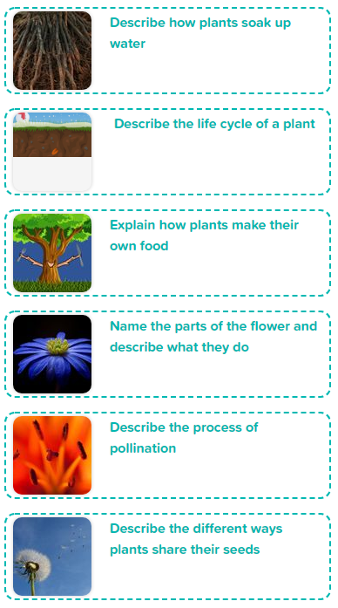
Year 3 Plant Life Cycles
Scientific Enquiry Covered | Rocket Words Covered | Name of Task / Tasks | Resources Needed | National Curriculum Reference | Summative Quiz Questions
Recording findings, using simple scientific languages, questions, labelled diagrams. | root, root hair, absorb, anchor, store | Drawing roots | onions cocktail sticks glasses magnifying glasses. | Explore the parts that flowers play in the life cycle of flowering plants; including pollination, seed formation and seed dispersal. | Roots are always found underground. Roots grow closely to the plant. Root hairs absorb water and minerals from the soil. Sort the images of roots from the others. What jobs do the roots do?
Oral and written explanations, displays or presentations of scientific concepts. | pollination, fertilisation, germination, dispersal, reproduction | Model the life cycle of a plant | handouts, paper coloured pens/ pencils presentation software (optional) | Explore the parts that flowers play in the life cycle of flowering plants; including pollination, seed formation and seed dispersal. | Put these processes in order starting from when a seed is planted. Plants depend on pollinators to reproduce. Plants start life as a seed or bulb which Select... and beings to grow. The plant sends up a shoot to the surface to Select... . Eventually the plant grows a flower to help it Select... . Insects are often used in Select... to help the plant move its pollen around.
Recording findings, using simple scientific languages, questions, labelled diagrams. | photosynthesis, chlorophyll, UV light, carbon dioxide, glucose | Let there be Light! | 2 potted plants (geranium or basil) magnifying lenses Handout | Explain the part that flowers play in the life cycle of flowering plants, including roots, stem/trunk, leaves, and flowers. | Why do many plants look green? T/F Photosynthesis is important to all life on Earth. Which of the following is needed for the photosynthesis reaction? T/F Plants photosynthesise all the time For the photosynthesis reaction to occur {{water}} travels up the xylem from the {{roots}} to the leaves of the plant. A gas called {{carbon dioxide}} enters the leaves through tiny holes. {{UV light}} from the Sun is trapped by {{chlorophyll}} in plant leaves. The reaction produces {{oxygen}} gas and {{glucose}}.
Recording findings, using simple scientific languages, questions, labelled diagrams. | anther, stigma, petal, style, filament | Build a model flower and label the key parts. Explain what each part is used for. | Handout, Coloured paper, Scissors, Glue, Pipe cleaners, Modelling clay, Flowers | Explore the parts that flowers play in the life cycle of flowering plants; including pollination, seed formation and seed dispersal. | Which part of a plant produces pollen? Sort these flower parts into male and female parts. The sepals protect the flower bud as it is growing. Flowers are used for... Pollen is made on the {{anther}} which is held up by the {{filament}}. The is collected on the {{stigma}} which has a {{sticky}} surface. The {{style}} holds up the stigma. The {{petals}} are used to attract insects to the flower.
Presenting learning and knowledge in a dance or drama | nectar, pollination, pollen, pollinator, waggle dance | Show how pollen is collected. | Handout | Explore the part that flowers play in the life cycle of flowering plants, including pollination, seed formation and seed dispersal | T/F Bees are attracted to a flower's pollen. The process of Select... is when a Select... moves Select... from one plant to another. Which of these are pollinators? How do bees collect pollen? How do bees communicate with each other?
Recording findings, using simple scientific languages, questions, labelled diagrams | sycamore, wind dispersal, water dispersal, animal dispersal, explosion dispersal | Seed dispersal investigation | scissors. paperclips Handout stopwatch tape measure | Explore the parts that flowers play in the life cycle of flowering plants; including pollination, seed formation and seed dispersal. | Sort these seeds into those dispersed using animals and those dispersed using wind. Plants want to keep their seeds near them. Plants are stuck to the same spot all the time so they use different ways to Select...their seeds. Plants try to get their seeds Select..., to grow into new plants. Seeds can be carried for short distance by being blown Select...or long distances by floating Select... and being carried Select... Which of the following can be used to disperse seeds? Which of the following helps a coconut tree distribute its seeds? Which of the following are ways plants disperse their seeds? (choose all that apply)
Developing Experts Year 3 National Curriculum Map September 2021

Slide 6
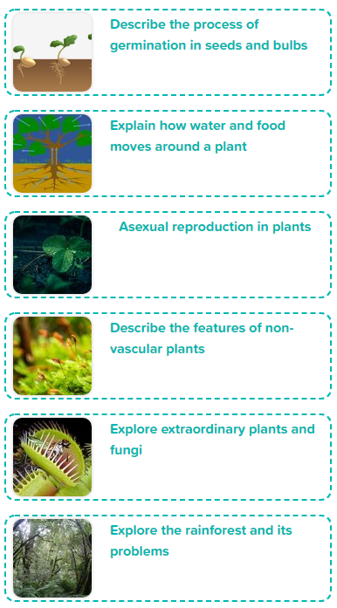
Year 3 Exploring the World of
Plants
Scientific Enquiry Covered | Rocket Words Covered | Name of Task / Tasks | Resources Needed | National Curriculum Reference | Summative Quiz Questions
Setting up simple practical enquiries, comparative and fair tests | seed, bulb, germination, shoot, sapling | Describe how seeds and bulbs change during germination | Handout, plastic cups cotton wool seeds (cress, radishes, and peas work very well) magnifying glass (optional) | Explore the parts that flowers play in the life cycle of flowering plants; including pollination, seed formation and seed dispersal. | What is the name of the process when a seed breaks open and begins to grow? Sort these stages of plant growth from youngest to oldest. Plant bulbs have a hard shell. Seeds and bulbs contain a large store of... {{Germination}} is the process when a seed begins to grow. To begin the seed absorbs a lot of {{water}} and begins to swell. Then it cracks open and {{roots}} grow out to anchor it and absorb more water. Next the seed sends up a {{shoot}} to the surface. when it grows above ground it uses its {{leaves}} to photosynthesise.
Recording findings, using simple scientific languages, questions, labelled diagrams. | transpiration, xylem, phloem, vascular, stomata | Examine xylem & phloem | celery - with leaves glass sharp knife food colouring (red) white flower - daisy (optional) | Identify and describe the functions of different parts of flowering plants: roots, stem/trunk, leaves and flowers | More transpiration occurs on windy days. Water and minerals enters the plant through the Select.... The plant then moves Select...through the Select...and water and through the Select..., these are found in the Select.... Water then exits the plants through the Select... in a process called Select.... Sort these parts of the plants into the order water travels through them. Where do plants get their water from? Which of the following are found in all vascular plants? (choose all that apply)
Recording findings, using simple scientific languages, questions, labelled diagrams. | asexual reproduction, runner, clone, eye (potato), parent (plant) | Creating a guide to asexual reproduction | Handout, paper colouring pens/ pencils potato/ strawberry seed packets (optional) | Explore the parts that flowers play in the life cycle of flowering plants; including pollination, seed formation, and seed dispersal. | What does asexual reproduction mean? Which of the following are methods of asexual reproduction. Strawberries reproduce by sending out a... Potatoes reproduce through a process called... Plants can be cloned from...
Asking relevant questions and using different types of scientific enquiries to answer them | non-vascular, moss, spores, moist, liverwort | Investigate moss | Handout Sample pots Moss | Explain the part that flowers play in the life cycle of flowering plants, including pollination seed formation Identify and describe the functions of different parts of flowering plants: roots, stem/trunk, leaves and flowers | Mosses reproduce using Select.... Male mosses produce Select..., that swims to the female plant in Select.... At the female plant the sperm fertilise the female plant's Select... . Non-vascular plants grow bigger than vascular plants. Non-vascular plants reproduces using...Choose 1 answer Which of the following features do non-vascular plants NOT have? Which of the following are non-vascular plants?
Recording findings, using simple scientific languages, questions, labelled diagrams. | fungi, Venus flytrap, insectivorous, pitcher plant, extraordinary | Venus fly trap model | Handouts, paints (red and green), paper plate, small pieces of paper or stick notes scissors, glue or sticky tape, green paper | Explore the parts that flowers play in the life cycle of flowering plants; including pollination, seed formation and seed dispersal. | What is an insectivorous plant? Which of the following are insectivorous plants? Touching what part of the Venus flytrap causes it to close? Insectivorous plants attract insects using... Mushrooms are a type of...
Recording findings, using simple scientific languages, questions, labelled diagrams. | rainforest, biodiversity, deforestation, poaching, pollution | Save the rainforest campaign | Handouts, Optional: books/internet research presentation / film-making software | To identify that most living things live in habitats to which they are suited and describe how different habitats provide for the basic needs of different kinds of animals and plants, and how they depend on each other. | What is a rainforest? Which of these are problems that the rainforest faces? Which of the following are made from things in the rainforest? The rainforest makes 20% of the world's... T/F The rainforest faces problems, but these can be stopped if people help
Developing Experts Year 3 National Curriculum Map September 2021

