Slide 1
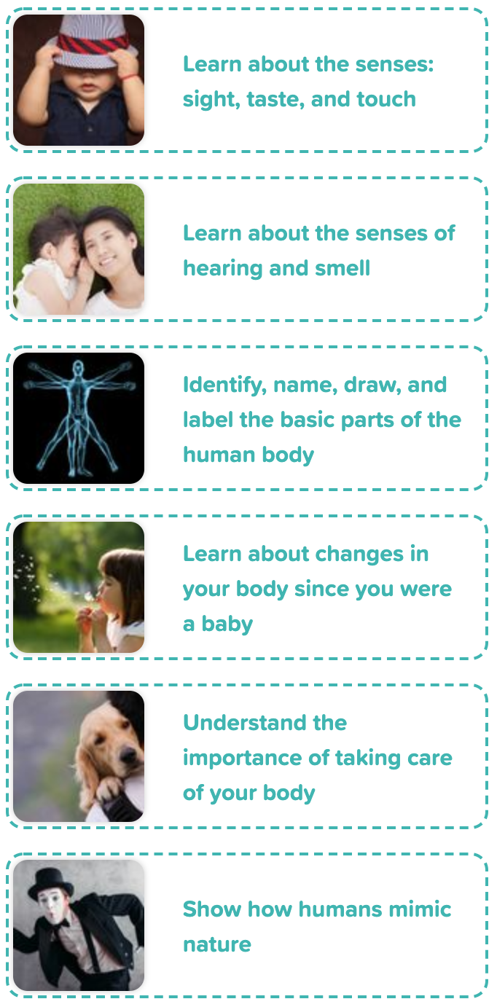
Year 1 Animals Including Humans
- About Me
Scientific Enquiry Covered | Rocket Words Covered | Name of Task / Tasks | Resources Needed | National Curriculum Reference | Summative Quiz Questions
Grouping and classifying | senses, eyes, sight, taste, touch | Describe the touch and taste of different food items. | Sense Test Range of food items e.g. fruit Bowl Blindfold, Shape Drawing Challenge Handout / Paper, Pencil, Blindfold | Identify, name, draw, and label basic parts of the human body, and say which part of the body is associated with each sense. | We see with our..? We taste with our..? We see with our {{eyes}} and we {{feel}} with our touch. True or false: Cats see better in the dark than humans. A kitten is soft. What sense would you use to find out if this was true?
Grouping and classifying | senses, ear, hearing, smell, nose | Smell Challenge. | Sensory Walk Handout Smell Challenge Trays/Cups Different aromatic objects (fruit, coffee, cakes, oranges, etc.) Blindfolds. | Identify, name, draw, and label basic parts of the human body, and say which part of the body is associated with each sense. | Which smells are pleasant? Another word for smell is {{aroma}}. True or false: Lemons taste sweet. True or false: Dogs can find people who are lost using their sense of smell. Can you name the 5 senses?
Identifying and classifying. | head, organs, torso, arm, legs | Complete a test which looks for patterns between how far someone can jump, and the length of their leg. | Tape Measure Paper Pens Standing Jump Handout | Identify, name, draw and label basic parts of the human body and say which part of the body is associated with each sense. | Our arms and legs are known as 'limbs'. Our skull protects our heart and lungs. We have over 200 bones in our body. Our body is held together by our {{skeleton}}, which is a group of {{bones}}. This includes the {{skull}} which protects our brain, our torso and our {{limbs}}, which include arms and legs. Which of these does the skeleton not do?
Make observations and to suggest answers to questions. Make cress heads to see how they change over time. | baby, food, grow, hair, teeth | Track how you have changed over time by using photos old and new! | Growing Up Photos (parents may need contacting in advance), Camera Handout, Cress Head Cress seeds, Compost Big pot to mix seeds and compost, Trowel, Tights or pop socks, Scissors, Plant pots, Markers, Watering can | Identify, name, draw and label basic parts of the human body and say which part of the body is associated with each sense. | Picture sorting exercise. Who checks a baby when they are born? True or false: Babies have teeth when they are born.
Asking simple questions and recognising that they can be answered in different ways. | exercise, cleanliness, healthy, food, rest | Group and classify by creating your own hot school dinner menu for a week. | Handout Glue Scissors | Identify, name, draw and label basic parts of the human body and say which part of the body is associated with each sense. | Exercise is so important because it keeps us..? To keep clean we need to {{wash}} our bodies and {{hair}} and {{clean}} our teeth. What do we need for washing? Choose which of these activities will keep you healthy. When we get enough sleep and eat the right foods our body and senses are more alert and responsive. Which of these sentences are true?
Using observations and ideas to suggest answers to questions | mimic, design, burr, designer, sonar | Design a piece of bicycle equipment, which is inspired by nature. | Handout | Identify, name, draw and label basic parts of the human body and say which part of the body is associated with each sense. | True or false: There is a train that has a nose that looks like the beak of a kingfisher bird. People who come up with ideas for new things are called..? In 1912, a huge ship called the {{Titanic}} sank after hitting an {{iceberg}}. Where could you find a hook and loop fastener? True or false: Designers get many of their ideas from nature.
Developing Experts Year 1 National Curriculum Map September 2021

Slide 2
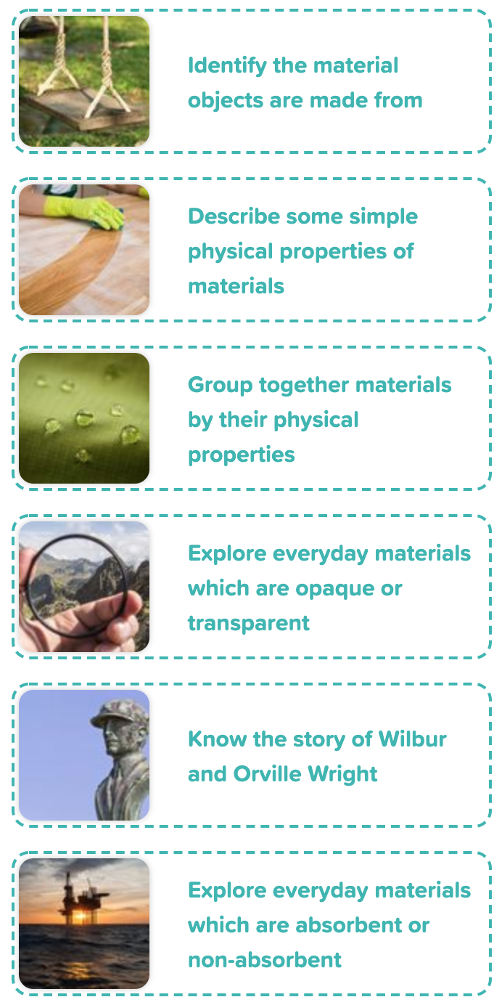
Year 1 Exploring Everyday
Materials
Scientific Enquiry Covered | Rocket Words Covered | Name of Task / Tasks | Resources Needed | National Curriculum Reference | Summative Quiz Questions
Identifying and classifying. Gathering and recording data to help in answering questions. | glass, plastic, metal, cardboard, wood | Use a 'Venn Diagram' to organise objects depending on the material they are made from. | Venn Materials Range of objects made from different materials 'Hula Hoops' (optional) Handout (optional) | To describe the simple physical properties of a variety of everyday materials. | Ceramic tiles are made of Select... . You can buy them in all sorts of Select... . You may have some in your kitchen or bathroom on the Select... . Which of these are made of fabric and which of these are made of metal? What does 'brittle' mean? Which of these would be the best material to make a swing out of? What does 'pull' mean?
Identifying and classifying; Observing closely using simple equipment | twist, transparent, opaque, sponge, squeeze | Exploring everyday materials! | Properties of Materials Paperclip, sponge paper, tennis ball or similar rubber band, pencil, small cup a water, These can be arranged around the room or put as a pile on each table. Handout | To describe the simple physical properties of a variety of everyday materials. | What does opaque mean? Which of these things are made of paper? What materials can a spoon be made of? How often should you clean your teeth? True or false: A sponge will soak up water.
Using observations and ideas - suggest answers and questions. | light, flexible, float, sink, rigid | Sort materials and take the Silly Sally challenge! | Materials Sort A range of objects Handout Silly Sally Challenge Handout | To identify and name a variety of everyday materials, including wood, plastic, glass, metal, water, and rock. | Which of these items are waterproof? Put these items into groups based on their colour. Items which are light or {{hollow}} will often float on water. On the other hand, items which are {{dense}} such as metal, {{sand}} and rocks will usually sink. What does 'waterproof' mean? Is cloth rigid or soft?
Performing simple tests | translucent, clear, transparent, frosted, opaque | Transparent, translucent or opaque investigation. | Opaque/Transparent Investigation, White paper Torches, Shapes cut from card (square, triangle, star, circle), Spring clothes peg or strong paperclip, Book, Objects made of transparent, translucent and opaque materials, Handout | Describe the simple physical properties of a variety of everyday material Explore properties such as: hard/soft; stretchy/stiff; shiny/dull; rough/smooth; bendy/not bendy; waterproof/not waterproof; absorbent/not absorbent; opaque/transparent. | The window in many bathrooms is...what?..so that light can pass through, but people cannot see in. A brick wall is ...what?.. so that you cannot see through it at all. True or false: A tree trunk is opaque. True or false: The human body is transparent. True or false: A car windscreen is translucent.
Performing simple tests. Carrying out simple tests. | aeroplane, flight, Wilbur Wright, Orville Wright, design | Fly different paper aeroplanes, and time how their flights, to choose the best design. | Paper Aeroplane Testing A4 paper, Tape measure Stopwatch, Safe space in which to throw paper planes Aeroplane Drag Challenge A4 paper, several sheets per child, Scissors, Paperclips Rulers, Handout | To describe the simple physical properties of a variety of everyday materials. | People fly by using feathers. Complete the statement: Two brothers called Orville and Wilbur {{Wright}} were the first to invent an aeroplane that {{flew}}! What is a glider? True or false: Over 100 years ago, Orville Wright flew the first aeroplane for the first time for a total of 12 seconds. What was the name of the first plane flown by Orville Wright?
Performing simple tests - Carrying out simple tests | sponge, absorb, swell, non-absorbent, oil spill | Explore the absorbency of different materials. | Absorbency Test , A bowl or tub of water, Strips of the following materials (approximate 1cm x 10cm) - toilet paper, kitchen paper, white paper, craft paper, felt/ cloth, ruler, food colouring (optional), Handout | To compare and group together a variety of everyday materials on the basis of their simple physical properties. | What is an oil spill? True or false: A wet sponge will absorb (soak up) more water than a dry sponge. True or false: An oil tanker is a type of boat that carries oil from one place to another over the oceans. Complete the statement: Cotton {{absorbs}} oil but not {{water}}. This is why it is a good fabric to use when soaking up oil spills in the {{ocean}}. Which of these is absorbent?
Developing Experts Year 1 National Curriculum Map September 2021

Slide 3
Year 1 Uses of Everyday
Materials
Scientific Enquiry Covered | Rocket Words Covered | Name of Task / Tasks | Resources Needed | National Curriculum Reference | Summative Quiz Questions
Identifying and classifying | magnet, magnetic force, pull, motor, microphone | Explore different materials to find out if they are magnetic. | Magnets in Objects Objects that contains magnets (optional) Video Handout | To identify and name a variety of everyday materials, including wood, plastic, glass, metal, water, and rock. | True or false: A paperclip is magnetic. True or false: A book is magnetic. True or false: Paper is magnetic. Which of these are magnets? Complete the statement: A horse can {{pull}} a cart.
Observing closely using simple equipment | wood, plastic, paper, can, material | Observe various items and describe them to understand what material they are made from. | Where Did It Come From? Five items (students choose) Handout | To describe the simple physical properties of a variety of everyday materials. | Recycling means to make something new out of things that have been used before. All materials come from nature, for example paper is made from Select... , glass is made from Select... , and metals are taken out of special types of Select... . Which of these can be recycled? Trees are made of..? What things can you find in a can?
Using ideas to suggest answers to questions. Using ideas to suggest answers to questions. | material, property, fabric, metal, glass | Look at the Handout for examples of different objects and pick which material is best suited for the job. | Which Material is Best Handout Mr Moody's Bad Day Video | To describe the simple physical properties of a variety of everyday materials. | How many sides does a triangle have? True or false: A triangle is the strongest shape. Which of these would be a good material for a bridge? Complete the statement: A beam bridge is made of {{towers}} that have boards across them to make the road. Some {{bridges}} are over 2 thousand metres long! Who or what uses bridges?
Identifying and classifying | iron, non-magnetic, magnetic, steel, copper | Testing magnetism | Testing Magnetism, 1 magnet per child/pair, A selection of materials to test i.e. card, sponge, rubber etc. It is a good idea to include, paperclips, iron nails as examples of magnetic, materials but also include aluminium foil to show not all metals are magnetic. Paperclip Challenge, Horseshoe magnets, Paperclips, Handout | To identify and name a variety of everyday materials, including wood, plastic, glass, metal, water, and rock. | Which of these objects are magnetic? Complete the statement: Some magnets are shaped like a {{horseshoe}}. True or false: All metal is magnetic. True or false: Some magnets are flat. True or false: Magnets can be used to pick up aluminium cans.
Identifying and classifying. | north pole, south pole, magnetic field, repel, attract | Does it make a difference if your needle has a greater strength of magnification? | Observing Attraction and Repulsion 2 bar magnets per group 2 books per group piece of string Handout | To identify and name a variety of everyday materials, including wood, plastic, glass. metal, water and rock. | The north and {{south}} poles of a magnet will {{attract}} each other. Repel means to pull towards you. Magnets can be used to pick up metal objects. Some tools have magnets in them. When people get lost they use this to find their way.
Performing simple tests. Carrying out simple comparative tests. | suspension bridge, cable, man-made material, natural material, bamboo fibre | Using recycled materials, who can build the strongest bridge? | Build a Bridge Challenge Recycled / craft materials i.e. Straws Sticky Tape Cardboard Pipe cleaners Books Weights or coins (must all be the same size) Investigation sheet Handout | To describe the simple physical properties of a variety of everyday materials. | Name some natural materials (things made or taken from nature). True or false: Bamboo is a plant. Complete the statement: A suspension bridge has tall towers and lots of {{cables}} (like a thick rope) to help hold the road up. Cables are sometimes made of bamboo fibre but mostly made of steel, which is a human-made {{metal}}. Name 2 types of bridge. True or false: Steel is a human-made material.
Developing Experts Year 1 National Curriculum Map September 2021

Slide 4
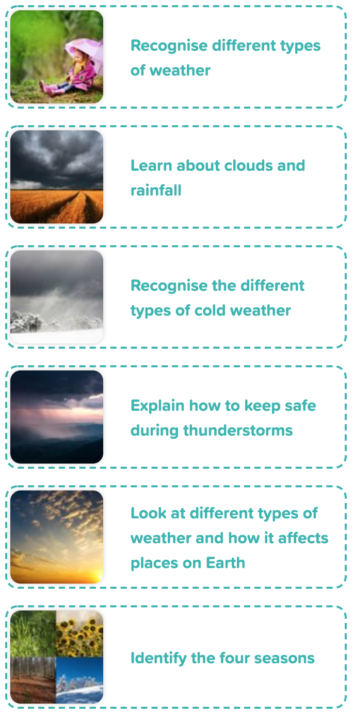
Year 1 Seasonal Changes
Scientific Enquiry Covered | Rocket Words Covered | Name of Task / Tasks | Resources Needed | National Curriculum Reference | Summative Quiz Questions
Using observations and ideas to suggest answers to questions. | weather, cloudy, rain, sunny, temperature | Observe the changes which happen with solutions over a period of time. Weather forecasting. | Weather Forecasters Handout - page 1-2 Weather Detectives Presentation video Handout - page 3-4 scissors glue | Observe changes across the four seasons, and observe and describe weather associated with the seasons and how the day varies. | What does the expression 'it's raining cats and dogs' mean? What two types of weather must be happening at the same time for a rainbow appear in the sky? In hot weather you need to wear a sun hat, {{sunglasses}} and sun {{cream}}. These protect you from getting {{burnt}} by the Sun. Name some reasons why we need rain? What is rain?
Using observations and ideas to suggest answers to questions | cloud, droplet, sky, sleet, flood | Create your own rain dance! | Instruments i.e. rain stick, beads/rice in a tube | Observe changes across the four seasons, and observe and describe weather associated with the seasons and how the day varies. | True or false: Clouds are made of big drops of water or ice. When there are a lot of clouds about and they are mostly grey, what do you think is on its way? Which of these would you use in rainy weather and which would you use in sunny weather? Why is it a good idea to collect rainwater in a big tub called a water butt in the garden? Complete the statement: Clouds are a collection of tiny {{water}} droplets that have joined together in the {{sky}}. They are all sorts of shapes and {{colours}}.
Using observations and ideas to suggest answers to questions | snow, blizzard, flurry, hail, ice | Match the cold weather and make a cold weather collage! | Match the Cold Weather Handout Cold Weather Collage craft materials bubble wrap cotton wool glue scissors colour pens/pencils | Observe changes across the four seasons, and observe and describe weather associated with the seasons and how the day varies. | A very windy snowstorm with lots of snow is called a..? Which of these clothes are suitable for a snowy day? Complete the statement: Hailstones are made in very high clouds where the air is {{very cold}}. The water in the clouds {{freezes}} and makes hailstones. Hailstones can fall during a cold Winter or during a {{thunderstorm}}. True or false: People called Inuit sometimes build little houses out of ice and snow called igloos. Every snowflake is..?
Performing simple tests | thunderstorm, thunder, lightning, safety, shelter | Weather role play! | Suitable space for role-play activity | Observe changes across the four seasons, and observe and describe weather associated with the seasons and how the day varies. | Thunderstorms may also bring hail. From these pictures, what is and is not a thunderstorm?Hailstones are frozen balls of {{ice}} which fall sometimes during a thunderstorm. The clouds would be very {{cold}} to produce hail. Hailstones can be as small as {{peas}} or even as large as golf balls! What is thunder? Where is it safe to go during a thunderstorm?
Gathering and recording data to help in answering questions | desert, rainforest, temperate, affect, humidity | Build a weather vane. | Wind Vane, Paper plates, Scissors, Cardboard, Straw, Straight pin, Pencil with eraser, Modelling clay, Glue Compass (could be a physical one or a electronically generated one - for instance, on a tablet), Crayons, pencils, pens, Handout | Observe changes across the four seasons, and observe and describe weather associated with the seasons and how day length varies. | When the {{Sun}} rises it affects everything it shines on. The air gets {{warmer}} and the temperature goes up. What can you use to measure the temperature outside (how hot or cold it is)? What is a desert? True or false: Rainforests are hot and wet places. When the air is hot and wet this is called humidity. Which of these things moves in a little wind?
Using observations and ideas to suggest answers to questions | Spring, Summer, Autumn, Winter, seasons | Make a tree of all seasons. | Tree of Four Seasons Two copies of the Handout Scissors, Crayons or colouring pencils, Dressing for the Season, Paper, Colouring pencils or pens, Magazine or catalogue clippings (clothes from different seasons) Scissors | Observe changes across the four seasons. | Name the four seasons of the year. Which is the coldest season of the year in the UK? Which pictures were taken in the Spring in the UK, and which were taken in Winter of the UK. True or false: There are some parts of the world in which it never snows. True or false: Earth takes one month to go around the Sun.
Developing Experts Year 1 National Curriculum Map September 2021

Slide 5
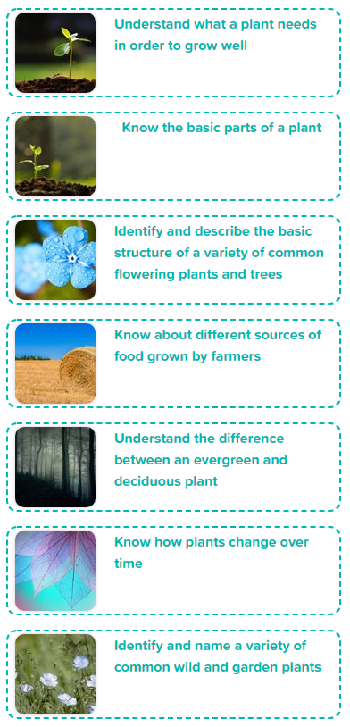
Year 1 Introduction to Plants
Scientific Enquiry Covered | Rocket Words Covered | Name of Task / Tasks | Resources Needed | National Curriculum Reference | Summative Quiz Questions
Observing closely and using simple equipment. | plant, soil, water, light, seed | The Planting Challenge. | Handout cress seeds pots or plastic cups soil | Identify and describe the basic structure of a variety of common flowering plants, including trees. | What is a seed? True or false: Some redwood trees grow almost 100 metres tall. That's about 100 children your age standing on each other's heads! Which of these are plants? Complete the statement: Plants need {{water}}, {{light}} and nutrients (good foods that keep them {{healthy}}). Just like us! Which of these foods are plants?
Observing closely and using simple equipment. | flower, leaf, branch, root, stem | Observe a plant closely and create a drawing or painting of it. | Drawing a Plant Handout | Identify and describe the basic structure of a variety of common flowering plants, including trees. | Which of these have lots of seeds inside them, which have only one seed? An acorn is the seed of an..? Which of these are parts of a plant? Complete the statement: How does a seed turn into a plant? If you put it in {{soil}}, {{water}} it and place it in a {{light}}, warm place, it will usually start to sprout into a baby plant. What would grow from a sunflower seed?
Collecting and recording data | oak tree, pansy, petal, sweet peas, tulip | Create crayon etchings of various different barks to look at the differences between them. | Handout Paper Crayons | Identify and describe the basic structure of a variety of common flowering plants, including trees | Sort the trees. Sort the flowers. What is the name of the flower in the picture? Yes, that's right it’s called a {{water lily}}. What tree is this? What flower is this?
Performing Simple Tests | potato, crop rotation, sugar beet, barley, arable | Growing Grass from Seed in variable conditions | Growing Grass from Seed, Two containers per pair (shallow plastic or plastic cups), Grass seed Soil / compost, Plant food, Water, KS1 Investigation Sheet | Identify and describe the basic structure of common wild and garden plants | Complete the statement: {{Cereals}} are used to feed both humans and animals. {{Pigs}} mostly eat cereal crops. So do {{poultry}}. How many ways can you cook potatoes? Which of these are poultry? Which of these are farm machinery? Sort these into order.
Observing closely and using simple equipment. | deciduous, evergreen, oak tree, pine tree, holly bush | Conduct a leaf scavenger hunt and make some wax crayon leaf rubbings! | Leaf Sorting Task Leaves, Leaf Rubbing , Leaves Paper, Wax crayons, Leaf Rubbing, Scavenger Hunt Leaf rubbings Handout | Observe changes across the four seasons. | A deciduous tree loses its leaves in Autumn and grows new ones in the Spring. What is the seed of the oak tree? What are the names of the four seasons? True or false: Some trees stay green all the way through the Winter. Which of these are deciduous trees and which are evergreen?
Grouping and classifying | seed, seedling, young plant, adult plant, fruit | Make your own growing tree! | Make a Growing Tree Various coloured paper (brown/green) scissors, sticky tape Handout 2 - Plant Card Challenge, Scissors | Biology - Plants: How Plants Change Over Time. | The sunlight and air help it grow into a... In the Autumn the {{leaves}} fall off trees and in the Spring the {{buds}} on the plants open. Separate the Summer and Autumn leaves. Separate the buds from the flowers. Most plants change over time and some stay the same.
Observe closely | Buttercup, daisy, dandelion, stinging nettle, wildflower | Make your own growing tree! | Make a Growing Tree Various coloured paper (brown/green) scissors, sticky tape Handout 2 - Plant Card Challenge, Scissors | Identify and name a variety of common wild and garden plants, and use the local environment throughout the year to explore and answer questions about plants growing in their habitat. | Sort the nettles into the correct bucket. {{White Dead}} nettles {{do not}} sting. They have white flowers. Sort the flowers into the right bucket. A popular children's game involves holding a {{buttercup}} up to the {{chin}}; a yellow {{reflection}} is supposed to indicate fondness for {{butter}}. Is this true? A wildflower is a type of flower that grows naturally in the _____.
Developing Experts Year 1 National Curriculum Map September 2021

Slide 6
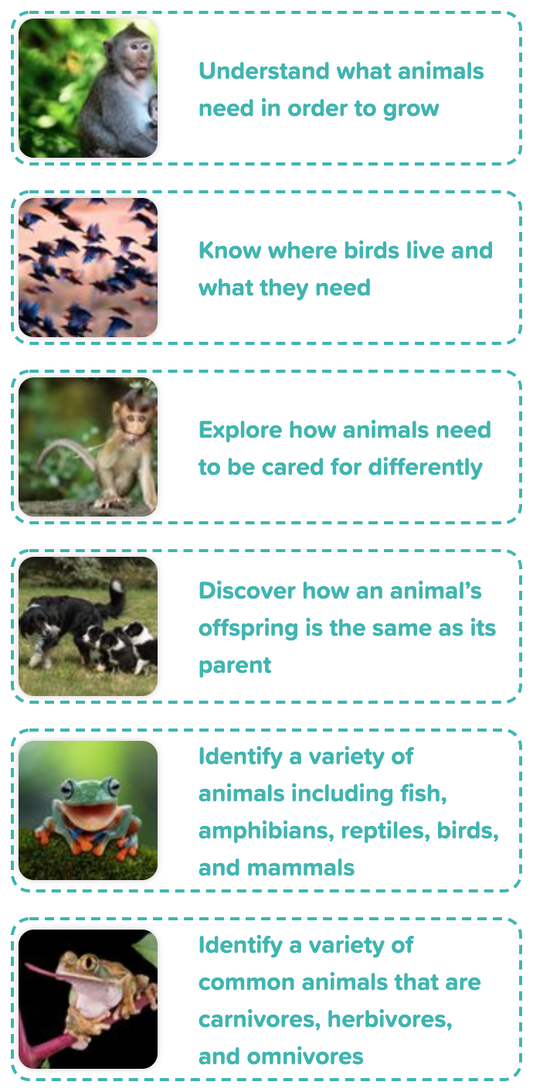
Year 1 Animals Including Humans
- About Animals
Scientific Enquiry Covered | Rocket Words Covered | Name of Task / Tasks | Resources Needed | National Curriculum Reference | Summative Quiz Questions
Identifying and classifying | food, water, shelter, air, energy | Pass the Puppy. Group pets into animals you would need to keep outside and animals you would keep inside. | Pass the Puppy Toy dog/puppy Page 1 of Handout Indoors or Outside? Page 2 of Handout Animal Adjectives | Describe and compare the structure and needs of a variety of common animals (fish, amphibians, reptiles, birds and mammals, including pets). | Which pet lives in a home? Pets need to be cared for. They need {{food}} and they need {{warmth}}. Pets need to be cared for. Place the most important thing a pet needs at the top of the list. Place the least important thing a pet needs at the bottom of your list. Where do these animals normally live if they are kept as pets? Sort the items into the right column.
Use observations and ideas to suggest answers to questions | bird, nest, build, mud, grass | Make a Bird Feeder. | Making a Bird Feeder Plastic bottle Wooden dowel / pencils Scissors, Push Pin, String Bird Seed, Lard / peanut butter / suet (optional) On The Menu, Selection of nuts and seeds, Weighing Scales | Early Years Framework for England. Understanding the world involves guiding children to make sense of their physical world and their community through opportunities to explore, observe and find out about people, places, technology, and the environment. | Birds build {{nests}} for their chicks. Birds sometimes use ________________ to build their nests. Are these bird nests or animal dens? Are these nests or bird feeders? Are these nests in trees or on the ground?
Observing closely using simple equipment, using observations and ideas to suggest answers to questions. | pet food, kennel, snake, ferret, iguana | Create a poster explaining all the different things you need to do and give your animals and pets the proper care they need. | Animal Care Poster, Paper Coloured pens, images to cut and stick, scissors, glue. Fur Exploration, Handout, Making Dog Biscuits, Baking paper, Mixing bowl, Measuring jug, Fork, Rolling pin, Cookie cutters, Baking trays, Water, Beef, stock cubes, Wholemeal flour, Eggs | Describe and compare the structure and needs of a variety of common animals (fish, amphibians, reptiles, birds, and mammals, including pets). | Dogs owners feed their pets...Picture sort. Sort the job into priority order with the most important job listed at the top. A dog's home is called a..? Every day dogs need to be..?
Gathering and recording data to help in answering questions. | kitten, puppy, offspring, newborn, care | Discover why babies look like their parents! | Monster Breeding Handout Building a Bird's Nest Sticks Leaves Straw String etc. | Describe and compare the structure and needs of a variety of common animals (fish, amphibians, reptiles, birds and mammals, including pets). | True or false: A baby cat is called a puppy. What is the offspring of a cat called? If both {{parents}} have blue eyes, the colour of their child's eyes is likely to be {{blue}}. Which of these are baby animals (offspring) and which are adult animals? How does a mummy cat clean her kittens?
Identifying and classifying | fish, amphibian, reptile, mammal, class | Find out the measurements of a crocodile or alligator and then draw or model it. | How big is that croc? Measuring tape, Cardboard, Tissue Paper, Pens, Pencils PVA glue Identifying Animal Types Card, Pencils, Grids, Handout | Identify and name a variety of common animals including fish, amphibians, reptiles, birds and mammals. | An {{amphibian}} is an animal that starts life in water and later can live on land. An animal which suckles its young on milk is called a {{mammal}}. True or false: A crocodile is a reptile. A snake is a reptile. There is a snake called a boa constrictor who wrap themselves around their prey (the animal they want to eat), squeezes it until it is dead, then...what? True or false: There are over 32,000 types of fish. Which of these are fish and which of these are mammals?
Observing closely using simple equipment. | carnivore, herbivore, omnivore, identify, predator | Find examples of herbivores, omnivores and carnivores. | Classifying Animals Types A4 paper cut into quarters to make small cards. | Identify and name a variety of common animals that are carnivores, herbivores and omnivores. | Which of these are carnivores and which of these are herbivore? Put these carnivores in order of size from largest to the smallest. An animal which eats mostly meat is called..? Which of these animals are carnivores? An animal which eats mostly plants is called..
Developing Experts Year 1 National Curriculum Map September 2021

