Slide 1

Why do we teach History?
Our Intent
)

Slide 2
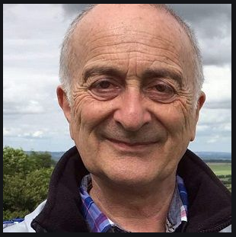
History
“How do you know who you are unless you know where you’ve come from? How can you tell what’s going to happen, unless you know what’s happened before? History isn’t just about the past. It’s about why we are who we are, and about what’s next.’’
Tony Robinson

Slide 3
Why do we teach it?

Slide 4
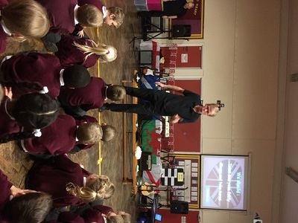
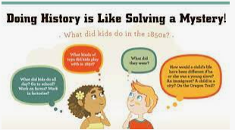

To arouse an interest in the past and to stimulate the children’s curiosity into finding out more

Slide 5
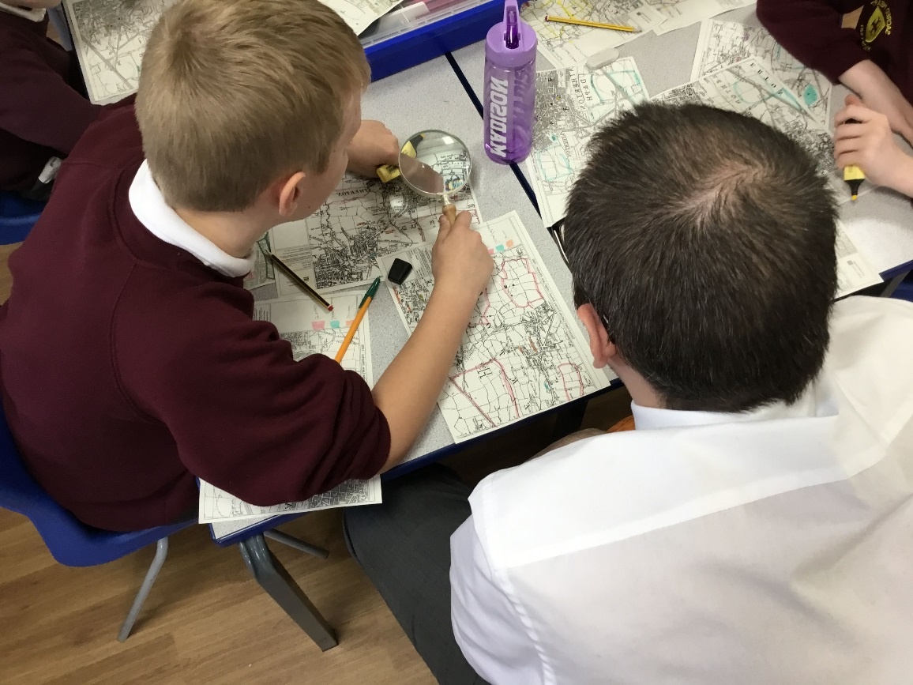
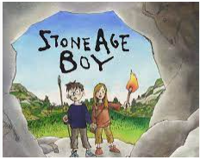

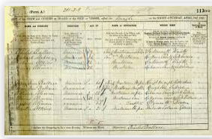
To develop knowledge and understanding of how people lived in other times and how those times were different from today

Slide 6
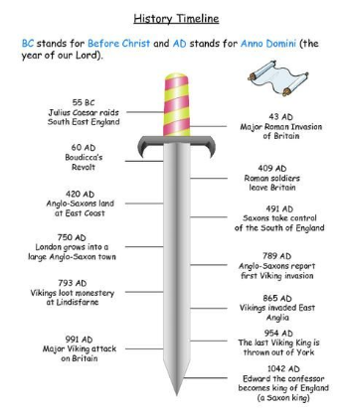
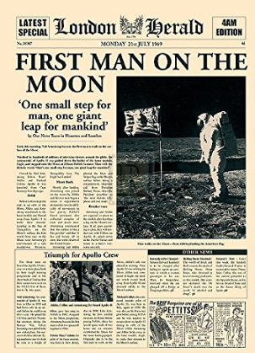
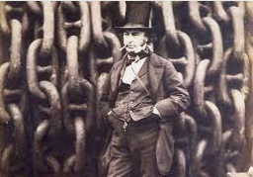

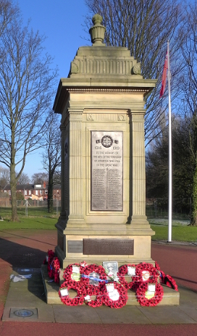
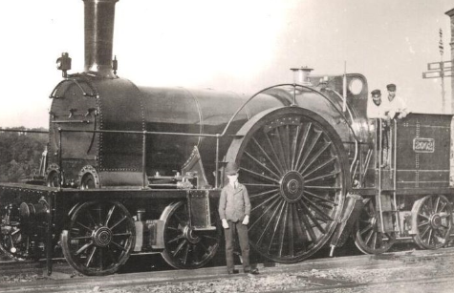
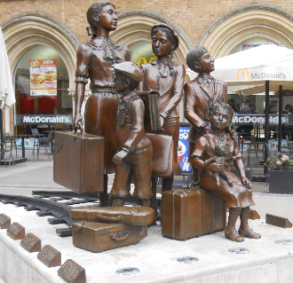
To enable children to know about significant events in British history, and to appreciate how things have changed over time

Slide 7
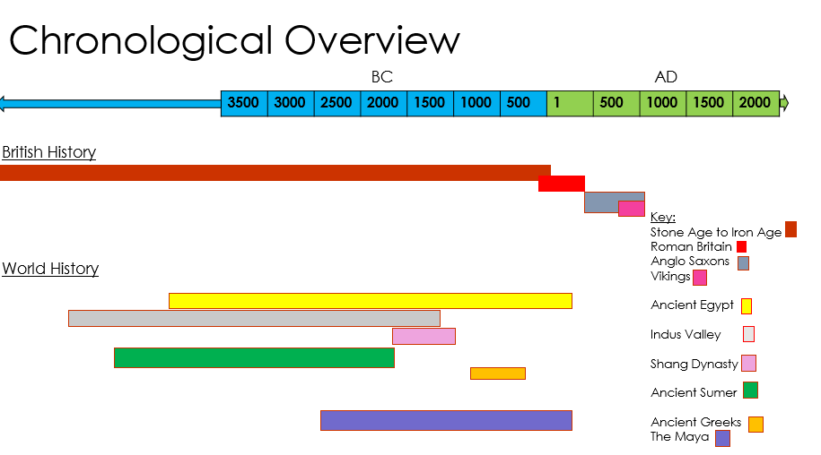
To develop a sense of chronology

Slide 8
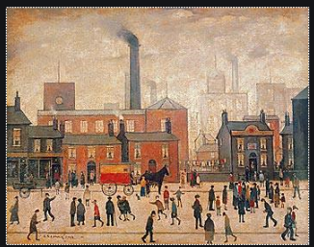
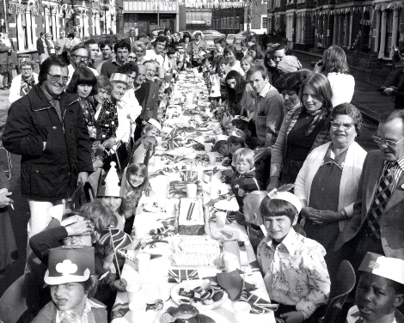
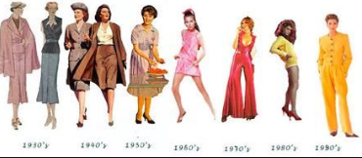
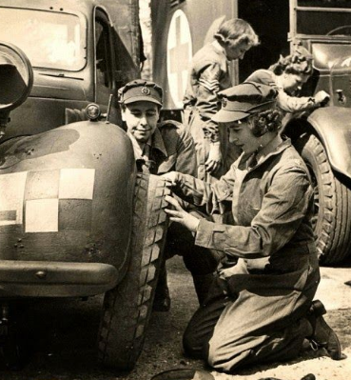
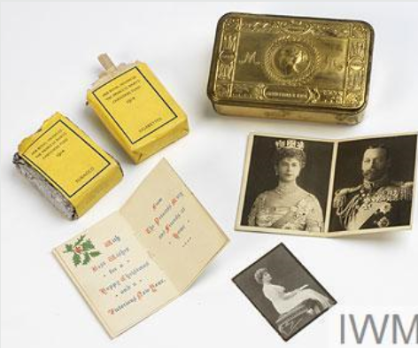
To encourage thinking about cause and effect, and how the past influences the present to experience a range of representations of the past

Slide 9
To develop the ability to communicate historical knowledge in a variety of forms; to understand how Britain is part of a wider European culture, and to study aspects of European history

Slide 10
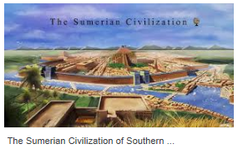
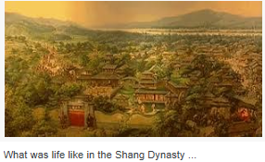
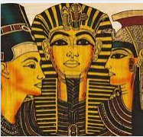

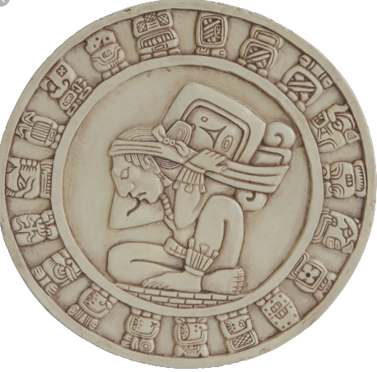
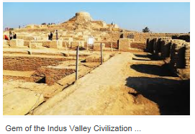
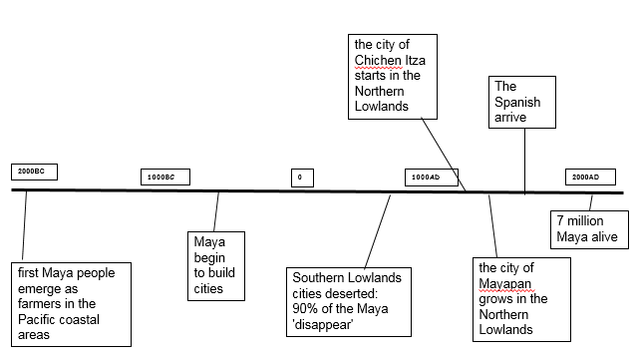
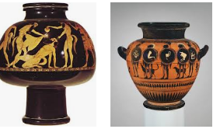
To gain some knowledge and understanding of historical development in the wider world
Meanwhile elsewhere…

Slide 11
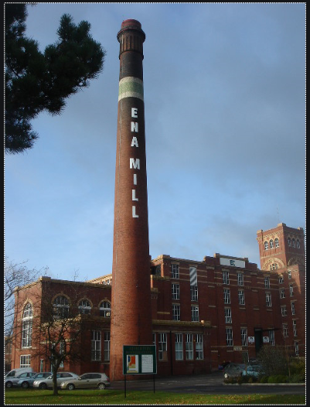

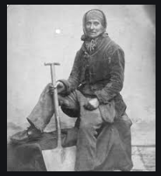
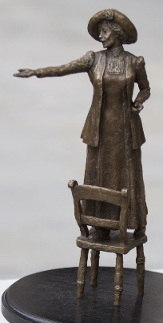
To help children understand society and their place within it, so that they develop a sense of their citizenship and cultural heritage

Slide 12
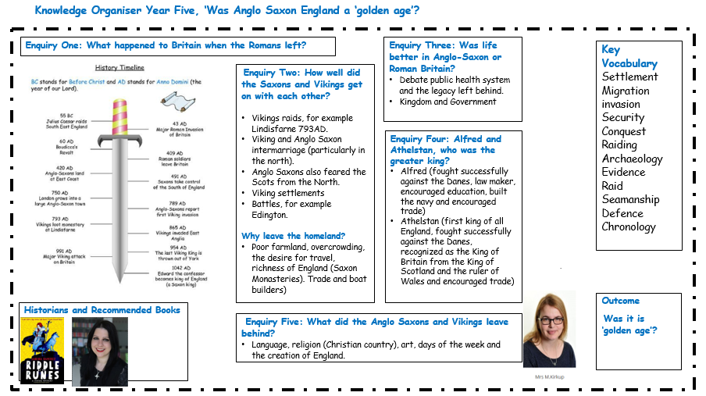
To develop in children’s ability to enquire, investigate, analyse, evaluate and present their thinking and learning.

Slide 13
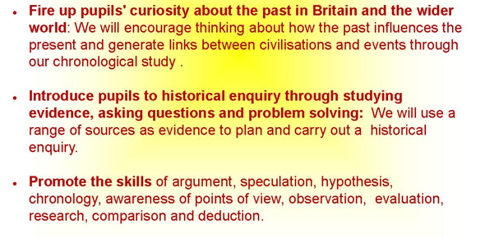
Our Core Values

Slide 14
Intent
History teaching focuses on enabling children to think as historians and the processes in history. We place an emphasis on examining historical artefacts and primary sources, and give children the opportunity to visit sites of historical significance. We encourage visitors to come into the school and talk about their experiences of events in the past. We recognise and value the importance of stories in history teaching, we regard this as an important way of stimulating interest in the past. We focus on helping children understand that historical events can be interpreted in different ways, and that they should always ask searching questions (e.g. ‘How do we know?’) about information they are given.
At Sacred Heart we recognise that in all classes children have a wide range of ability in history, and we seek to provide suitable learning opportunities for all children by matching the challenge of the task to the ability of the child. We achieve this by:
setting tasks which are open-ended and can have a variety of responses;
setting tasks of increasing difficulty, some children not completing all tasks;
providing resources of different complexity, depending on the ability of the child;
using teaching assistants to support children individually or in groups.
Emphasis is placed on the development of knowledge discipline and a historical perspective alongside factual knowledge. A variety of teaching approaches are used:
Teacher presentations, role play, drama, story-telling.
Question and answer sessions, discussions and debates.
Individual and group research. Investigating artefacts and sources of evidence.
Fieldwork, and visits to museums and sites of historic interest.

