Slide 2
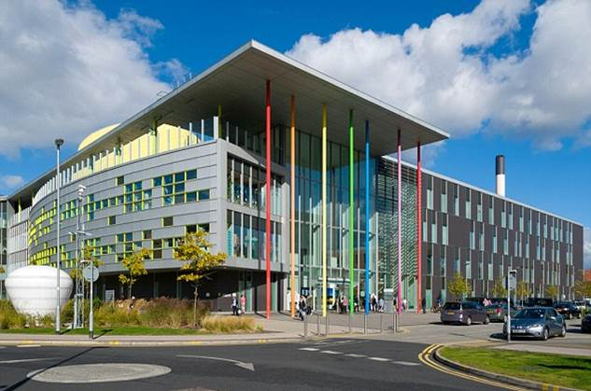
Royal Manchester Children’s Hospital opened in June 2009
Patients are from across the North-West and beyond
Over 276,000 patients are treated each year
Notes:
Size of 39 football pitches; 350 beds

Slide 3
Treatment
Research
Care
Notes:
We do this by supporting the following areas:
Treatment: Charitable support plays an important role in providing the hospital with leading state of-the-art equipment for the best treatment & diagnosis.
Care: Projects supported by the charity help create a less clinical environment as visiting a hospital can be a very daunting experience for young children. Examples include our teenage ‘chill out’ zone, outside play area and Magic Makers. Artwork – increases child-friendly environment; work around the hospital includes interactive pieces
Research: Carrying out research into the best ways of tackling childhood illness is one of our main ambitions. We provide funding to try and find ways of preventing, treating and curing complex, life-limiting, and often life threatening, illnesses.

Slide 4
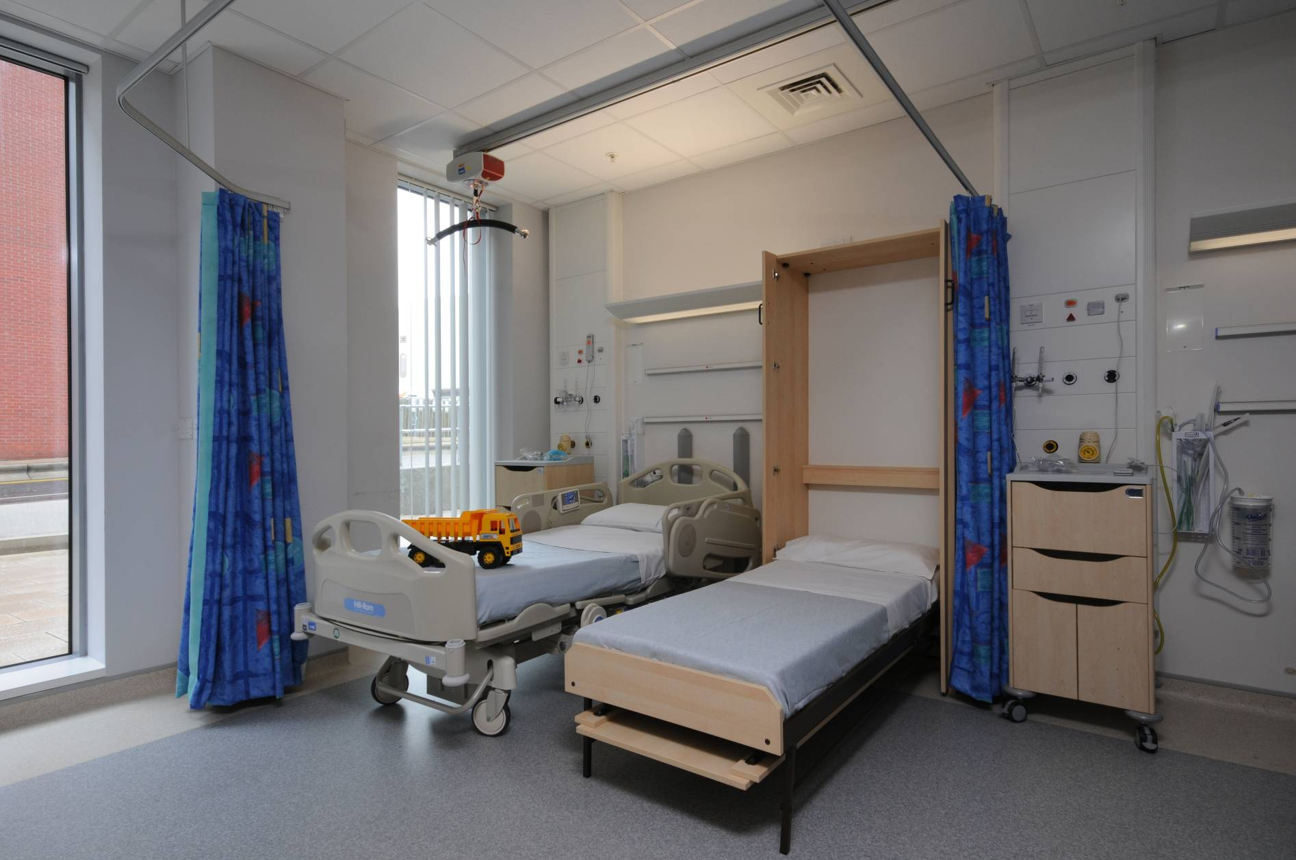
Notes:
An example of how fundraising benefits the hospital – purchasing beds that pull down from the wall so parents can stay with their child when they are ill

Slide 5
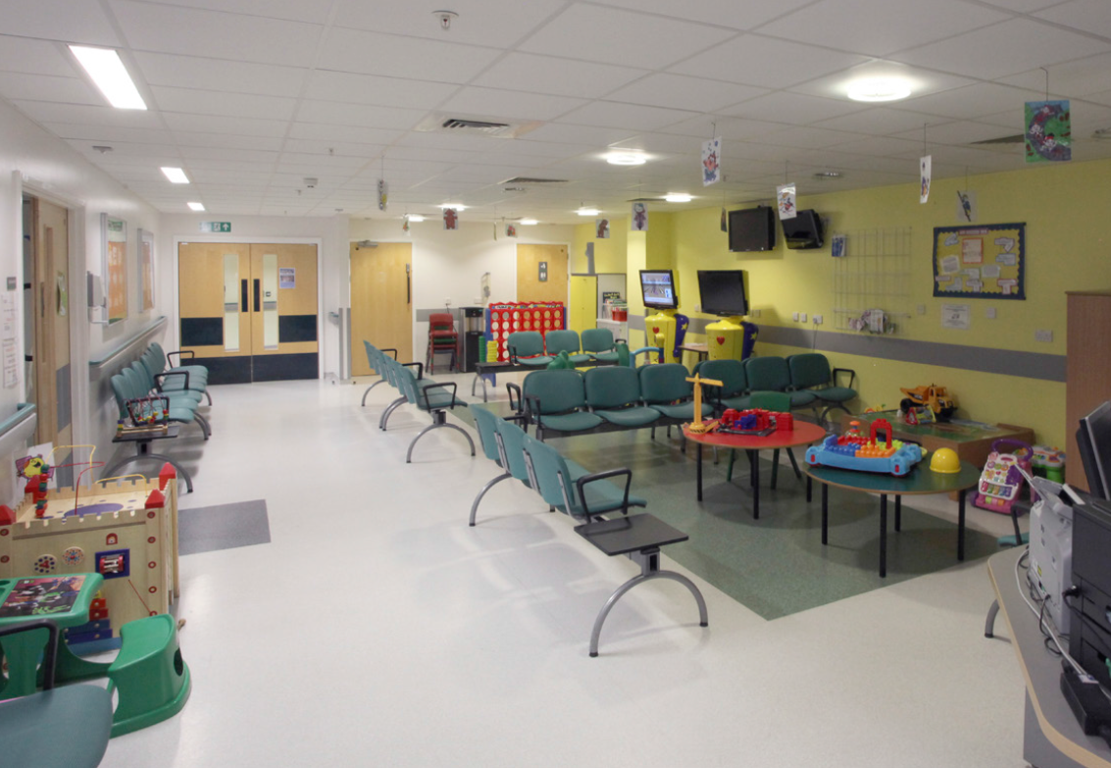
Notes:
An example of a waiting room in the hospital before fundraising

Slide 6
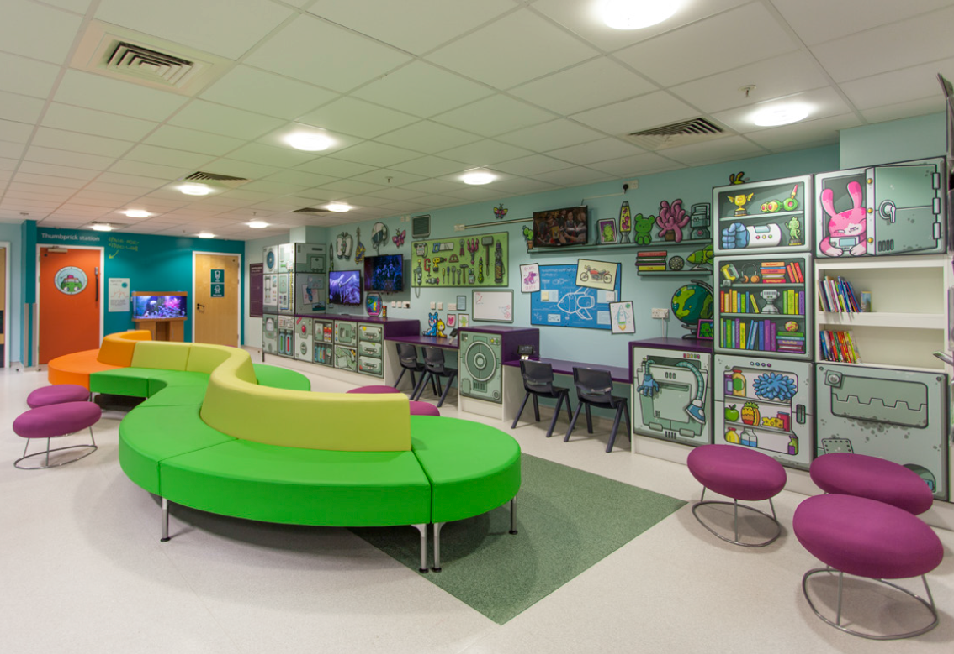
Notes:
The new waiting room after it has been refurbished through fundraising. The back wall is full of toys for all ages including x-boxes, book and games

Slide 7
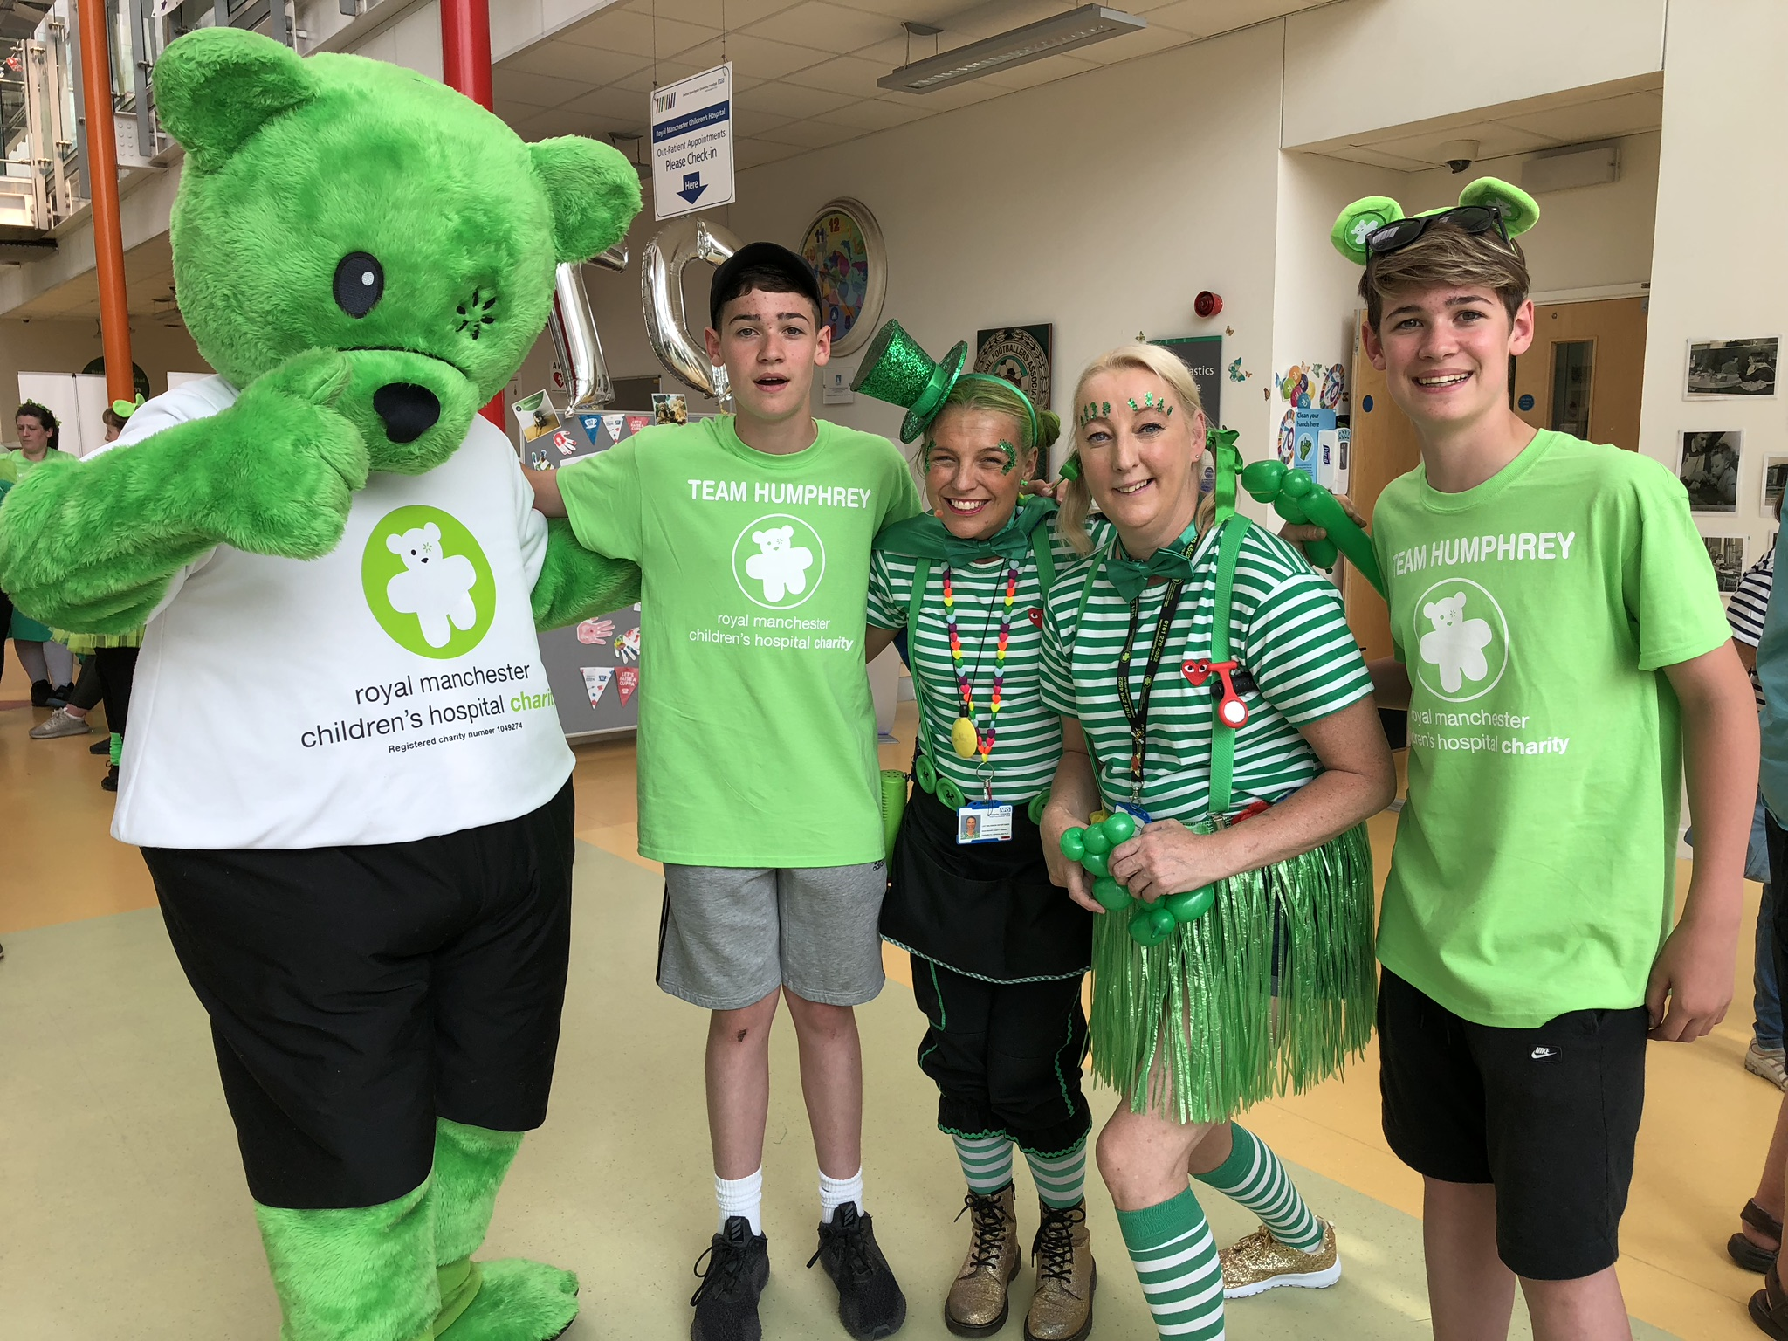
Notes:
Our mascot Humphrey Bear with two of the Magic Makers

Slide 8
Play Fund
The Play team at Royal Manchester Children’s Hospital provides one of the largest hospital play services in the UK and Europe.
The money raised from your non-uniform day on Friday will go to the Play Therapy fund to enable the team to purchase more toys and play equipment.

Slide 9
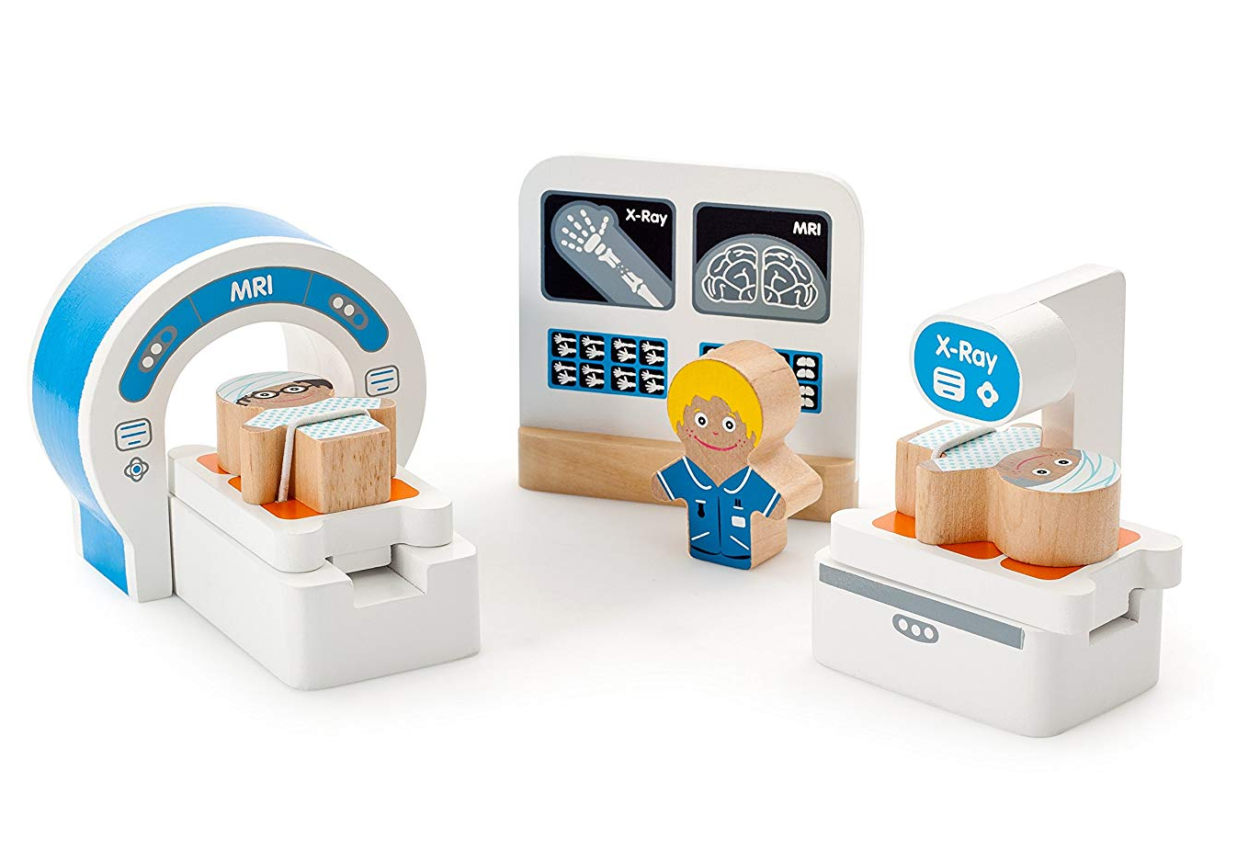
Notes:
Example of the toys which we use at the hospital to explain the procedures to patients

Slide 10
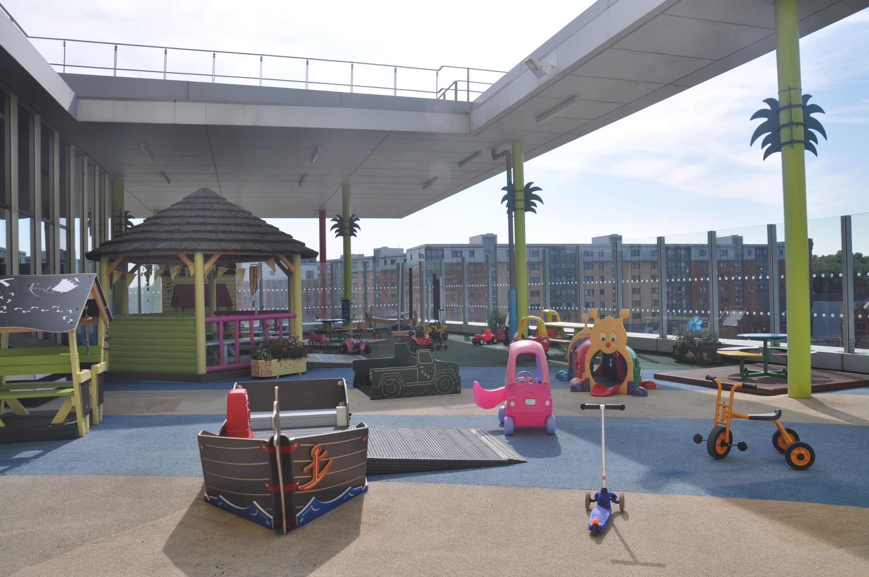
Notes:
Outside play area for patients at the hospital

Slide 11
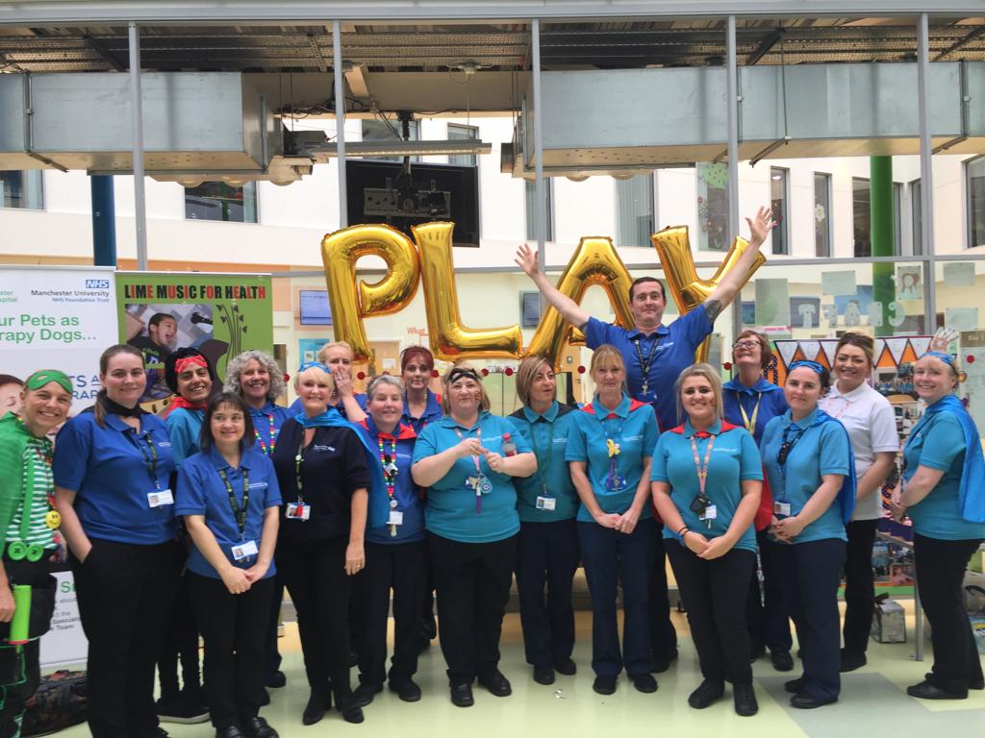
Notes:
A big thank you from our play team

Slide 12
Film
Notes:
https://www.youtube.com/watch?v=B1ErpBll0rU

